Slide 1
Presentation cover slide example: Vertical white logo on blue background
Latest Trends in AI-Enabled Medical Products – Product Examples and Standards Projects
Pat Baird, pat.baird@philips.com
Sr. Regulatory Specialist
September 10, 2025

Slide 2
Personal Story…
Twenty years ago, when doing new product research, I visited several hospitals, and asked a nurse “What is different about healthcare now than when you first started as a nurse?” She was very frustrated at the administrative duties that she has, the amount of time she spends sitting in front of a computer and that she doesn’t spend much time with patients.
She told me “I became a nurse to take care of patients, but I spend all of my time taking care of computers!”
I am sharing this story because what I like about Artificial Intelligence applications is that they can help users be more efficient and can help care-givers spend more time giving-care.

Slide 3
There are many uses for AI…
Artificial Intelligence is being used in many ways in many industries; the medical device industry (particularly imaging) has been using AI for many years.
However, sometimes when we think of AI, we are only thinking of a few examples. This presentation is intended to show several applications and the benefits of this technology for healthcare, as well as trends from inside and outside of the medical device field.
AI is transforming, but any transformation has risks associated with it.

Slide 4
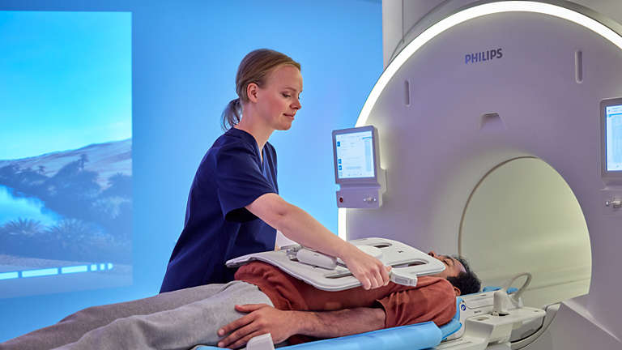
Healthcare AI Examples
What I like about AI is that it has many different uses and many potential benefits.
Increased efficiency for MRI scans: Helps select patients with the most urgent needs; adjusts itself for patient movement during a scan; reduces cardiac scan time from 60 minutes to 30 minutes, improves image quality. Helps the system become more efficient and reduces need for helium to cool the system.
Improved user interaction - Allows clinician to use conversational language to convert findings into structured reports, which can then be reviewed. This helps construct and revise reports in real-time; also helps add diagnostic impressions and identify potential inconsistencies.
Impacts personal healthcare as well – shaver and a toothbrush that have built-in motion sensors and use AI to make suggestions for better coverage.

Slide 5
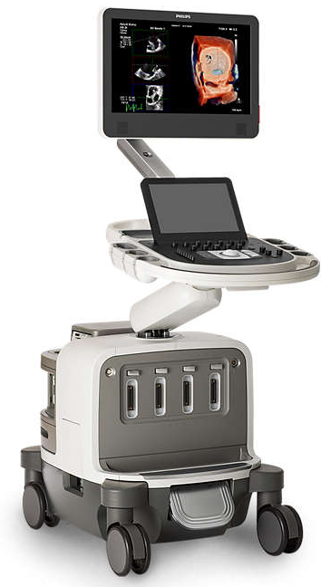
Ultrasound
The heart is a very complex organ, and ultrasound devices play an important role in patient health.
AI can be used to automate the frame selection and caliper positions during ultrasound examples. This results in faster and more reproducible echocardiographic measures.
This also takes measurement for right ventricle volume, ejection fraction, and other important calculations to help the clinical assess cardiac function.
These are just a few examples of the benefits of AI in medical devices and shows you where the innovation is happening for our industry. We need harmonized approach to get these products to our patients.

Slide 6
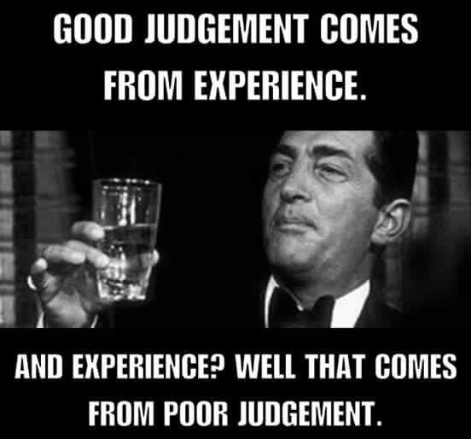
Standards & Other Harmonization Projects
AI is getting a lot of attention lately, and there are many projects inside and outside of healthcare related to developing good quality AI products. This includes the development of national and international standards and national and international regulations (e.g. IMDRF)

Slide 7
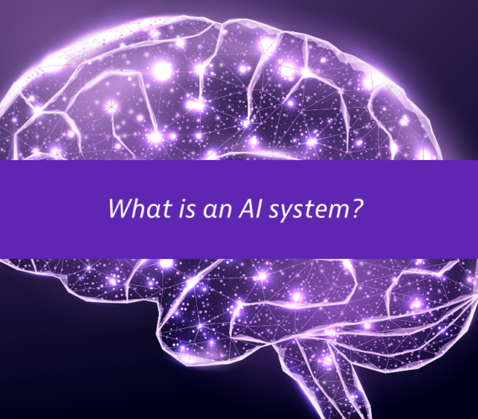
What is “AI” ?
The Organization for Economic Cooperation and Development (OECD) consists of 53 countries including South Korea, US, and EU. OECD defines AI as:
“An AI system is a machine-based system that, for explicit or implicit objectives, infers, from the input it receives, how to generate outputs such as predictions, content, recommendations, or decisions that can influence physical or virtual environments. Different AI systems vary in their levels of autonomy and adaptiveness after deployment.”
https://oecd.ai/en/wonk/definition

Slide 8
What is different about ML vs. traditional software development?
When developing software to help with image recognition, diagnosis, identification of high-risk patients, etc., we usually talk to human experts to understand how they make their decisions, and we then write software to mimic their thought process.
For Machine Learning systems, we have a relatively generic algorithm that has the capability to learn, and we provide it with a lot of data, and it refines itself according to patterns that it sees in the data. The data is what is defining the logic, not human experts. But this leads to some problems..
  The data might be incomplete (e.g. missing important elements)
  The data might be incorrect (e.g. data from wearables might not be 100% accurate)
  Patterns may or may not be relevant (e.g. might be a coincidence in the data that is not clinically relevant);
  The data might not fully represent the target patient population
  Health & Healthcare change over time (e.g. more cases of flu during the winter – what if your data is from spring & summer?)

Slide 9
AI Standards Overview
There has been very little published as a standard that is relevant to our industry, and therefore not much that I can say “you must follow this standard!” Instead, there are several projects that are still being developed.
ISO/IEC JTC1, SC42, developing horizontal standards for all industries. SC42 has many simultaneous projects and even more are being created. It is not likely that these horizontal standards would be completely applicable for medical devices, but they may contain ideas that we like and would carry to healthcare. A negative effect is that certain governments might not understand the differences between industries and insist on using SC42 for everything.
  One standard they developed is “ISO/IEC 23894 - Risk Management” – this is about “Enterprise Risk” (risks to budget, risks to schedule) and not about safety..
IEEE is developing a number of AI standards, but only a few are specific to healthcare.

Slide 10
4213 - Information technology — Artificial Intelligence — Assessment of machine learning classification performance
4213 - Assessment of machine learning classification performance
5338 - AI system life cycle processes
5339 - Guidelines for AI applications
5392 - Information technology — Artificial intelligence — Reference architecture of knowledge engineering
5469 - Functional Safety
5471 - Artificial intelligence — Quality evaluation guidelines for AI systems
6254 - Objectives and methods for explainability of ML models and AI systems
8200 - Controllability of automated artificial intelligence systems
12791 - Treatment of unwanted bias in classification
12792 - Transparency taxonomy of AI systems
20546 - Big Data - Overview and Vocabulary
20547.1 - Big Data reference architecture - Part 1: Framework and application process
20547.2 - Big Data reference architecture - Part 2: Use cases and derived requirements
20547.3 - Big Data reference architecture - Part 3: Reference architecture
20547.4 - Information technology — Big data reference architecture — Part 4: Security and privacy
20547.5 - Big Data reference architecture - Part 5: Standards roadmap
22989 - AI Concepts and Terminology
23053 - Framework for AI using ML
23894 - Risk Management (ISO 31000, not 14971)
24027 - Bias in AI systems and AI aided decision making
24028 - Overview of Trustworthiness in AI
24029.1 - Assessment of the robustness of neural networks - Part 1 Overview
24029.2 - Formal methods methodology
24030 - Use cases and application
24368 - Overview of ethical and societal concerns
24372 - Overview of computations approaches for AI systems
24668 - Process management framework for Big data analytics
25059 - Systems and software Quality Requirements and Evaluation (SQuaRE)
38507 - Goveranance implications of the use of AI by organizations.
42001 - Management system
22100-5 - Safety of machinery — Relationship with ISO 12100 — Part 5: Implications of artificial intelligence machine learning
5259-1 - Data quality for analytics and ML — Part 1: Overview, terminology, and examples
5259-2 - Data quality for analytics and ML — Part 2: Data quality measures
5259-3 - Data quality for analytics and ML — Part 3: Data Quality Management Requirements and Guidelines
5259-4 - Data quality for analytics and ML — Part 4: Data quality process framework
ISO/IEC JTC1 SC42
Has a lot of projects..
I have highlighted 23894 “risk management” and 5469 “functional safety” so that you can see that they don’t even have a similar document number (no “.1”, “.2”, etc.)
Some law makers assume that horizontal standards can apply to all industries – after all, the lawmakers are horizontal! (more on the next slide)

Slide 11
Potential Problems with “Horizontal Standards”
Some standards are for a particular industry – such as medical devices. These standards are called “vertical standards.” Sometimes, vertical standards are for a specific type of product.
Other standards can potentially be used by several industries; these are called “horizontal standards” and usually involve topics like “workplace fire protection” – standards that apply to many different situations.
However, for AI, there are several things that have been published as a horizontal standard, but if you read them, they might not be appropriate for the medical device industry.
Our industry is regulated and already has a large set of standards, so we already have good quality controls in place. Horizontal standards assume that we have NO quality controls and tries to fill that gap by demanding additional controls that we do not need.
I mention this because sometimes lawmakers don’t understand the quality controls that we already have, and they demand that we follow a horizontal standard that will not make the products better nor safer. One example is the demand to follow 42001 – which is not harmonized with regulations like the EU AI Act.

Slide 12
Potential Benefits of “Horizontal Standards”
As a former software engineer, I like “re-using existing code” – and this applies to standards development. We can start working on sector-specific standards by using some of the concepts from horizontal standards.
Before creating new vertical standards, as a sector, we need to contribute to the creation of horizontal standards to ensure they can be leveraged in our industry. When reviewing existing sector-specific standards, we should assess how references to horizontal standards can replace existing requirements. In time, through iterations, sector and horizontal standards should converge, whereby the horizontal standards provide the minimum foundations and aligned terminology that vertical standards can build upon, adding only sector- or technology-specifics.
Our sector makes that assessment through IEC TC62 SNAIG. IEC TC62 has endorsed various horizontal standards.

Slide 13
Key Vertical (Medical Device) Standards Currently Being Developed
AI Risks
Cybersecurity
Verification and Validation of AI

Slide 14
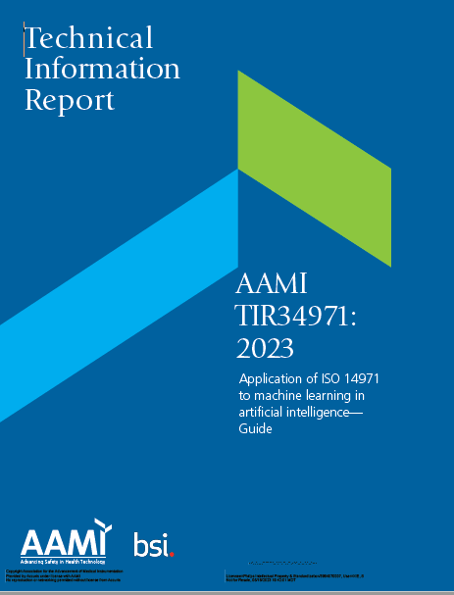
Artificial Intelligence Risks
ISO 14971 is a commonly used risk management standard for medical devices. You might remember that there is a companion document “ISO 24971” that includes a list of IVD-related hazards. Since ML systems can fail in unusual ways, I started a US national project to create a list of new ML-related hazards and possible controls. This was published in 2023 as “TIR 34971”.
We are expanding this internationally to the ISO/IEC committee that owns 14971 and 24971; this will be named “24971-2” and is in the last phase of comments before publishing.
As soon as 24971-2 is published, we’ll start working on the next revision to talk about failure modes of GenerativeAI.

Slide 15
24971-2 ML-related hazards – Identification of Characteristics Related to Safety: Data Management
Some examples from 24971-2 include:
Incorrect data – the data has errors or isn’t applicable (eg corrupted data, data entry errors, calculation errors, inconsistent labelling of data.) This could also be related to how outliers are treated.
Incorrect handling of outliers – sometimes outliers are important to understand the full spectrum of possibilities, other times the outlier is due to poor quality data.
Incomplete data – missing data (eg empty fields in a database)
Subjective data – data that are influenced by beliefs or personal opinions rather than based on facts (e.g. patient reporting pain scales, differences in professional opinions)
Inconsistent data – the quality of the data being used might vary from source to source, or even from the same source, taken at different times. (e.g. drift.)
Atypical data – the quality of the data during development might not represent the quality of the data in actual use (e.g. high resolution vs low resolution mammograms.)
You should document assumptions about data (e.g. data is independent and evenly distributed, data is free of noise, etc.)
Ask yourself if the data reasonably leads to a conclusion (e.g. can heart-rate data be used to determine pregnancy?)

Slide 16
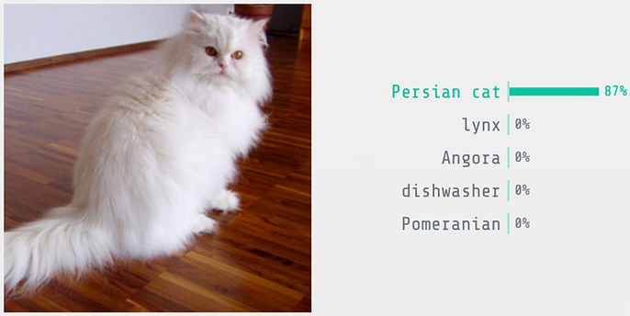
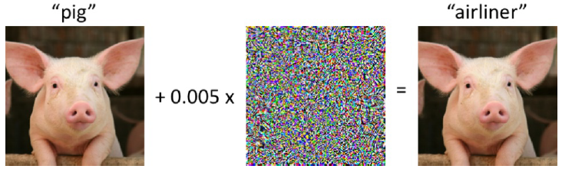

Cybersecurity & AI..
ML systems have a lot of data. Potentially very attractive data. This data is often handled by multiple stakeholders as it is passed from one system to another.
Due to the nature of the data & how ML systems work, it might not be obvious that there has been a security issue…
“Example of adversarial perturbation used to evade classifiers”;
Draft NISTIR 8269 A Taxonomy and Terminology of Adversarial Machine Learning
Source: “Artificial Intelligence and Medical Algorithms” Berkman Sahiner, FDA Conference on Medical Device Standards and Regulations, March 23, 2018
16

Slide 17
Draft Paper “Cybersecurity Considerations Unique to Machine Learning-Based Medical Devices”
Although AI/ML products are vulnerable in the same way that non-AI/ML applications, there are extra things to worry about due to the technology. Data is…
  Very important: ML models needs to learn from the data. If the data is manipulated, product performance is impacted.
  Very opaque: We don’t know exactly why ML decided something, so it is hard to know the root cause of poor performance.
  Very attractive target: A giant set of data gets people’s interest…
There is participation from both the cybersecurity and ML experts. I will be taking this internationally to ISO/IEC, but rather than waiting an extra year to develop a standard, people felt the need to publish a paper NOW!
We are not making this up! This project uses the work being done by multiple organizations – including standards and government agencies – we even found some things that they missed! We will publish it at the end of this year and will immediately start a project to add GenerativeAI concerns and also discuss the use of AI-based cybersecurity defense tools – even if the medical device doesn’t use AI, can AI be used to help defend the product from attacks ?

Slide 18
IEC/TC62 PT 63450 AI-enabled Medical Devices – Methods for the Technical Verification and Validation
“This document establishes methods for medical device manufacturers to verify and validate artificial intelligence / machine learning-enabled medical devices (AI/ML-MD), i.e. medical devices that use artificial intelligence, in part or in whole, to achieve their intended medical purpose. This includes verification and validation activities for the model of the artificial intelligence as well as selection,
metrological characterization and management of the data sets.
Such activities are implemented at various stages of the medical device lifecycle, especially including design control, monitoring and design change.
This document is also applicable to any hardware or software utilizing artificial intelligence that impacts the intended use of a medical device”

Slide 19
International Collaboration is Needed
Many years ago, when working on an interoperability standard for medical devices, I noticed frustration during the meetings and made the comment of “Before we get machines to talk to each other, we need to be better at getting people to talk to each other !”
I think there is a similar theme for AI in our industry: “For Artificial Intelligence to succeed, we need to improve our collective intelligence.” I think we need to share experiences, share ideas, etc.
THIS is why I travelled from Chicago just for this conference – to be a part of the conversation about using this technology to help our patients.
Because there are so many challenges to AI in healthcare, I want to thank our collaborators, thank standards committees, and thank conference organizers and attendees who participate in these sessions.

