Slide 1
Same Principles, New Technologies: Regulation of AI in Medical Devices
Camille Vidal, PhD, Vice President of Regulatory Affairs – Digital
Notes:
First, I want to thank the organizers of the conference for giving me the opportunity to present today and be part of the important conversation around bringing AI and Generative AI into medical devices.
I believe that if done responsibly the latest advancement of AI will continue to transform how healthcare is delivered and improve the experience of our patients and healthcare providers.
GE HealthCare purpose is to create a world where healthcare has no limits and AI plays a crucial role in making that happen.

Slide 2
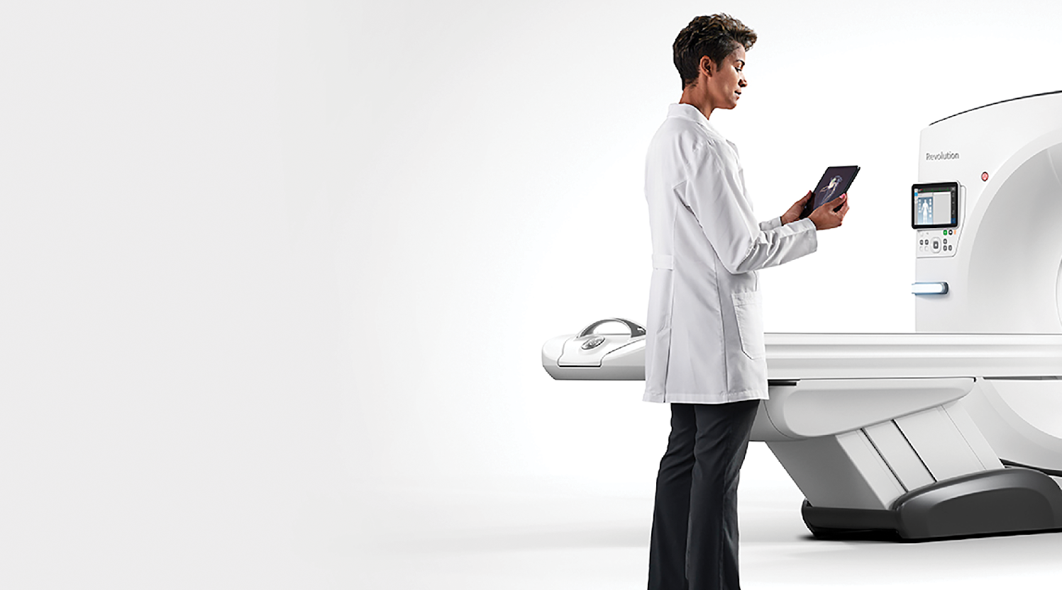




Workflow Optimization
Effortless Workflow
Simplified scanning from start to finish
Effortless Workflow intelligently automates CT workflow from pre-scan protocoling to post-scan processing.
It uses automated and AI-based features to help streamline the entire CT experience, providing maximum efficiency and consistency.
Pre-scan
During scan
Post-scan
56%
66%
21%
reduction in
positioning time¹
reduction in total exam clicks²
reduction in total exam time³
1 The data was based on comparison between GE’s legacy products (16 ch and 64 ch scanner) and Revolution Ascend in the three institutions using a pilot product and selected routine head and body. The data set of this comparison was 838 exams for legacy products and 1387 exams for Revolution Ascend. The time saving value may not be effective for all institutions depending on the clinical practice. Defined the scan setting time is from “Open new patient” to “Confirm setting for Scout”
2 Compared with legacy GE scanner. The required clicks are defined as clicks required to execute a scan from selecting a new patient till start scan. All associated clicks for and in clinical practice, number of the required clicks may vary depending on the circumstances, including but not limited to, the clinical task, exam type, clinical practice, and image reconstruction technique.
3 The data was based on comparison between GE’s legacy products (16 ch and 64 ch scanner) and Revolution Ascend in the three institutions using a pilot product and selected routine head and body. The data set of this comparison was 838 exams for legacy products and 1387 exams for Revolution Ascend. The time saving value may not be effective for all institutions depending on the clinical practice. Definition of entire exam time is from “Open new patient” to “Last primary recon completed” for Revolution Ascend and “Close exam” for legacy products.
Notes:
Slide 2
I am only going to highlight two uses of AI in this introductory slides. They are example of how AI can impact workflow and access to care.
The first example is how AI embedded into CT scanners enables what we call an Effortless Workflow.
AI can assist at every steps of the exam process from the moment the patient enters the imaging suite to the time they step out and their images have be transmitted to the radiologist for review.
Assistance pre-scan by helping position the patient and the table, by helping select the right parameters for the scan, during the scan by improving the clarity of images, and post scan by processing the acquired images and sending them to the radiologist for review.
The goal is a smoother technologist and patient experience with reduce friction and quicker exam.

Slide 3
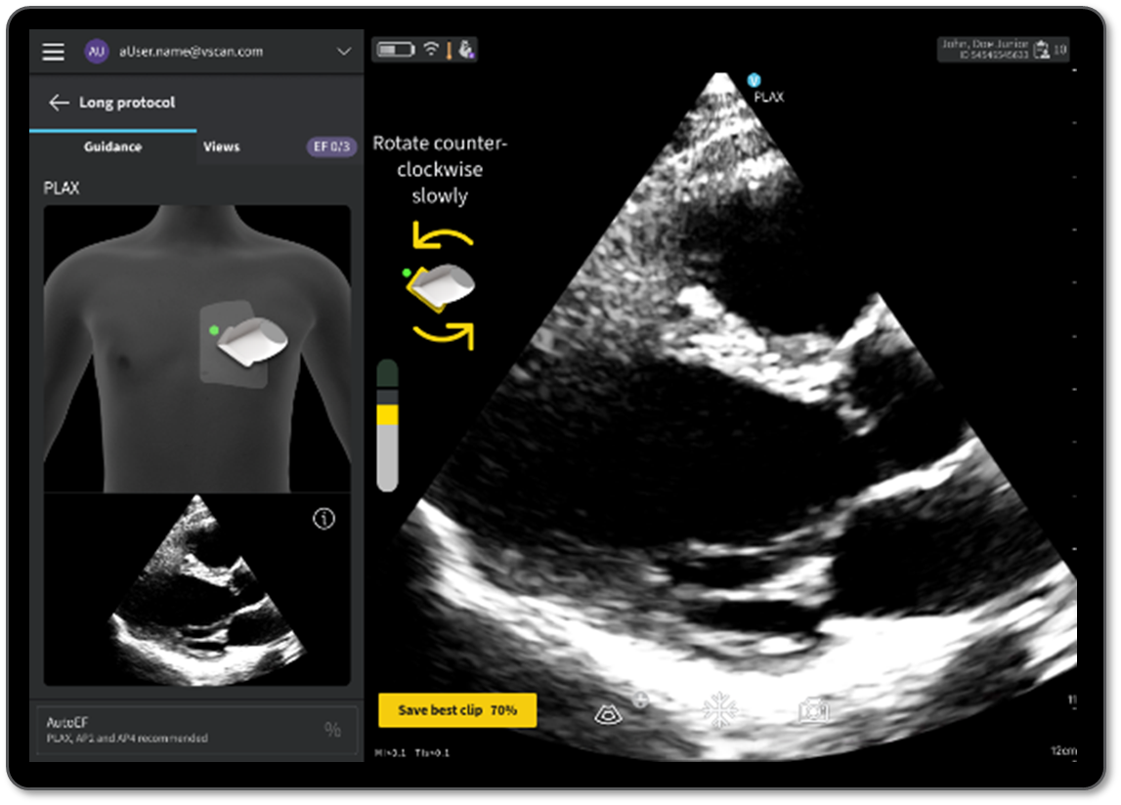
Access to Care
Provide real-time, turn-by turn, on-screen guidance that prompts probe movements to help more medical professionals capture diagnostic-quality cardiac images.
AI Guidance
Enable more healthcare providers to perform high-quality ultrasound exams wherever and whenever patients need them
Real-time guidance
Quality Meter
Auto Capture
Save best clip
Notes:
Slide 3
This second example is about AI guidance embedded on a portable ultrasound system to allow a nurse practitioner or a primary care physician to acquire diagnostic cardiac images thanks to the step by step guidance of AI.
Describe the solution
That means being able to scan patients where they are and performing these cardiac exams when they are needed, rather than having to refer the patient to a sonographer. It helps improving access to care.

Slide 4
A leap forward for AI in healthcare
Deep Learning
Foundation Model
Narrow datasets
Large datasets
Training
Single modality
Multimodal
Modality
Limited
Broad
Adaptability
Notes:
Slide 4
The large majority of the AI functionalities in medical device so far are based on machine learning or deep learning, sometimes referred to as narrow AI. The models are built to perform a specific task and trained a specific narrow dataset.
The next wave of AI, namely foundation models and generative AI is just at a nascent phase. This new AI advancements are build on Foundation models, large models built on massive amount of data. These Foundation Models have the ability to learn a detailed representation of the data and through fine tuning can be applied to a number of tasks.

Slide 5

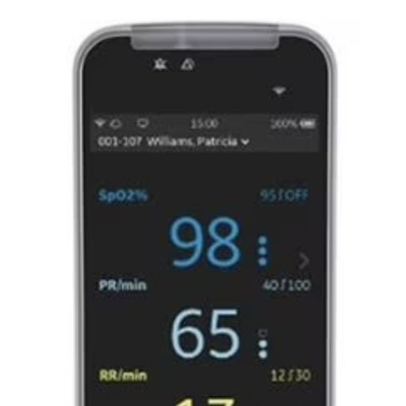
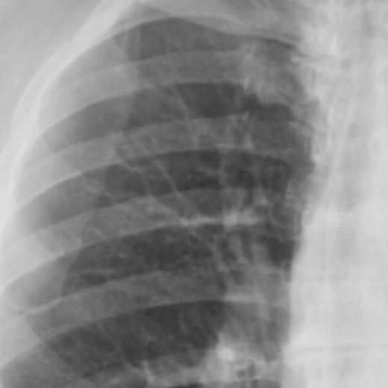
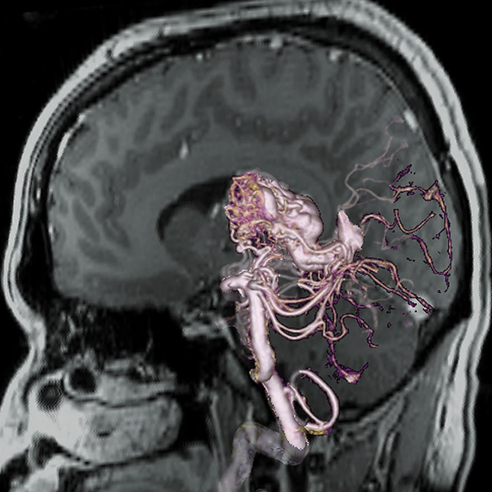
Foundation models create more flexibility and faster scalability to unleash unprecedented efficiencies
Traditional machine learning models: narrow focus, narrow solutions
Foundation models: expansive knowledge, broader potential
Train
Deploy
Pre-train
Fine Tune
Tasks
Tasks
Labeled Data
ML
Model
Abnormality detection
Abnormality detection
PHI
Labeled Data
ML
Model
Anatomy segmentation
Anatomy segmentation
Unlabeled Data
Foundation
Model
Labeled Data
ML
Model
Automated measurements
Automated measurements
Labeled Data
ML
Model
Radiological quantification
Radiological quantification
JB02183XU
Notes:
Slide 5
In practice that means that where we had to build a model for each task, there is now the possibility to create a single Foundation Model for instance for U/S, MR or X-ray images and apply it through fine tuning to a number of different tasks from segmenting region of interest to detecting and characterizing lesion, writing a draft report.
Because Foundation Models also have the ability to take multimodal data like text, images, videos, waveform for instance, one can start imagining applications that break data silos and integrate the patient data throughout their care journey.

Slide 6
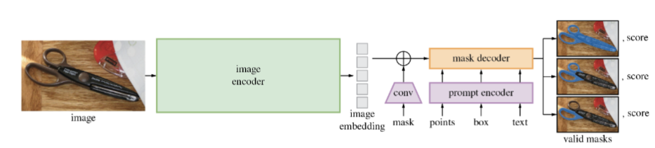
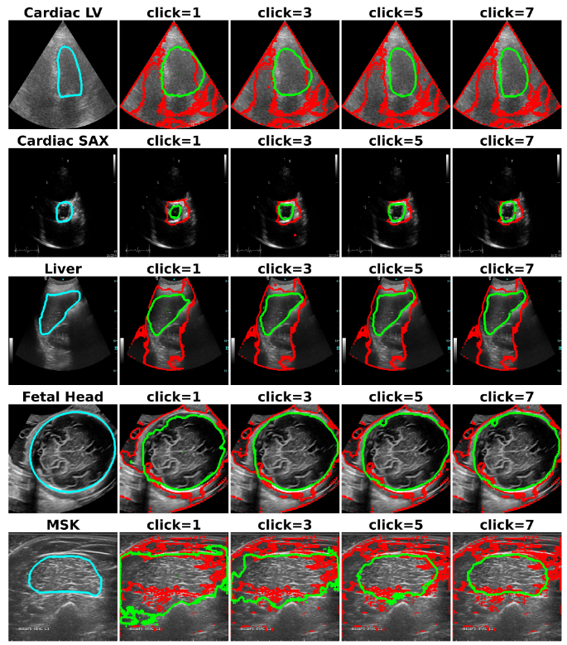
SAM and SonoSAM
Segment Anything Model (SAM)
Foundation Model developed by Meta to segment objects in natural images
Trained on 1 billion image-mask pairs (SA-1B)
Key parts of the Model architecture includes image encoder, mask decoder, and prompt encoder
SonoSAM
Transfer learning by fine tuning the mask decoder and prompt encoder to 200,000 Ultrasound segmentation masks
Goal:
Prompt based segmentation tool
Applicable to all Ultrasound B-mode scans and sweep across acquisition protocol, system, probe
Applicable to any anatomy
SAM Architecture
Mask Decoder
Image Encoder
Prompt Encoder
Blue – Ground Truth
Red – SAM prediction
Green – SonoSAM Prediction
Notes:
Slide 6
Let’s take an example of some research that GE HealthCare has conducted on Foundation Models and how we see the existing regulatory framework apply to medical devices enabled by this new wave of AI technology.
Our goal was to create an interactive prompt segmentation tool for U/S. The user clicks on the part of the image they want segmented, the system contour the region of interest. The user has the option to provide additional click to further refine the segmentation. But instead of making a tool designed for one acquisition type and one organ we wanted it to be generic enough to segment any region of interest on Ultrasound.
We took the Segment Anything Model, a foundation model created by Meta to segment objects in natural images with just a click. It was trained on 1 Billion image masks from Natural images.
When applied to ultrasound images the SAM model struggled with the noise structure and cone shape of the ultrasound scan. Our research team took fine tuned the model using 200,000 image masks from ultrasound. There was a noticeable improvement in segmentation across a variety of anatomy and ultrasound scanners.
Assuming you have built what you think is an effective interactive segmentation tool how do you make it go through the regulator process?

Slide 7
AI enabled Software Medical Devices
Intended Use
AI
Post-market Controls
Design & Risk Control
Algorithm Qualification
Benefit Risk Profile
AI
Cybersecurity Update
Software Testing
Technological Characteristics
AI
Lifecycle Management
Labeling & Transparency
AI
AI
AI
Usability
Clinical Validation
Regulatory Pathway
Establish Safety and Performance
Maintain and Monitor
Notes:
Slide 7
Developing and bringing a SW medical device on the market is a multistep process.
It usually start with defining the intended use of the system, its technological characteristics and its benefit risk profile. These elements will usually drive the actual pathway for regulatory authorization.
Describe the Design phase and maintenance phase.
The same principles applies to AI enabled medical devices although some steps may be done differently or require more focus and effort.
The high level principles of development, testing and postmarket responsibilities remain unchanged which means that the existing regulatory pathway can be applied to these devices and functions with some adjustments in methods.

Slide 8
Considerations for GenAI/FM-enabled devices
01
02
03
04
Define intended use
Adopt robust risk management methods
Assess Safety and Effectiveness
Establish change control & lifecycle management
Notes:
Slide 8
Let's look at 4 elements in particular

Slide 9
01 Define the intended use
Intended use defines benefit/risk, device classification, clinical evaluation
May be broader than other MDs, but defined enough to understand user needs & design requirements
Aligned to the scope of evidence at the time of initial regulatory authorization
Scope expanding as new data becomes available through Pre-Determined Change Controls Plan (PCCP) or new Regulatory submission
Expansion to different Benefit/Risk profile falls outside of a PCCP bound (e.g. segmentation to lesion characterization)
Initial scope of Regulatory Authorization
U/S acquisitions Protocols & systems
Scope Expansion through
Pre-Determined
Change Plan
Anatomy
Notes:
Slide 9
Starting with the intended use.
Some stakeholders sometimes question whether AI functions based on Gen Ai and FM can have an intended use considering their broad range of applications.
In practice the regulation applies to the downstream application of the Foundation Models and not the model itself. The model might fuel several applications with distinct intended use (e.g. segmentation, lesion detection and characterization).
Looking at our interactive U/S segmentation tool, the intended use or context for use has two dimensions, anatomy and U/S acquisition method. The intended use needs to be defined enough to understand the user needs and design requirements.
It is only once the intended use is defined that the benefit/risk profile of the device is understood, therefore its classification and the extent of clinical evaluation needed.
Unless an extremely low risk application, the first regulatory authorization will likely be aligned with the scope of evidence in the submission. The manufacturer could take advantage of a Pre-determined change control plan to secure expanded authorization upfront for changes that would allow expansion to new anatomy or systems in our example.

Slide 10
02 Adopt a robust risk management process
Identify and mitigate risks
Develop product with safety controls
Continue across the product lifecycle
Hallucinations
Ontology-based model and machine reasoning
Misrepresentation of clinical information
Explainability and transparency
Contaminated or biased data
Source data bias and fairness audits
Data/concept drift
Temperature control for repeatable results
Overreliance on output
Human Oversight

Slide 11
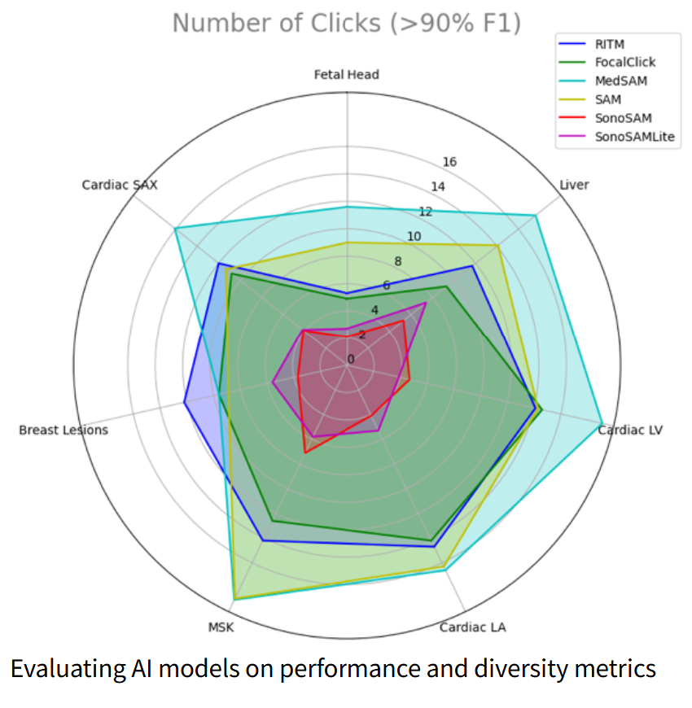
03 Assess safety and effectiveness
Fine tuned model qualification to demonstrate accuracy, robustness and minimization of bias
Independent & representative dataset across a set of representative systems, acquisition techniques & anatomical regions
Software Verification & Validation
Clinical validation & Usability based on intended use
Challenge: Partial coverage of use cases may necessitate an iterative approach through PCCP and/or postmarket monitoring
Ravishankar, H. et al., (2024). SonoSAMTrack: Segment and Track Anything on Ultrasound Images. arXiv. https://doi.org/10.48550/arXiv.2310.16872
Technology in development that represents ongoing research and development efforts. These technologies are not products and may never become products. Not for sale. Any reported results are preliminary and subject to change. Not cleared or approved by the U.S. FDA or any other global regulator for commercial availability.

Slide 12



04 Establish control & lifecycle management
Change control
Maintain version control & end-to-end validation
Configure model to produce consistent output
Adaptability & speed
Leverage PCCP to expand use within a bounded intended use
Build speed to allow quick iterations (e.g. adopt new FM version)
Post-market monitoring
Evaluate best software practices to capture feedback during use
If device risk level requires it, consider mechanisms to monitor ongoing performance as a risk mitigation

Slide 13
Conclusion
GenAI/FM-enabled MDs can be regulated within existing MDs regulatory frameworks.
Pre-Determined Change Control Plans are a valuable regulatory tool for FM/GenAI-enabled MDs to ensure safety and effectiveness, and agility.
Continuous postmarket monitoring of GenAI enabled MDs can help bridge the gap between premarket assessment and real-world performance.
Medical device regulatory authorities are best suited to oversee the governance of GenAI/FM-enabled medical devices, given their domain expertise and established frameworks.
International regulatory coordination is vital to harmonize policies and requirements for GenAI/FM-enabled medical devices.
Notes:
GenAI/Fm enabled MDs can be regulated within existing MD regulatory frameworks. Some adaptations will be beneficial like allowing Pre-Determined Change Control Plan for foreseeable changes that the manufacturer can describe and that would require resubmissions. In some circumstances, when the risk level of the device requires it, continuous postmarket monitoring may help bridge the gat between premarket assessment and real world performance.
Because medical device regulators have deep domain expertise and established regulatory systems, I believe AI regulation in medical device is most efficiently implemented by the medical device regulators rather than through cross sector legislation. A vertical approach allows new expectations to fit naturally within existing regulatory framework and allows for a more focus application to healthcare.
International collaboration between regulators is key to enable efficient regulation of the next advancement of Ai in medical devices. I am encouraged by how experts in IMDRF working groups for instance are coming together and have been able to align on Good machine learning principles, principles for pre determined change control plans and now working on AI Lifecycle. I am also encouraged by the international collaboration around standard that Pat presented to us, it will provide a set of useful common methods and practices.
I have no doubt that AI will continue to transform healthcare. Let's continue to work together to introduce AI responsibly in medical devices so it benefits all patients while minimizing risk.
Because behind every regulation, every product, and every decision—there’s a patient. And sometimes, that patient is you or a loved one. Thank you!

