Slide 1

Generative AI in Medicine: Services, Evidence, and the SaMD Boundary
Woong Bae @Soombit.AI
Notes:
Thank you for being here today at this event. I am the CEO of soombit.ai. Today, I will be speaking on the topic, "Generative AI in Medicine: Services, Evidence, and the SaMD Boundary.
I understand this can be a complex and serious topic. Before I begin, I want to provide some context about my perspective. My company is a startup that develops specialized generative AI software for medical imaging. However, I am not a regulatory expert. Therefore, my presentation today will offer insights from the viewpoint of a medical AI researcher. I ask you to please keep this in mind as I share my thoughts.

Slide 2

Agenda
Latest Services in Generative AI–based Medical LLM & Clinical Evidence
  OpenEvidence
  Prof. Valmed
  AIRead-CXR
Generative AI based SaMD - Points for Discussion
Notes:
Here is the agenda for my presentation.
First, I will introduce some of the latest services in generative AI-based medical LLMs and discuss their clinical evidence. I will cover three cases: OpenEvidence, Prof. Valmed, and our own solution, AIRead-CXR. Second, I will raise some points for discussion regarding generative AI-based SaMD

Slide 3
Purpose of Regulation:
Ensure baseline “Safety for patients and the public”
Notes:
As we all know, the fundamental purpose of medical device regulation is to ensure a baseline of safety for patients and the public. This principle of 'patient safety first' is the foundation for our entire discussion.

Slide 4
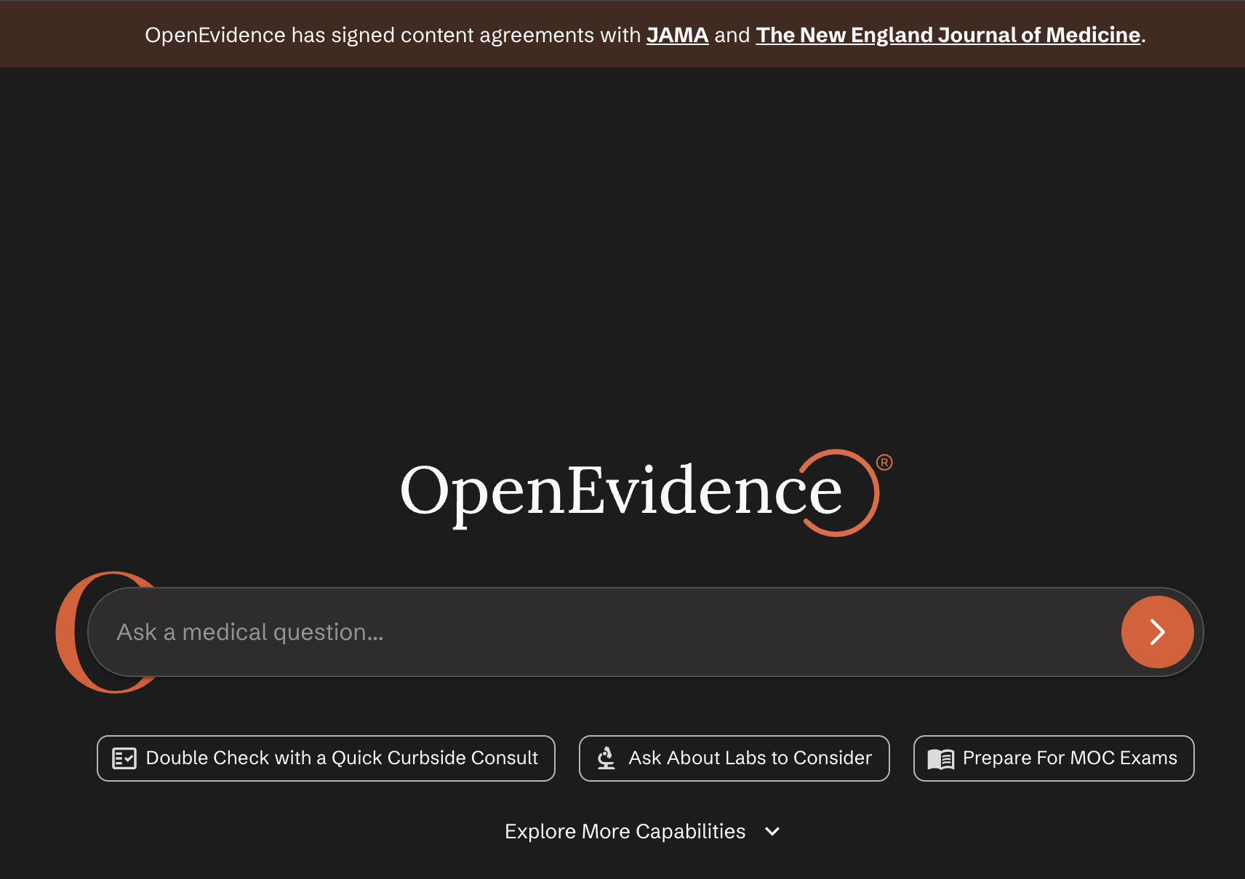
Case 1: OpenEvidence
Evidence-focused medical “Search” assistant (NEJM or JAMA)
  Supports clinical judgment, medical information search
  Over 40% of U.S. physicians rely on OpenEvidence in more than 10,000 hospitals and clinics
  Non-SaMD
Notes:
Let's begin with our first case study: OpenEvidence.
As you can see in the image on the bottom right, OpenEvidence functions like a search engine for medical knowledge. Clinicians can ask questions and receive answers supported by evidence.
Its key feature is that it partners with leading institutions like the publishers of NEJM and JAMA. Through these partnerships, it accesses the latest information and provides clear references for its answers.
Because of its reliable data and well-cited references, it is reportedly used by over 40% of physicians in the United States. It is important to note, however, that this product is not regulated as a SaMD.

Slide 5
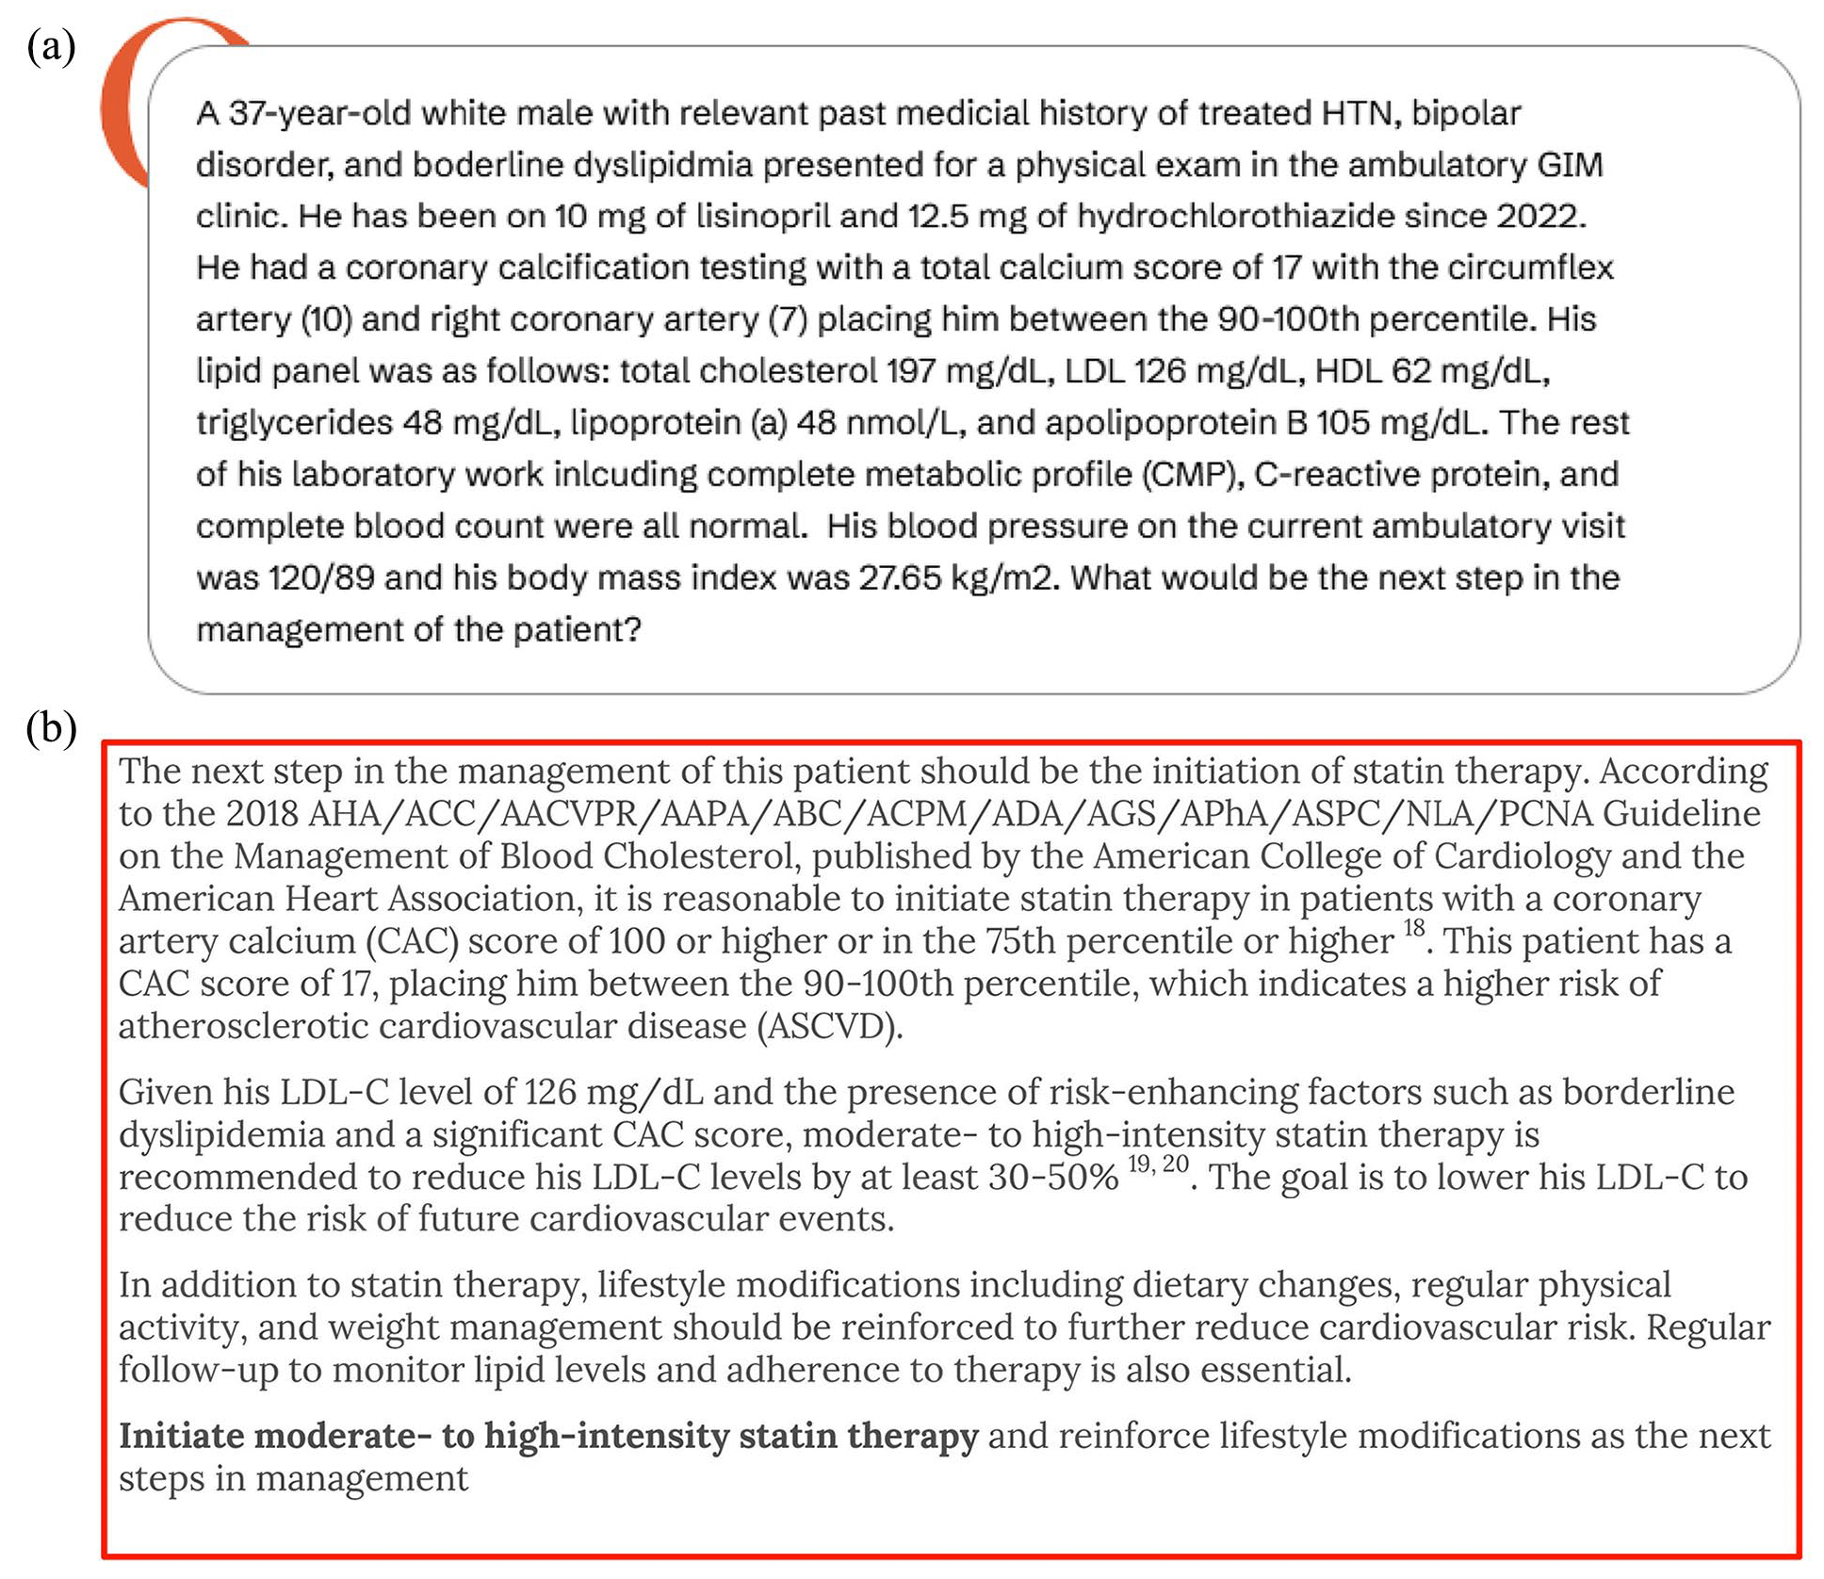
Case 1: Clinical Evidence of OpenEvidence
To evaluate ability to provide evidence-based recommendations for five common chronic conditions in primary care.
Hurt, Ryan T., et al. "The use of an artificial intelligence platform openevidence to augment clinical Decision-Making for primary care physicians." Journal of Primary Care & Community Health 16 (2025): 21501319251332215.
Notes:
Now, let’s look at the clinical evidence for OpenEvidence. A small-scale study was published this year. In this study, five physicians evaluated the answers provided by OpenEvidence for five common chronic patient conditions found in primary care.

Slide 6
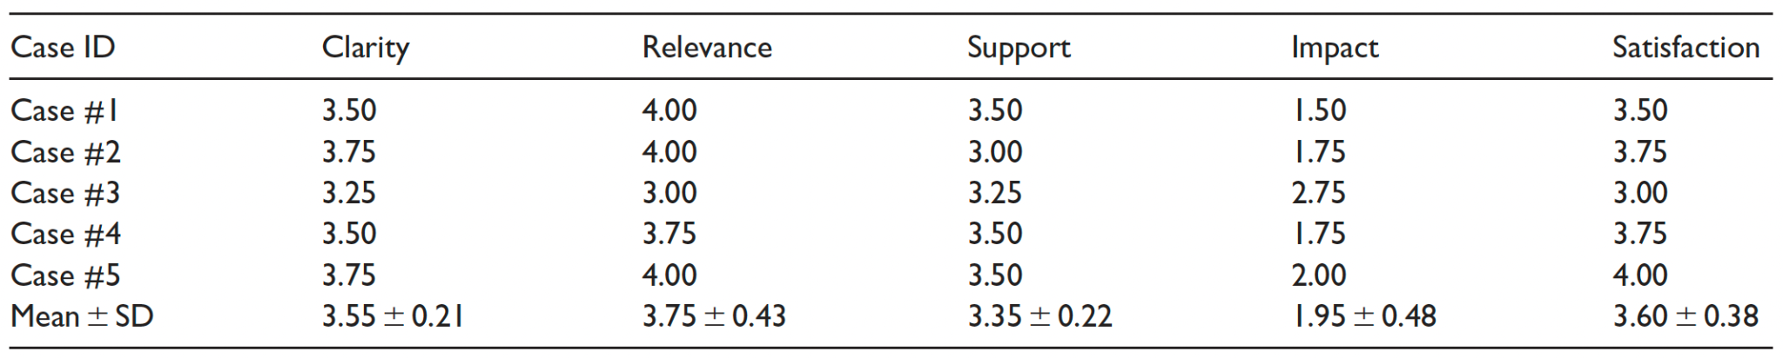
Case 1: Clinical Evidence of OpenEvidence
Five patient cases were retrospectively analyzed; physicians posed clinical questions and rated OpenEvidence responses (0–4 scale) on clarity, relevance, evidence support, decision-making impact, and satisfaction.
Hurt, Ryan T., et al. "The use of an artificial intelligence platform openevidence to augment clinical Decision-Making for primary care physicians." Journal of Primary Care & Community Health 16 (2025): 21501319251332215.
Notes:
The physicians rated the responses on a 4-point scale across several categories, including clarity, relevance, evidence support, and decision-making impact.
The results are quite interesting. The 'evidence support' category received a high average score of 3.35. However, the 'decision-making impact' scored much lower, at 1.95.
This suggests that while the tool provides high-quality support that can improve workflow efficiency, its direct influence on a doctor's final clinical decision is limited. It helps them work better, but it doesn't make the decision for them.
Of course, we must acknowledge that the reliability of this study is limited due to the very small number of test cases.

Slide 7
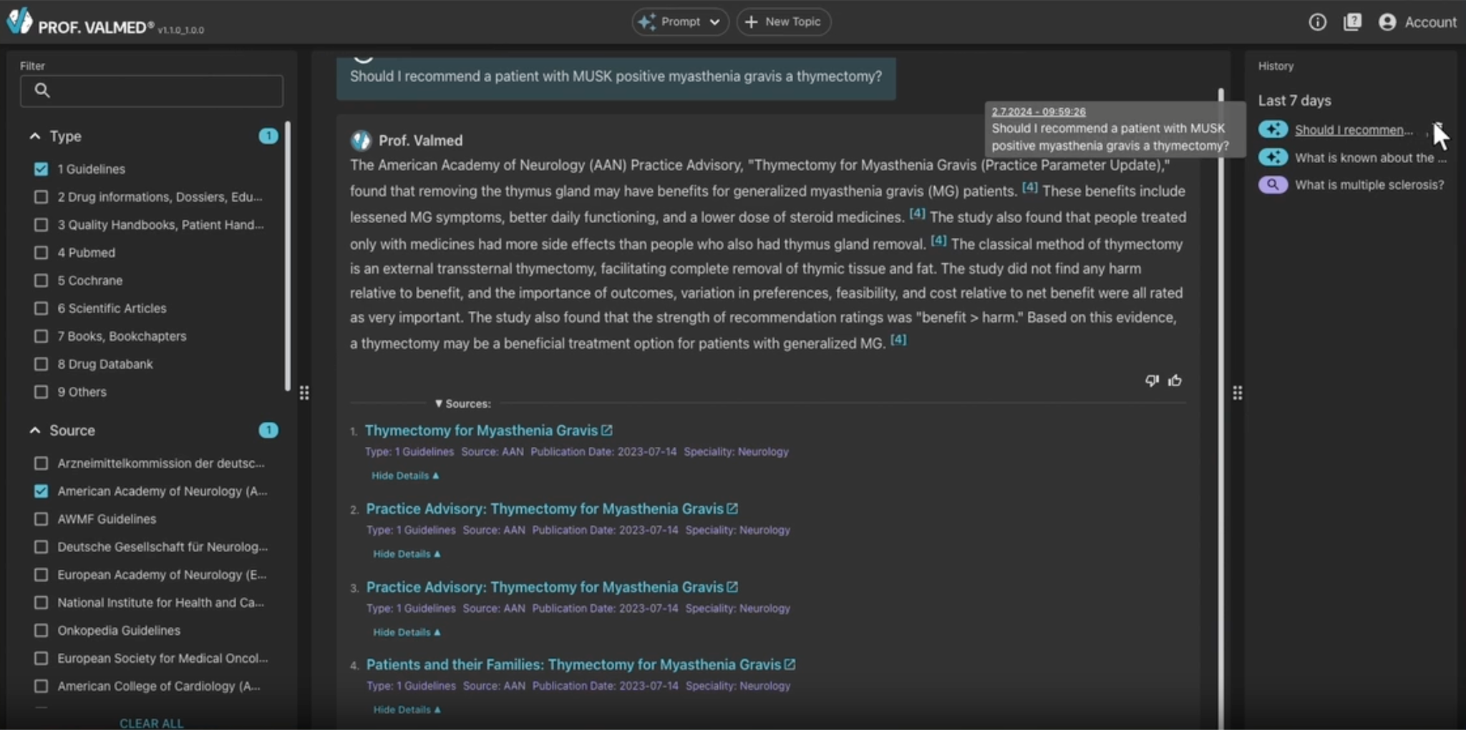
Case 2: Prof. Valmed
Medical Co-Pilot “Chatbot” for “Doctors”
  Uses GPT-4 + 2.5M curated docs (guidelines, PubMed, etc.)
  Validated diagnostic/treatment info. Focus on accuracy & trusted sources.
  SaMD(Class IIb CE)
Notes:
Next, I'd like to introduce Prof. Valmed. This is a medical co-pilot chatbot designed for doctors.
The company built its own database of 2.5 million documents from medical guidelines and PubMed. The service uses a technique called RAG, or Retrieval-Augmented Generation, with the GPT-4 model to search this large database and provide information.
A key point here is that the quality of the service is highly dependent on the quality of its own 2.5 million documents. Unlike OpenEvidence, this device has received CE certification in Europe as a SaMD Class IIb device.

Slide 8
Case 2: Clinical Evidence of Prof. Valmed
900 medical queries testing (3-phase evaluation)
  Stress-test: Q&A multiple times to check for consistency
  Tested the system against board-certified specialists across multiple medical specialties
  Brought in real-world testing with medical professionals from different backgrounds
  Result: safety index of 0.26(average)
https://www.hardianhealth.com/insights/valmed-ai-medical-device-regulatory-clearance#:~:text=The%20clinical%20evaluation%20masterclass.
Notes:
As a certified medical device, Prof. Valmed went through various validation processes. First, the developers built a test dataset of about 900 medical queries. Then, they conducted a three-stage evaluation.
The first stage was an internal test to evaluate consistency through multiple Q&A sessions. The second stage involved testing the Q&A with specialists from various medical fields. Finally, the third stage was a test in a real-world setting with medical staff from diverse backgrounds.
The results led to a safety index of 0.26, which supported the conclusion that the service provides safe and reliable results.

Slide 9
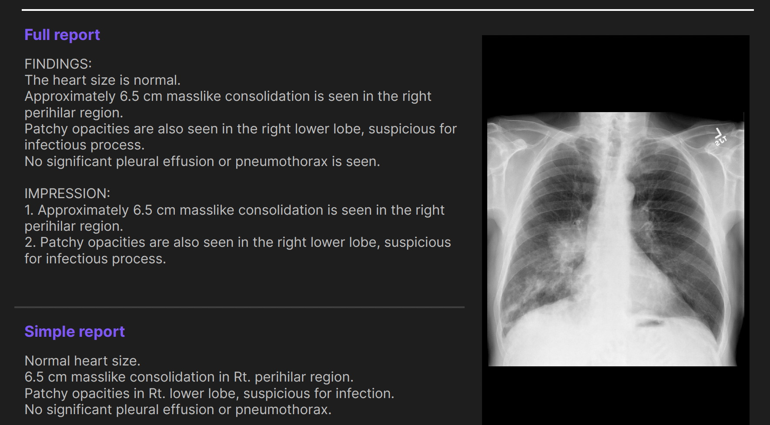
Case 3: AIRerad-CXR
Generative AI Model for preliminary radiology report for CXR
  Based on over 14 million CXR-report pair study datasets
  Intended User: Radiologist
  Input: CXR(PA,AP) images
  Output: preliminary Report
Notes:
Finally, I would like to introduce our company's product, AIRead-CXR. This is a generative AI that creates preliminary reports for chest X-ray images. It was trained on a dataset of 140,000 chest X-ray and report pairs. We are proud to say that it is the first of its kind in South Korea to receive IND approval for a clinical trial as generative AI SaMD, which is currently in progress. The intended user is a radiologist. The input is a frontal chest X-ray image, and the output, as you can see in the image, is a preliminary radiology report covering a wide range of findings that radiologists review.

Slide 10
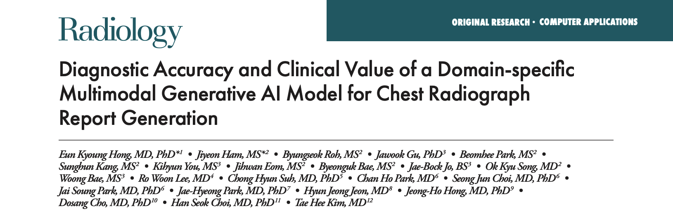

Case 3: Clinical Evidence of AIRerad-CXR
Evaluating Only the Performance of Generative AI Preliminary Reports
w/wo CAD Evaluation of Generative AI Preliminary Reports
Value of Using a Generative Artificial Intelligence Model in Chest Radiography Reporting: A Reader Study (Radiology 2025)
Diagnostic Accuracy and Clinical Value of Domain-Specific Multimodal Generative AI for Chest Radiograph Report Generation (Radiology 2025)
Notes:
To demonstrate the clinical evidence for AIRead-CXR, I will introduce two studies that were published in the journal Radiology.

Slide 11
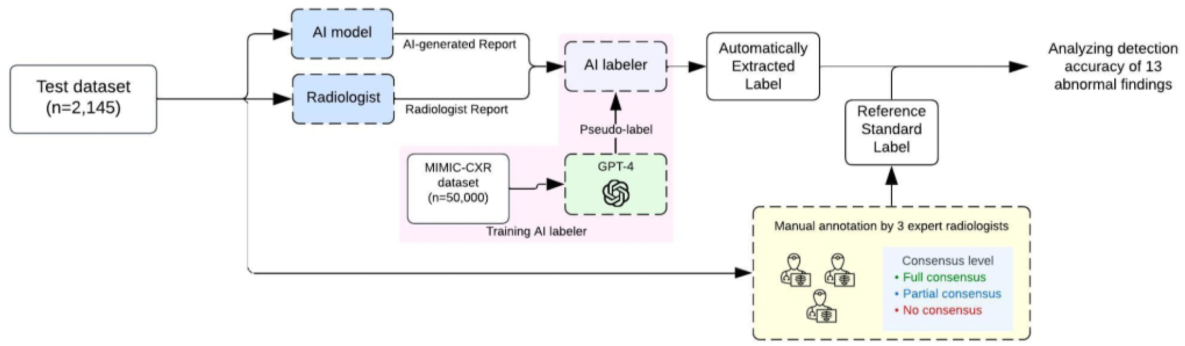
Case 3: Quantitative Clinical Evidence of AIRerad-CXR
Assessing the classification performance of the 13 most important CXR findings
  Converting natural language report to multi-label
Diagnostic Accuracy and Clinical Value of Domain-Specific Multimodal Generative AI for Chest Radiograph Report Generation (Radiology 2025)
Notes:
First, we conducted a quantitative analysis. This diagram explains how we transformed the AI-generated free-text radiology reports into a multi-classification task. This was to determine the presence of 13 specific findings.
To do this, we developed an automated labeling model called CheX-GPT. It was trained using pseudo-labels generated by GPT-4. The full details of CheX-GPT are available on our company’s GitHub.
The reference standard for this test was established through the independent annotations of three radiologists for each case.

Slide 12
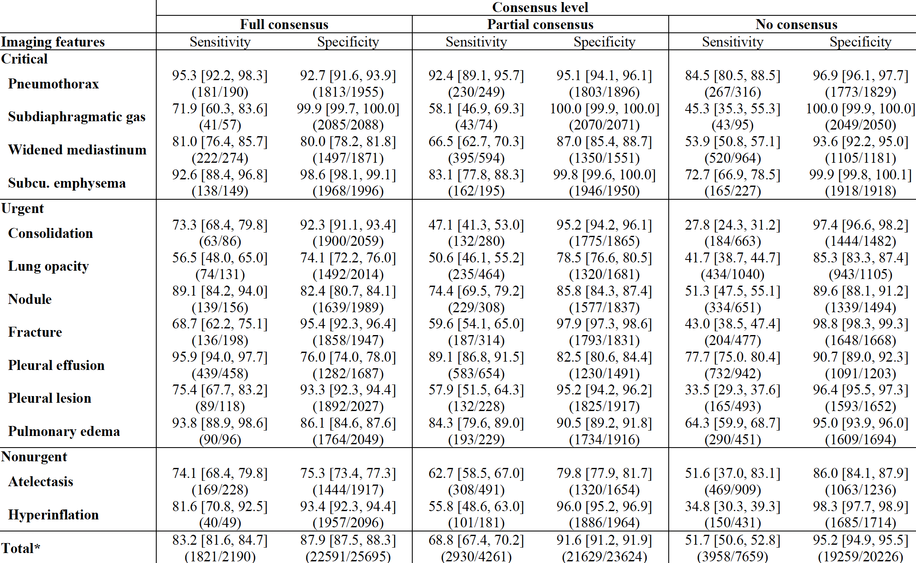
Case 3: Quantitative Clinical Evidence of AIRerad-CXR
AI-generated reports demonstrated good performance in detecting CXR findings for full consensus.
Diagnostic Accuracy and Clinical Value of Domain-Specific Multimodal Generative AI for Chest Radiograph Report Generation (Radiology 2025)
Notes:
The AI-generated reports demonstrated good performance in detecting chest X-ray findings where all three radiologists were in full consensus.

Slide 13
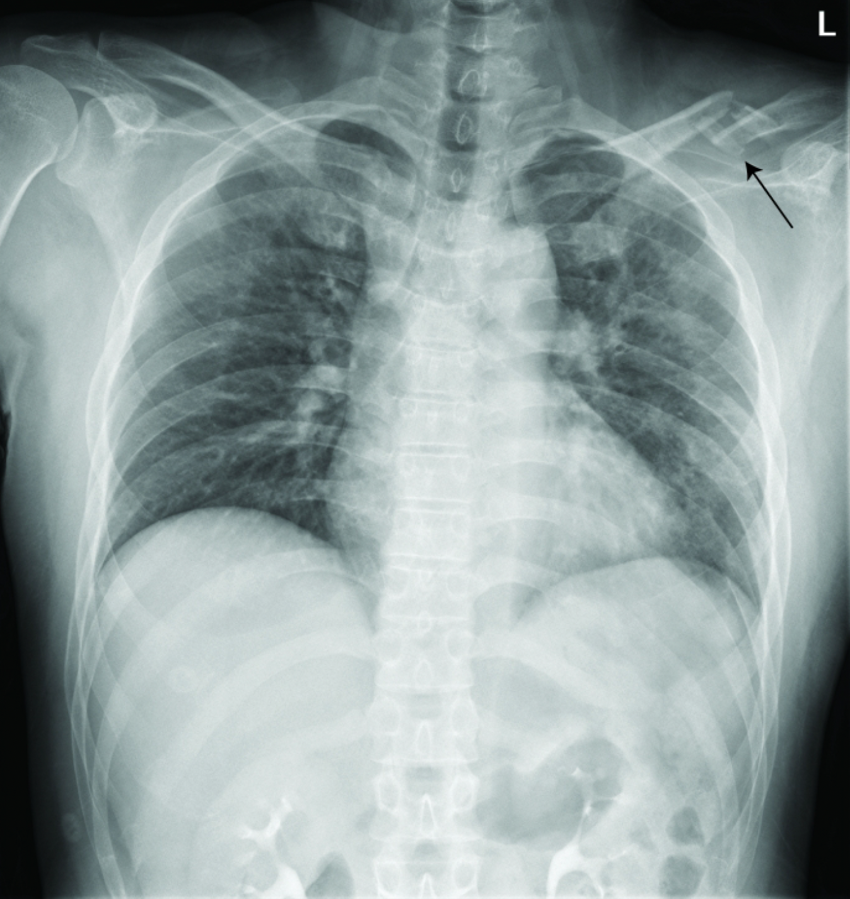
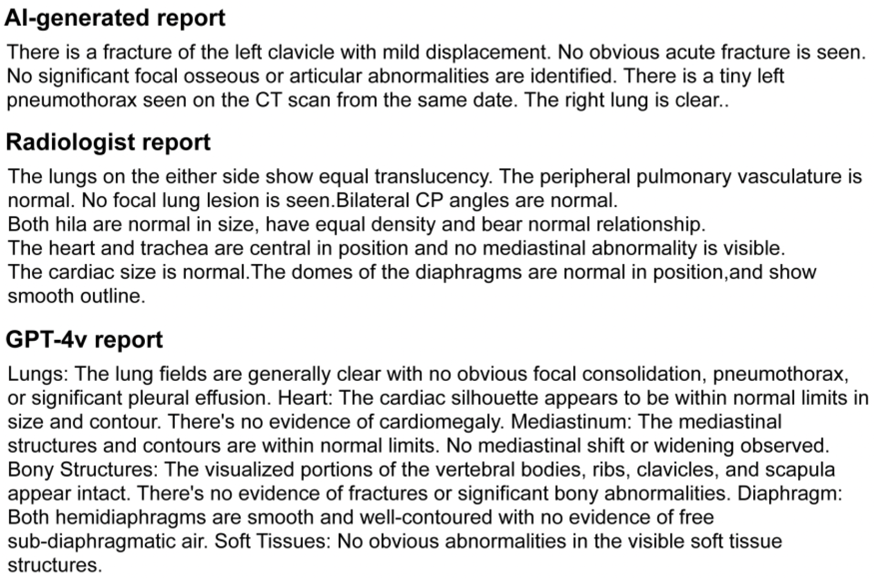
Enough Metrics? Example
Opinion of reference radiologists
Two radiologists confirm the left clavicle fracture,
while none reported a pneumothorax.
Hallucination case: “seen on the CT scan from …”
Diagnostic Accuracy and Clinical Value of Domain-Specific Multimodal Generative AI for Chest Radiograph Report Generation (Radiology 2025)
Notes:
Would evaluation based solely on classification quantitative metrics be sufficient?
In one case, the AI accurately detected a left clavicle fracture, which was missed by both radiologists and GPT-4v. However, the AI report included hallucinated information, mentioning findings "seen on a CT scan," despite no CT scan being provided.

Slide 14
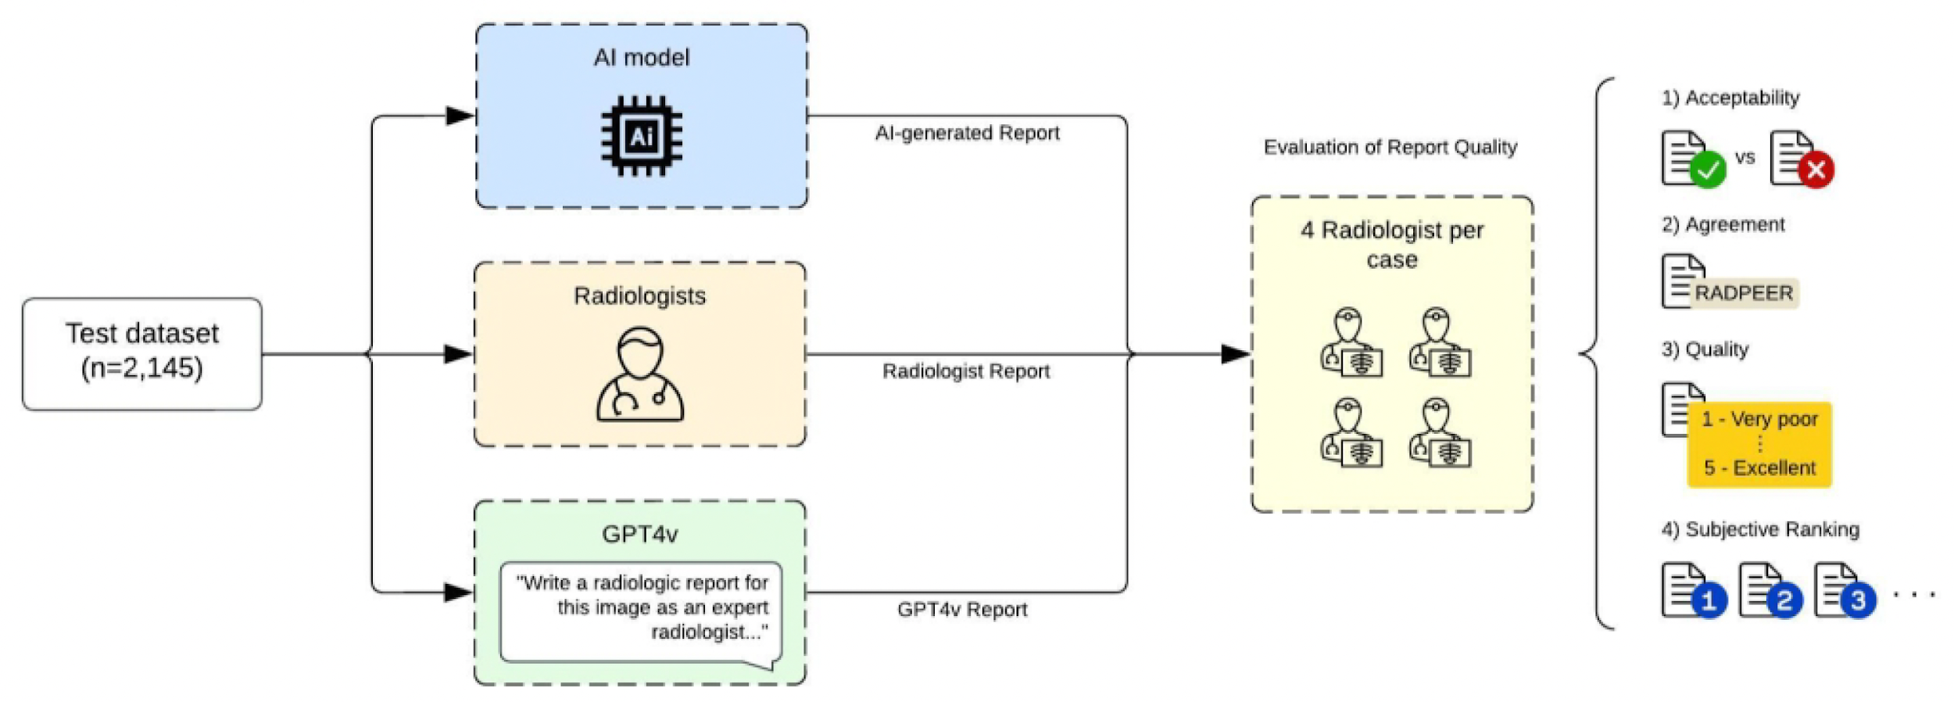
Case 3: Qualitative Clinical Evidence of AIRerad-CXR
Comparing AI-generated reports with radiologists and GPT-4v.
Using four different metrics to evaluate qualitative performance, conducted independently by four radiologists.
Diagnostic Accuracy and Clinical Value of Domain-Specific Multimodal Generative AI for Chest Radiograph Report Generation (Radiology 2025)
Notes:
As in the example I just showed you, the classification metrics alone cannot fully evaluate the quality of a natural language preliminary report. Therefore, We also conducted qualitative analysis by comparing AI-generated reports with those written by radiologists and GPT-4v.
And we used four different metrics to comprehensively evaluate the qualitative performance: Acceptability, Agreement Score, Quality Score, and Ranking.

Slide 15
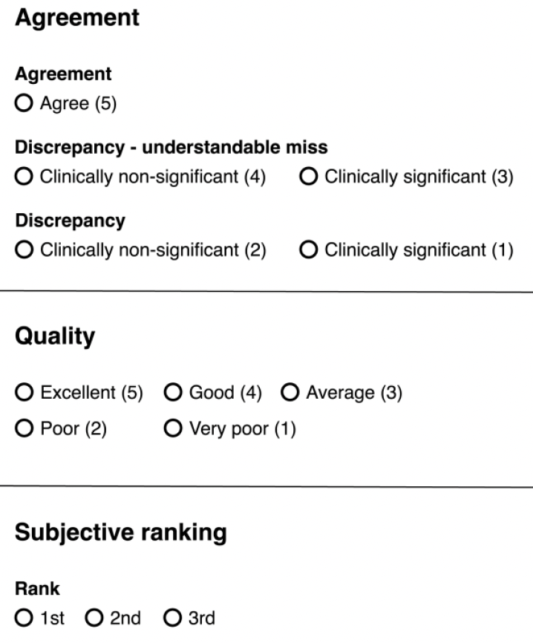
Case 3: Qualitative Clinical Evidence of AIRerad-CXR
Metric for AI Model Quality Evaluation
  Acceptability
    whether the radiologist would endorse the report as their
    own without any changes
  Agreement Score (RADPEER)
    a peer-review methodology developed by the ACR to evaluate
    the agreement
  Quality Score
    a subjective measure reflecting the radiologist's opinion on the overall quality
  Ranking
    rank the reports based on their overall impression,
    comparing AI-generated reports, radiologist-written reports, and GPT-4v reports.
Diagnostic Accuracy and Clinical Value of Domain-Specific Multimodal Generative AI for Chest Radiograph Report Generation (Radiology 2025)
Notes:
Let me briefly explain these four metrics. Acceptability measures whether a radiologist would approve the report as their own without any modifications. The Agreement Score was based on an expanded RADPEER score, evaluating discrepancies on a 5-point scale. The Quality Score used a 5-point Likert scale to subjectively assess the report's overall quality. Finally, Ranking allowed radiologists to directly compare the reports from our AI, GPT-4v, and a human radiologist.

Slide 16
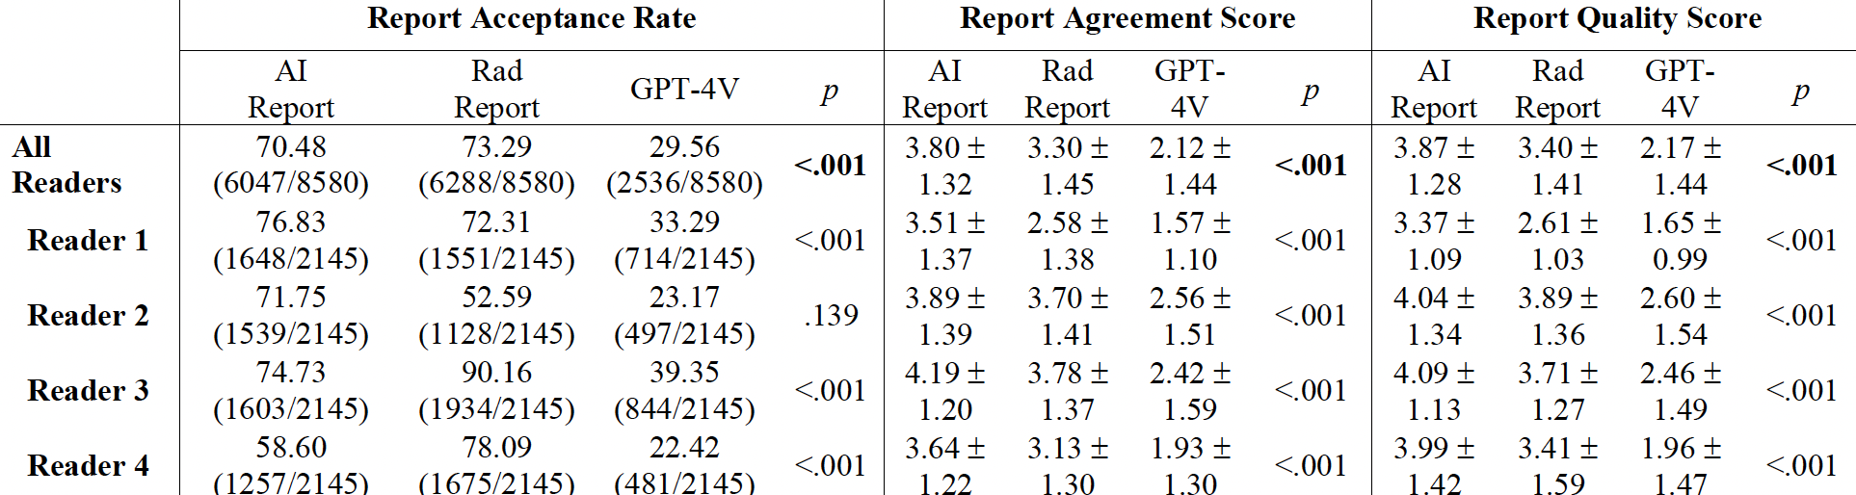
Case 3: Qualitative Clinical Evidence of AIRerad-CXR
The agreement and quality score showed that AI-generated reports had higher agreement and quality over radiologists’ and GPT-4v reports.
Diagnostic Accuracy and Clinical Value of Domain-Specific Multimodal Generative AI for Chest Radiograph Report Generation (Radiology 2025)
Notes:
The results of the qualitative analysis were very encouraging. AI-generated reports had slightly lower acceptability rates than radiologists' reports. However, our AI reports scored higher on both agreement and quality compared to the radiologists' reports.

Slide 17
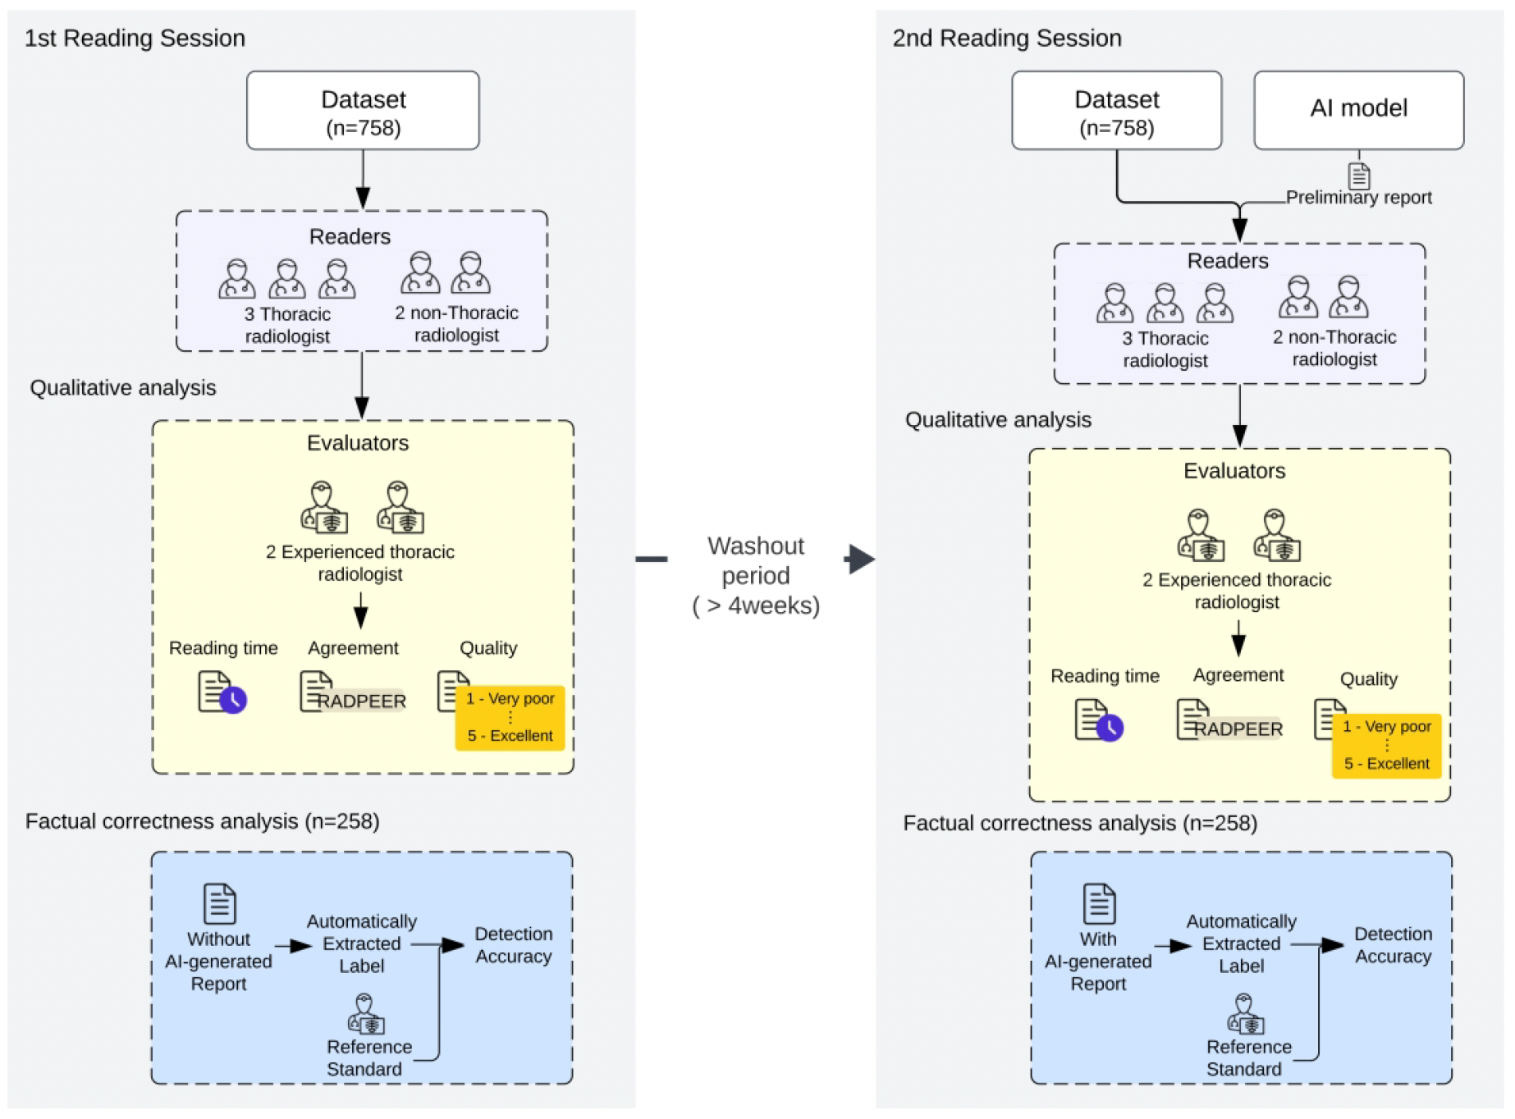
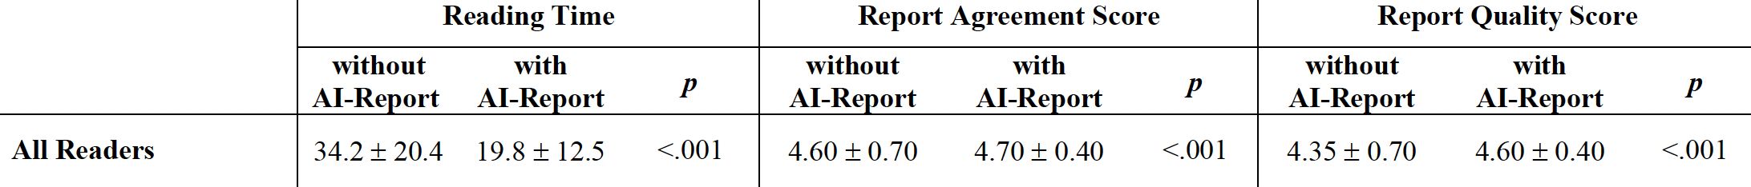
Case 3: w/wo CAD Clinical Evidence of AIRerad-CXR
A multireader, multicase study was conducted, where CRs were interpreted w/wo the aid of AI-generated reports.
significant reduction in reading time from 34 to 19 seconds.
agreement and quality scores improved (4.6 to 4.7), (4.3 to 4.6).
Value of Using a Generative Artificial Intelligence Model in Chest Radiography Reporting: A Reader Study (Radiology 2025)
Notes:
* Finally, to confirm the performance with and without our tool, we performed a multi-reader, multi-case reader study in 2 sessions. Five radiologists, who were “readers” independently interpreted the CXRs, blinded clinical information. In the first session, they reported the CXRs without AI; in the second, they used AI-generated preliminary reports, with the option to revise. There was a 4 weeks wash-out period between the first and second sessions. The sequence of CXRs was randomized to minimize bias. For qualitative evaluation of the reports, 2 thoracic radiologists, who were “evaluators”, separately evaluated the agreement and quality of reports from both sessions.
* The results were clear. The introduction of AI-generated reports significantly reduced average reading times for the radiologists. Furthermore, the agreement and quality scores both generally improved with AI use.

Slide 18
‘Intended use’ of AIRead-CXR, Prof. Valmed, OpenEvidence
An assistive AI in a clinician-in-the-loop framework,
designed not to replace clinical decision-making
but to enhance workflow efficiency and quality.
Notes:
So far, I have discussed three different services: AIRead-CXR, Prof. Valmed, and OpenEvidence. Despite their differences, they all share the same fundamental intended use. They are designed to be an assistive AI in a 'clinician-in-the-loop' framework. Their purpose is not to replace clinical decision-making, but to enhance workflow efficiency and quality.

Slide 19
Safety and reliability from the Physician’s perspective
AIRead-CXR, Prof. Valmed >= OpenEvidence
Better Clinical Evidence
Safer against Automation & Cognitive Bias
(‘Able’ to verify AI outputs)
Notes:
From a physician’s perspective, I think many physicians would give higher scores to AIRead-CXR and Valmed than to OpenEvidence. Perhaps… because these tools are supported by good peer-reviewed clinical evidences, which helps reduce the risks of automation and cognitive bias, thereby lowering the likelihood of mistakes. In addition, all of these tools allow physicians to directly assess the accuracy of the AI’s output. With AIRead-CXR, they can verify the results against the images. With Valmed and OpenEvidence, physicians can check the answers using their own knowledge or by consulting references.

Slide 20
Safety and reliability from the Patient’s perspective
Prof. Valmed =? OpenEvidence
Human Doctor(Trust) > Better Clinical Evidence
Human Doctor(Trust) > Safer against Automation & Cognitive Bias
(‘Unable’ to verify AI outputs)
Notes:
Now, what about the patients’ perspective? For most patients, if they were to use these services directly, it would be difficult to verify the results from Valmed and OpenEvidence due to a lack of medical knowledge. And if they knew their physician was using one of these AI tools, they would likely feel comfortable with any of them — in fact, most of them would not really mind. This is because their trust is strongly placed in the human doctor, not in the AI tools themselves.

Slide 21
Purpose of Regulation:
Ensure baseline Safety for patients and the public
“Clinical Significance” of Information Based on
“Intended Purpose”
Notes:
As I mentioned earlier, the purpose of medical device regulation is to ensure at least a minimum level of patient safety. Currently, regulators determine whether a product is a medical device, and its appropriate class, by considering the Intended Purpose to assess the level of clinical significance.

Slide 22
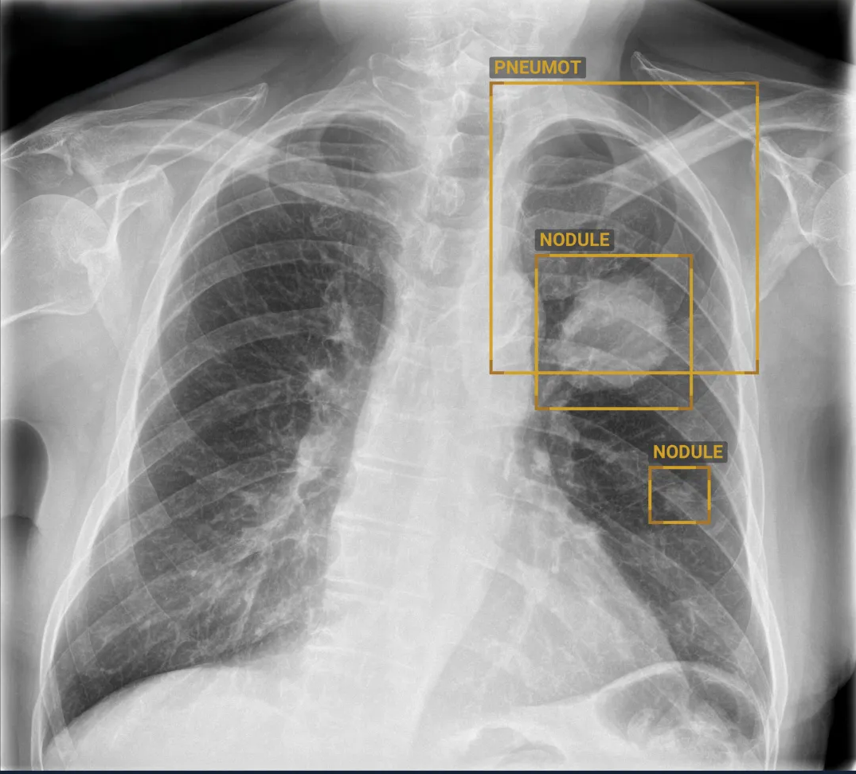
Intended Users
For Radiologist
For physician
For Patients
Notes:
Here, I want to emphasize the difference based on the intended user. A radiologist can judge the outputs with high accuracy. A general physician can clearly evaluate findings like a large nodule or a pneumothorax but may struggle with a small nodule. For a patient, a chest X-ray might just look like a black and white image. As this shows, we already know that the clinical significance risk of the same information changes depending on the expertise of the intended user.

Slide 23
SaMD: Safety for Generative Medical ‘Assistive’ AI
The assumption of equivalence in clinical performance and intended use
Clinical
Significance Risk
OpenEvidence
For a patients
AIRead-CXR
For a physician
SaMD ?
For Assistive AI
OpenEvidence
,Prof. Valmed
For a physician
AIRead-CXR
For a Radiologist
Intended User’s Ability
Notes:
Therefore, I would like to propose an idea for discussion. When we regulate generative medical 'assistive' AI, perhaps we should also consider the intended user's ability to evaluate the AI's output.
As shown in this diagram, as the intended user's ability to evaluate the AI increases, the clinical significance risk of the same product could be seen as lower. This is because the expert user acts as a strong safety filter.
Considering this factor could help us make more nuanced decisions about whether a tool should be a medical device, and if so, at what classification level. This could be a factor in fostering innovation while ensuring patient safety.

Slide 24
Thank you for
your time and attention!

Slide 25
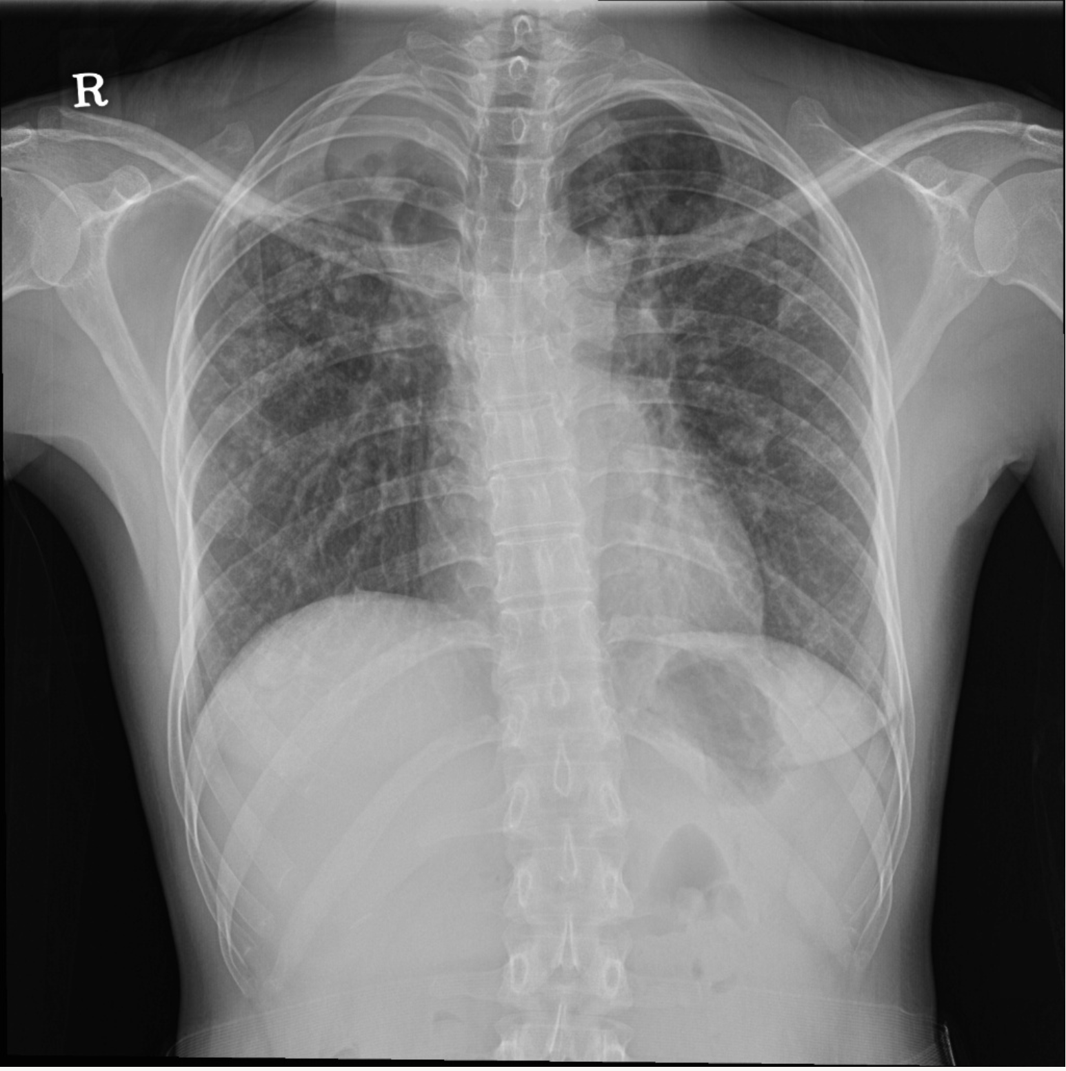
Report #1
Cavitary lesion in RULZ. Multiple nodules with or without calcifications at both lungs.
- Pulmonary Tbc, both lungs, more likely active.
Report #2
Cavitary lesion in RULZ. Multiple nodules with or without calcifications at both lungs.
- r/o pneumonia, both lungs.

