Slide 1
Regulatory Approaches to AI-based Medical Devices in Australia
AIRIS September 2025
Tracey Duffy
Therapeutic Goods Administration (TGA) Australia

Slide 2
When does TGA regulate Artificial Intelligence (AI) ?
Health software
Medical device software
We don’t regulate:
Consumer products (not for therapeutic use)
All health software - Scope of what TGA regulates is relatively small
Clinical practice
We regulate AI that is for therapeutic use under the medical device regulatory framework

Slide 3




How is AI being used in healthcare in Australia?
Diagnostics and drug discovery
Analysing medical images and genomic data to aid in identifying anomalies or diseases
Identifying potential drug candidates – reducing the lead time to treatment and potentially leading to faster availability of new medications
Predictive analytics
  Identifying at-risk patients for conditions (including chronic diseases, sepsis, etc.) readmissions, and adverse drug events - improving patient care and outcomes while reducing costs
  Prediction based on personal information
Virtual assistants
  Interactive healthcare providers online and in the real world
  Constant real time monitoring patients, preventative analytics, early intervention, medication management, companionship and mental health support
Electronic health record system integration
  Managing patient data, automating administrative tasks, and improving decision-making by providing relevant patient information – reducing administrative errors, improving patient outcomes

Slide 4
When is AI a medical device – the legal requirement in Australia?
Manufacturer’s intended purpose is critical – some exclusions and exemptions for low risk
Software and AI is a medical device when the manufacturer intends for their product to be used for:
  diagnosis, prevention, monitoring, prediction, prognosis or treatment of a disease, injury or disability
  compensation for an injury or disability
  investigation of the anatomy or of a physiological process
  to control conception
  in vitro examination of a specimen derived from the human body for a specific medical purpose
  Software that is an accessory to another medical device

Slide 5



Machine learning-enabled medical devices – adopted IMDRF
IMDRF guidance defines this as “A medical device that uses machine learning, in part or in whole, to achieve its intended medical purpose.”
Machine Learning - is a subset of AI that allows computers to learn without being explicitly programmed.
Machine Learning algorithms are trained on data to make predictions or decisions. For example, diagnostic tools that can enhance image scanning, support decision making and predict the risk of disease.
  Machine learning (ML)
  Deep Learning
  Generative AI
  Large language models (LLM)
  Neural networks

Slide 6
Recent examples of AI approved and regulated by the TGA
Melanoma
screening
Breast cancer screening
Sepsis risk
3D anatomical models
Stroke
diagnosis
Genetic testing (IVDs)
Treatment
planning
Closed-loop
systems
Lung cancer screening

Slide 7
Artificial intelligence – regulatory challenges
LLMs not validated for a medical purpose
AI is not always immediately visible in the design
Privacy and consent of data used and collected
Rapid development and diversity of AI systems
Clinical practitioners are not always aware of the extent to which they are accepting the risk for use of software
Data for training and testing of the AI is often not related to use case population or is too small to be valid
The AI model and its design is not always based on good clinical or scientific evidence

Slide 8

Software and AI – Overcoming challenges – but is this enough?
Balancing innovation with safety
Education: ensuring healthcare providers and consumers are supported to make good decisions
Aligning internationally: maintaining consistency and interoperability
Post-market monitoring: managing the risks of unintended bias, performance degradation and off-label use
Therapeutic Goods Administration – tga.gov.au

Slide 9

What evidence is needed for AI – what is it doing (and how)?
This evidence must be sufficiently transparent to enable the evaluation of the safety and performance of the product.
A description of what the AI/ML model is doing and how it contributes to the intended purpose of the device.
Information about the algorithm and model design including information on the training and testing phases:
What type of model (neural network, support vector machine etc)?
Was training supervised vs unsupervised vs semi-supervised
What tuning techniques were used?
Is the model locked, or can it continue to learn once deployed?

Slide 10


What evidence is needed for AI – data
Description of the data used for training and testing:
  dataset sizes must be sufficiently large to ensure statistical credibility
  how data was selected, labelled etc
  description of the populations represented in the data
  a justification for how this data would be generalisable or appropriate for the Australian population and sub-populations for whom the AI is intended to be used, in the context of Australian clinical practice standards
  has synthetic data been used

Slide 11

What evidence is needed for AI – validation
Details of model verification and validation such:
  Scope and results of testing and external validations, including Clinical validation
  Use of reference standards (established ground truth)
  Accuracy, sensitivity & specificity
Management of risks including overfitting, unwanted bias, and performance degradation such as data drift.

Slide 12

Resources for software and AI evidence is growing
IMDRF Current work on:
Harmonised approach to predetermined change control plans for low-risk updates to software and AI models
Guidance for AI use in medical devices over the entire lifecycle
IEC 62304 – Medical device software life cycle processes
Describes software and QMS requirements for:
  Development (including testing and release)
  Maintenance
  Risk management
  Configuration management (including change control)
  Problem resolution

Slide 13

What about Gen AI and ‘unlocked’ AI ?
Clinical context is important:
Is it appropriate for the use/risk context if outputs cannot be reliably predicted (i.e. probabilistic Gen AI outputs)?
Manufacturer is responsible for the accuracy of outputs even if using 3rd party foundational models – what are the implications if they are wrong? Are there any know limitations (hallucinations etc)
Transparency – do users know what tech is being used, why and how – are appropriate consent provisions in place?
Observations:
For unlocked ML algorithms – manufacturer would need to show how they ensure the product continues to perform as intended, depending on risks may need to perform continuous monitoring and implement processes to respond to unexpected change sin performance
Pragmatic approach is to lock algorithms when deployed, with planned re-training and validation over time.

Slide 14
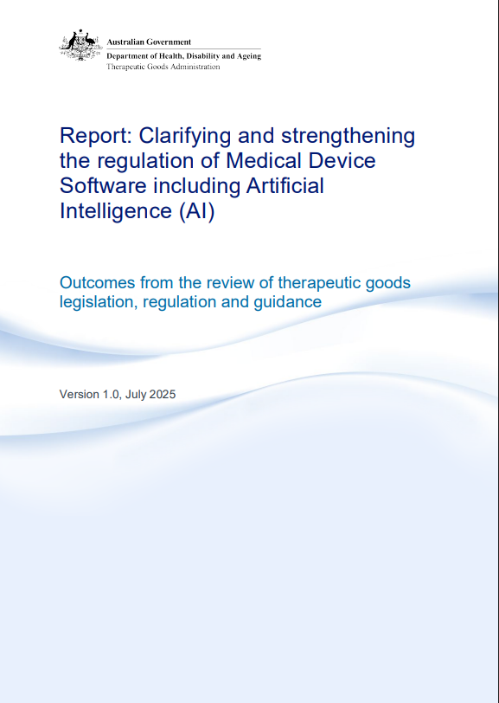





TGA’s SaMD and AI review – Report
14 key findings, grouped into five strategic priority areas
Priority Area 1
Supporting stakeholders
Providing clear information and guidance explaining regulatory requirements to support compliance.
Priority Area 2
Robust regulation
Refining regulation to ensure risks associated with therapeutic goods continue to be appropriately mitigated throughout their lifecycle
Priority Area 3
Reinforce roles & responsibilities
Ensuring language in our legislative framework (the Act) captures responsibility appropriately
Priority Area 4
Improve transparency of AI use
Facilitating access to information and support for stakeholders to understand how AI is used in the goods they access and how it is regulated.
Priority Area 5
Conducting compliance
Pragmatic and timely compliance activities to ensure the policy outcomes

Slide 15
Thankyou!
digitaldevices@tga.gov.au

