Slide 1

Singapore’s Regulatory Framework for AI in Medical Devices
WONG Woei Jiuang
Assistant Group Director
Medical Devices Cluster
Health Sciences Authority

Slide 2
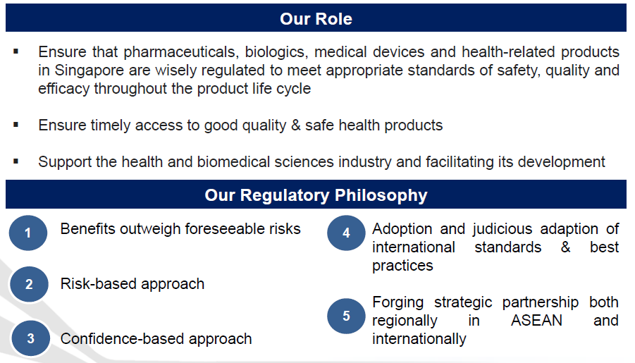
HSA’s Role in Health Products Regulation

Slide 3
Artificial Intelligence Medical Devices (AI-MDs)
AIMDs that are intended directly for medical purposes such as screening, detection, diagnosis, treatment, management or monitoring of any medical condition or disease are regulated by HSA as Medical Device (MD).
Our AI-MD definition and coverage are aligned with international guidelines from the IMDRF* and other reference regulatory agencies.
The use of AI for the following purposes are NOT regulated as MD:
For lifestyle or wellness related purposes (e.g., diet planning and weight management)
For use in hospitals solely for administrative functions (e.g., patient appointment scheduling)
For use in hospitals solely for training healthcare staff (e.g., simulation activities) or research purposes (e.g., recording study outcomes)
* International Medical Device Regulators Forum. Besides Singapore, IMDRF includes other regulators
such as the US, UK, EU, Australia and Japan
Legislative definition of “Medical Device” can be found in the First Schedule of the Health Products Act 2007: http://statutes.agc.gov.sg/

Slide 4
Risk Categorisation of AI-MDs
AI-MDs are like software-based medical devices in terms of their design, development, deployment and post-implementation changes
AI-MDs are risk classified based on the internationally aligned risk categorisation principles developed for software MDs. The risk classification is based on the intended purpose assigned by their manufacturer/developer (i.e., by design and by claims)
Functionalities and Features (e.g., triage, analyse, predict, adjust or control therapy)
Indications for clinical use (e.g., non-serious or serious or critical clinical condition)
Implementation and clinical workflow (e.g., drive clinical or patient management, diagnose or treat)
HSA’s Digital Health Webpage
https://www.hsa.gov.sg/medical-devices/digital-health

Slide 5
Pre-market Regulatory Requirements
AI-MDs uniqueness
Ability to learn continuously post deployment for clinical use
Performance depends heavily on the quality of the data set used to train
Performance can change from original specifications assigned and validated
Quality
Safety & Efficacy
Benefit-Risk Considerations
Real-World Effectiveness
Quality Management System (QMS): AI-MD development/ Retraining/ Deployment under QMS ISO 13485
Data quality: Training & Validation data sets shall be diverse (representative of intended patient populations), adequate patient dataset size and good quality (labelled by personnel with appropriate expertise)
Before AI-MD registration:
AI-MDs are required to undergo pre-clinical & clinical validation to ensure safety and efficacy.
Post-market: Developers are required to monitor and validate AI model on an on-going basis and perform re-training, as necessary
Risk management:
Required to implement risk management to identify, assess, mitigate & monitor all foreseeable risks associated with AI-MDs. Adequate in- built controls should be considered.
Cybersecurity risks:
Appropriate and adequate security controls shall be implemented. Appropriate life-cycle processes are required to be in-place to ensure cybersecurity risks are addressed throughout the product cycle.
Real-world Effectiveness: Upon deployment, manufacturers are required to monitor and report AI-MD real-world effectiveness. This is applicable for future iteration of AI models.
Ability to roll back to previous versions in case of inaccuracies or defects in newer versions
Refer Annex B for the key requirements evaluated by HSA when registering AI-MDs

Slide 6

New Regulatory Sandbox for AI-SaMD (not yet implemented)
Key Eligibility Criteria:
Developed by MOHT, Synapxe or public healthcare clusters
Class A (low risk) or Class B (moderately low risk) devices
Supervised by public healthcare consultant or higher
For public healthcare licensee use only
Must be notified to HSA upon deployment
Safety Controls:
Annual ISO 13485 quality management attestation
Internal product control checklist
Existing cyber and data security requirements
CMB/CEO endorsement required
Mandatory safety issue reporting to HSA
12-month monitoring period by HSA

Slide 7
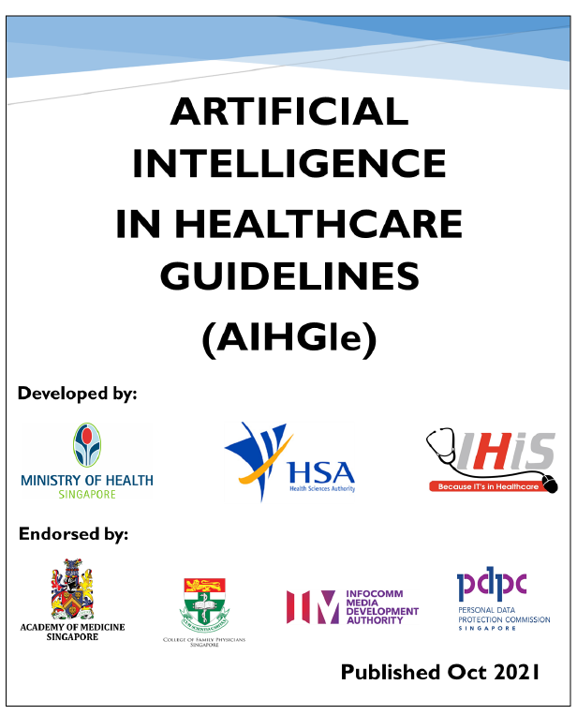
Artificial Intelligence in Healthcare Guidelines (AIHGIe)
HSA has worked with MOH and Synapxe to draft the guidelines on good practices for AI developers and implementers (e.g., healthcare institutions – hospitals, clinicals, laboratories, etc.)
Guidelines published by MOH in 2021. They are meant to provide key recommendations to encourage the safe development and implementation of AI-MDs and other AI applications in healthcare settings.
Some key recommendations on AIMD’s implementation include:
Exercise clinical governance and oversight over the adoption and implementation.
Introduce appropriate oversight based on device’s intended use, workflows of the AIMD and the clinical context.
Monitor AIMD continues to perform at/above the deployment baseline.
Reference: https://www.moh.gov.sg/licensing-and-regulation/artificial-intelligence-in-healthcare
Notes:
as best practices to be adopted.

Slide 8

AI-SaMD Regulatory Framework in Singapore Healthcare

Slide 9


Join Us: IMDRF 2026 in Singapore!
29th IMDRF Meeting 9–13 March 2026

