Slide 1



Regulatory Considerations of AI for Health: NOW & NEXT
Sameer Pujari
Lead, AI and Frontier Technologies
Kanika Kalra
Technical Officer (Digital Health and AI)
Department of Data, Digital Health, Analytics and AI
World Health Organization
pujaris@who.int

Slide 2

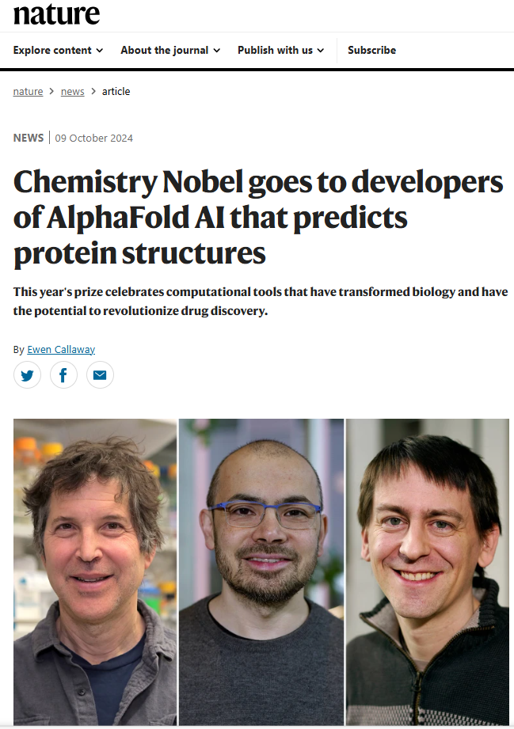

2024
NOBEL PRIZE 2024 AND ARTIFICIAL INTELLIGENCE

Slide 3

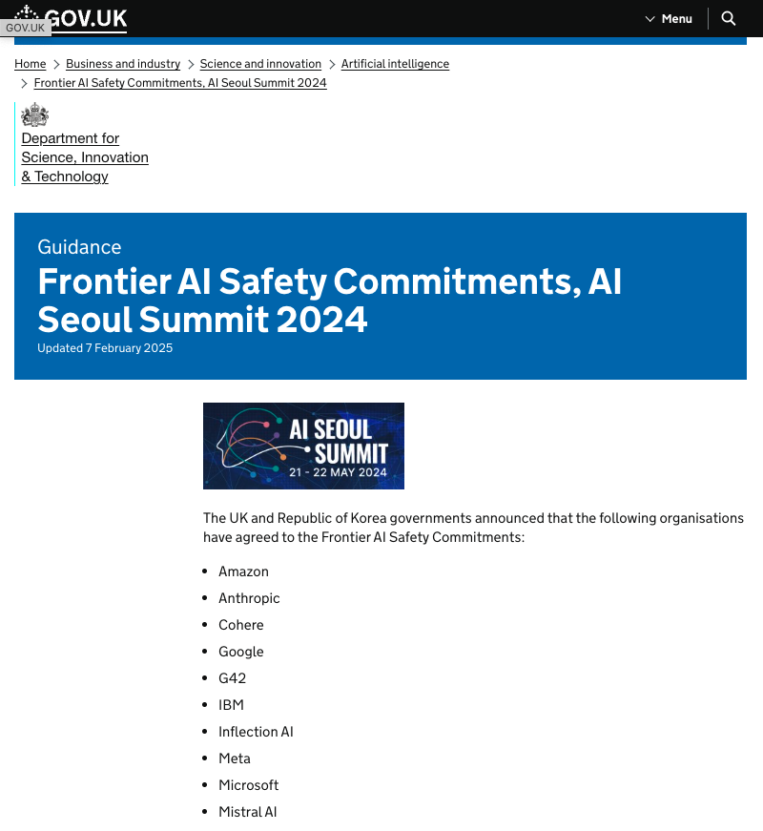

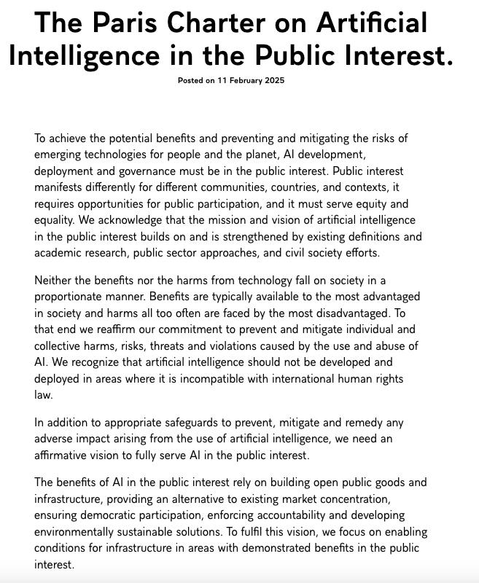
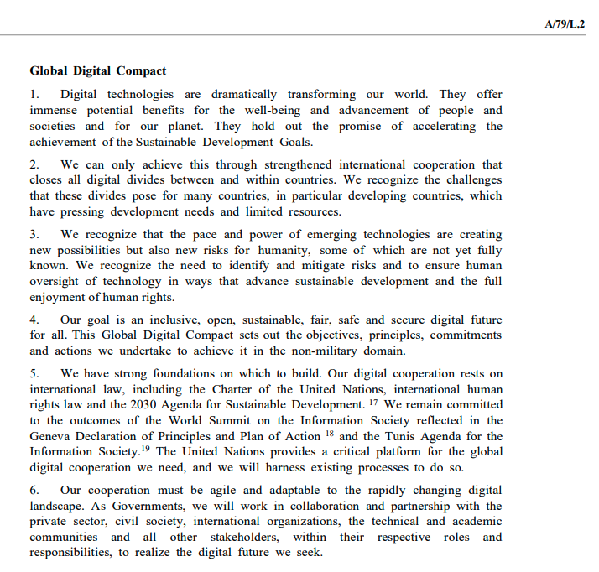
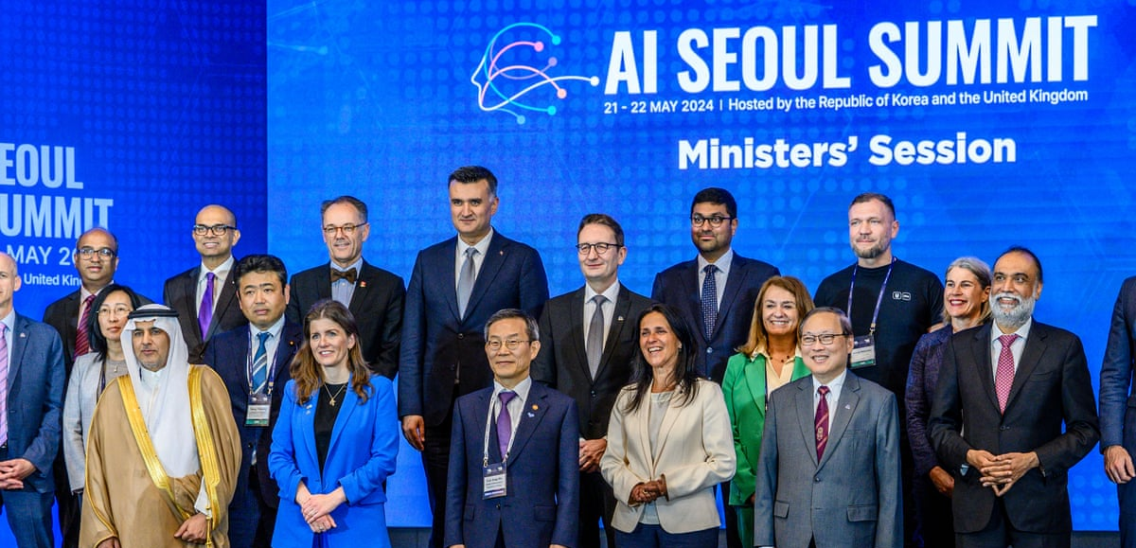
UN’s GLOBAL DIGITAL COMPACT
KEY INTERNATIONAL EFFORTS ON AI GOVERNANCE & REGULATION
SEOUL AI SAFETY SUMMIT
AI ACTION SUMMIT, PARIS
NEXT
AI IMPACT SUMMIT 2025,
INDIA
February 19-20, 2026
Notes:
International AI Governance – Recognizes the need to enhance AI governance for the benefit of humanity, ensuring responsible and ethical development.
Human Oversight & Risk Mitigation – Emphasizes the importance of human oversight in AI to mitigate risks, particularly in areas with uncertain long-term effects.
Equity & Inclusion – Calls for closing digital divides, ensuring all nations—especially developing countries—have equal access to AI advancements.
Human Rights & AI – Stresses that AI must respect human rights, including privacy, dignity, and non-discrimination.
Interoperability & Responsible Data Governance – Encourages AI systems that are interoperable and follow responsible data governance frameworks.
Environmental Sustainability – Highlights the role of AI in advancing environmental sustainability while minimizing its own negative ecological impact.
Gender & Social Inclusion – Recognizes the gender digital divide and the importance of empowering women and underrepresented groups in AI and digital development.
Public-Private Collaboration – Calls for a multi-stakeholder approach, including governments, private sector, academia, and civil society, to shape AI’s role in digital transformation.

Slide 4






WHA 77 |
STRATEGIC ROUNDTABLE
AI for Health:
Opportunities, Risks, and Challenges
Global Initiative on AI for Health
Setting Standards – Developing technical benchmarks, validation methods, and governance frameworks for safe & effective AI.
Trust & Transparency – Ensuring AI tools meet rigorous quality, safety, and ethical standards.
Bridging Knowledge Gaps – Empowering practitioners, policymakers & patients through knowledge-sharing and digital literacy.
Speakers L-R: Prof. Dr. Matias Goyen (GE Healthcare), Dr. Karen DeSalvo (Google), Mr. Marco Marsella (DG Sante, EU), Dr. Tedros (DG, WHO), Dr. Magdalena Skipper (Nature), Dr. Atul Gawande (USAID), Prof. Dr. Effy Vayenda (ETH Zurich), Dr. Saia Ma’u Piukala (RD, WPRO)
Notes:
I have summarized some key points from our discussion:
Opportunities and Challenges of AI in Health: AI has the potential to revolutionize health through advancements in research, disease surveillance, and clinical application. However, it is crucial to address the risks and ethical considerations associated with its use.
Ethical Governance and Policy Development: Ensuring the safety, equity, and effectiveness of AI in health requires robust governance frameworks, ethical principles, and clear regulatory oversight. Collaborative and inclusive approaches are essential to developing these frameworks.
Global Initiative on AI for Health (GI-AI4H): WHO’s joint initiative with ITU and WIPO to promote responsible, equitable, and scientifically grounded use of AI in health is a useful first step to convene parties, foster dialogue and develop consensus recommendations and more importantly, technical standards for AI in global health.
Benchmarking and Validation: Establishing rigorous validation methods and publicly available tools to assess Health AI is critical to ensure safety, quality and humanity. We are at an important inflection point where building and safeguarding trust is vital.
Knowledge Sharing: Sharing knowledge around AI for health among practitioners, patients, and policymakers is fundamental. Enhancing literacy and critical appraisal skills, as well as understanding the ethical and social implications of AI, will empower users to effectively integrate AI tools into healthcare practice.

Slide 5
SIX MAJOR SUB DOMAINS OF ARTIFICIAL INTELLIGENCE
Computer Vision
Digital Twin
AI in Robotics
Interprets visual
information from the
world
Monitors and
simulates physical
objects in real-time
Enables robots to
perform complex
tasks efficiently
Data Focus
Physical Focus
Decision Support Systems
Ambient AI
Predictive Analysis
Enhances user
experiences
seamlessly in
environments
Forecasts future
trends based on
historical data
Provides insights for
informed choices

Slide 6
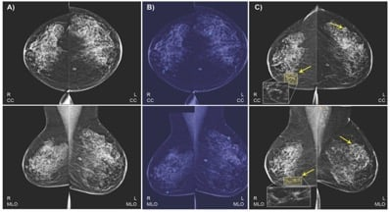
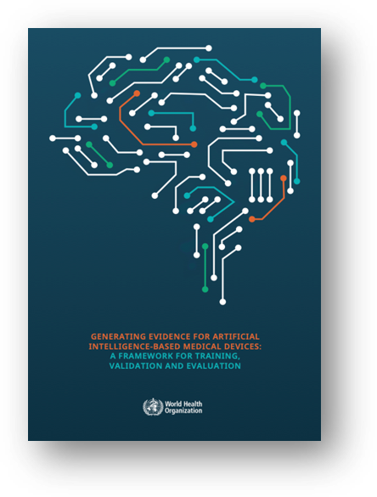

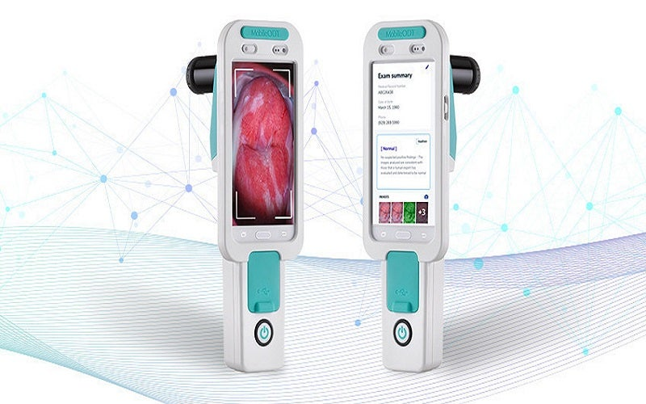
Computer vision
Pathology (Digital Pathology)
Pathology (Digital Pathology)
AI systems have also been employed in pathology to analyze histopathological images for various types of cancer, providing support for pathologists in diagnosis.
Performance: AI models can assist in identifying malignant tissues from biopsy samples with high accuracy.
Accuracy: A comprehensive review reported that AI algorithms used in breast cancer detection achieved an area under the receiver operating characteristic curve (AUC) of 0.94, indicating excellent diagnostic accuracy .
Comparison: This performance level is comparable to, and in some cases exceeds, the diagnostic capabilities of expert pathologists .

Slide 7
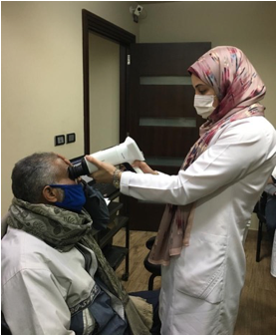
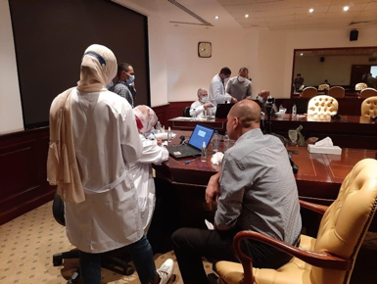
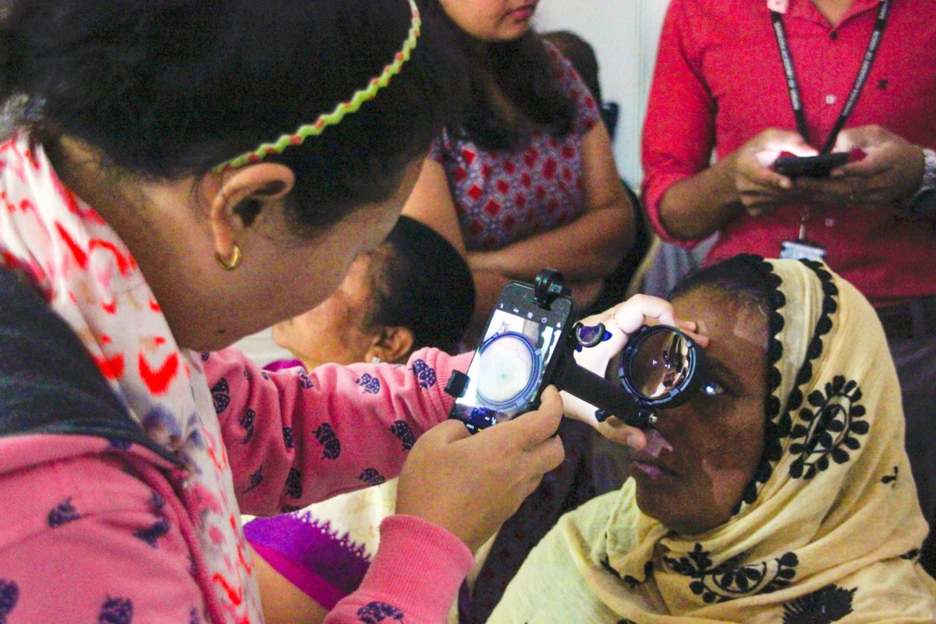
Computer vision
Diabetic Retinopathy Screening
Diabetic Retinopathy Screening
AI in screening for diabetic retinopathy, a diabetes as well as early detection.
Accuracy: According to a systematic review, AI models like those developed by Google Health achieved a sensitivity of 87% to 90% and specificity of 98% for detecting referable diabetic retinopathy.
Comparison: These performance metrics are on par with the diagnostic accuracy of ophthalmologists and optometrists.

Slide 8
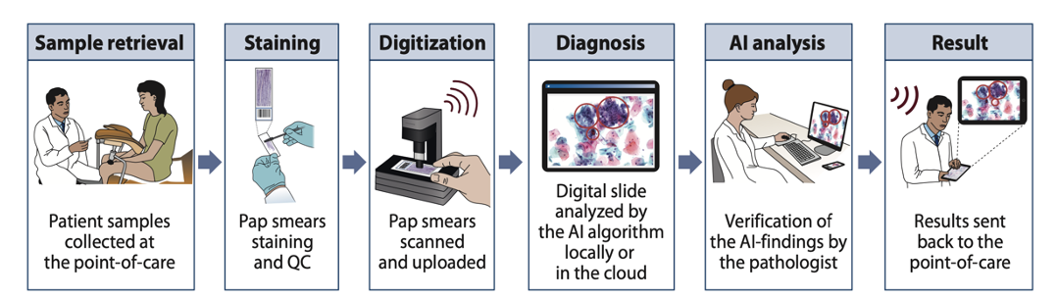
Computer vision
AI for Diagnostic at point of care
Diagram: Steps involved in AI-enabled screening of pap smears
Feature​ | Traditional Test (e.g., HPV, Pap)​ | AI-Based Screening (e.g., image analysis)​
Basis​ | Biological markers​ | Data patterns (data in, data out)​
Result Type​ | Physical report/test output​ | Digital prediction (probability or decision)​
Input Sensitivity​ | Moderate​ | High – image/data quality critical​
Update Potential​ | Fixed​ | Can and will be updated/improved​
Infrastructure Needs​ | Labs, reagents, transport​ | Devices, power, possibly internet​
Transparency​ | Clear mechanisms​ | Often “black box”​
Time to Result​ | Hours to days​ | Seconds to minutes​
Regulation​ | Established frameworks​ | Emerging, varies by country​
Suitability for POC​ | Limited in remote settings​ | High – especially with offline capability​
Scalability​ | Logistically challenging​ | High if devices and support exist​
Holmström O, Linder N, Kaingu H, Mbuuko N, Mbete J, Kinyua F, et al. Point-of-Care Digital Cytology With Artificial Intelligence for Cervical Cancer Screening in a Resource-Limited Setting. JAMA Network Open. 2021 Mar 17;4(3):e211740.
Table: AI versus traditional diagnostic tests

Slide 9
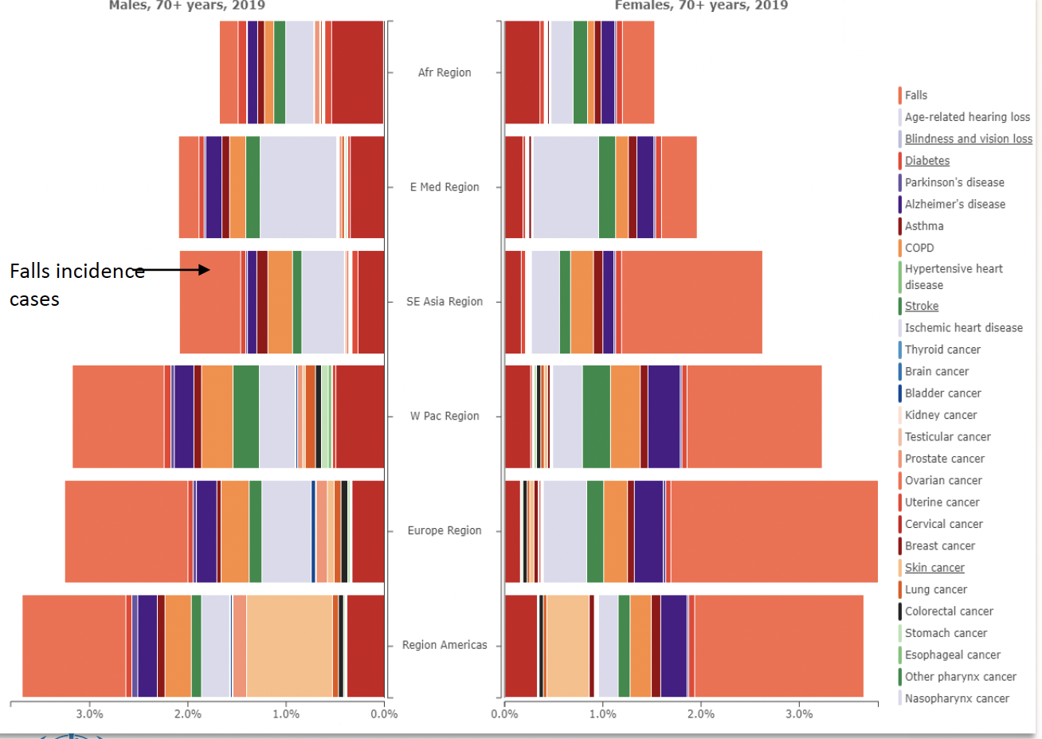
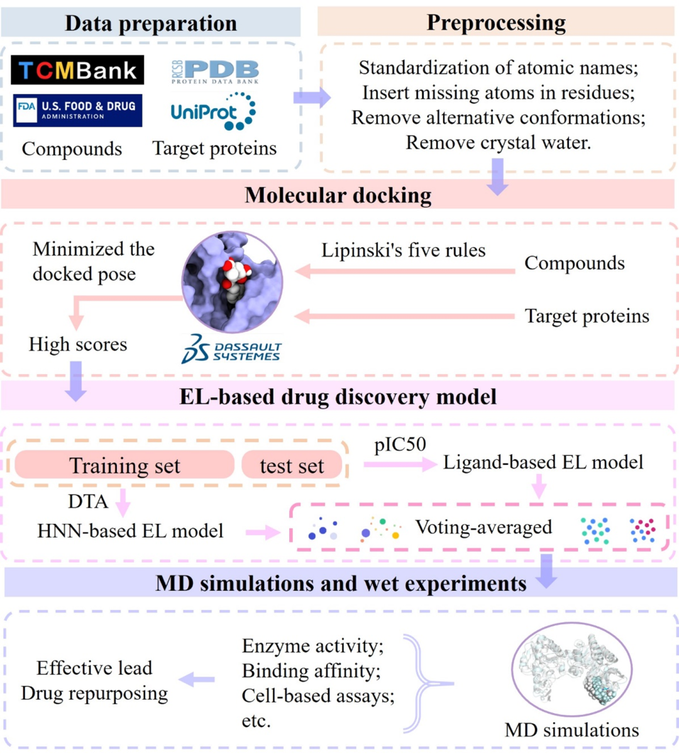
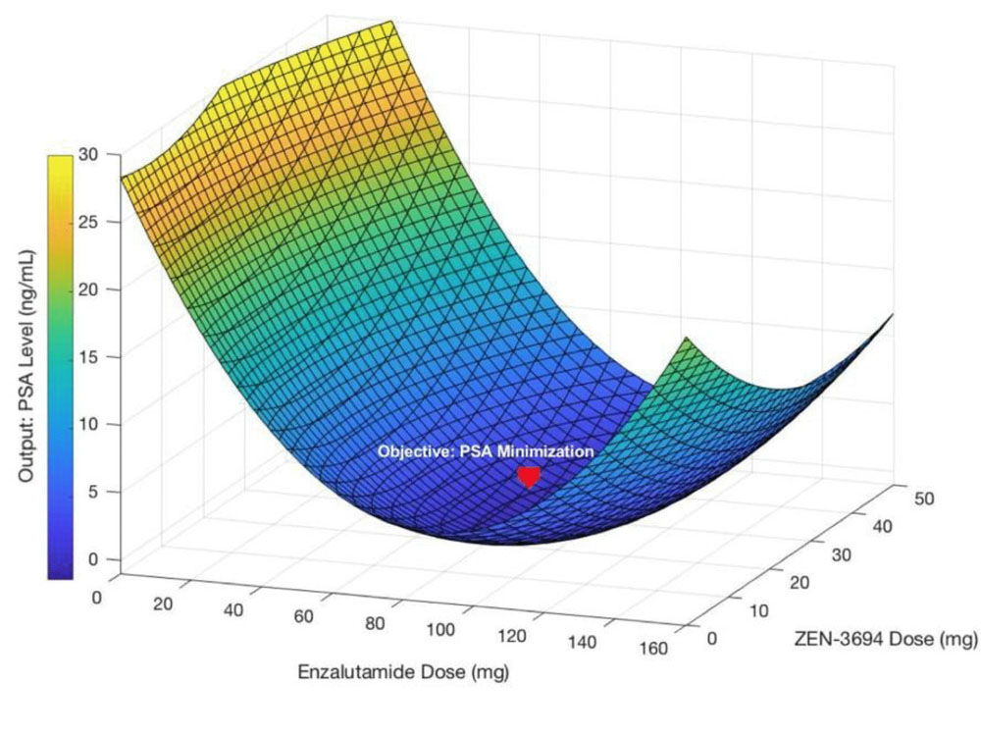


AI for Drug Discovery
AI for Bone Health
AI for Traditional medicine
To avoid the drawbacks of traditional drug combination therapy development to improve patient outcomes
Discovering novel biomarkers for bone diseases.
Identifying individuals at high fracture risk
Prevent falls among older persons
Provide standardized information about ingredients, diseases and their corresponding gene targets
Data source: WHO Falls Factsheet https://www.who.int/news-room/fact-sheets/detail/falls, Global Burden of Disease Study (GBD 2019) and Ilic, I.; Ristic, B.; Stojadinovic, I.; Ilic, M.Epidemiology of Hip Fractures Due to Falls, Medicina 2023, 59(9), 1528;
Notes:
The last example is the AI for Public Health Response to Infectious Diseases
AI can be used effectively with IoT to help collect necessary data and predict future situations, such as outbreaks of viral diseases to reduce morbidity, mortality and prevent global spread.
This makes it easy for health ministry to take any effective decision to control the situation.
This demonstrates the role of AI in the public health response to infectious diseases in Low and middle income countries such as Bangladesh.

Slide 10
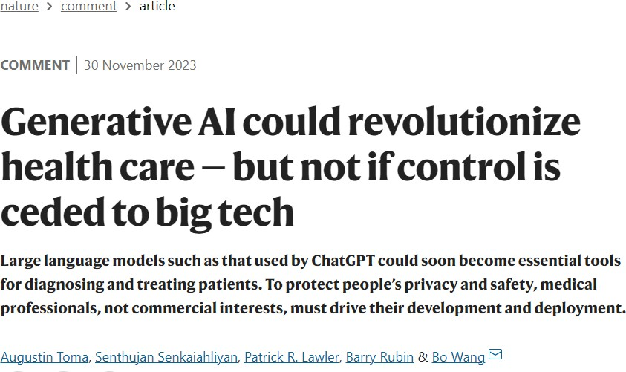
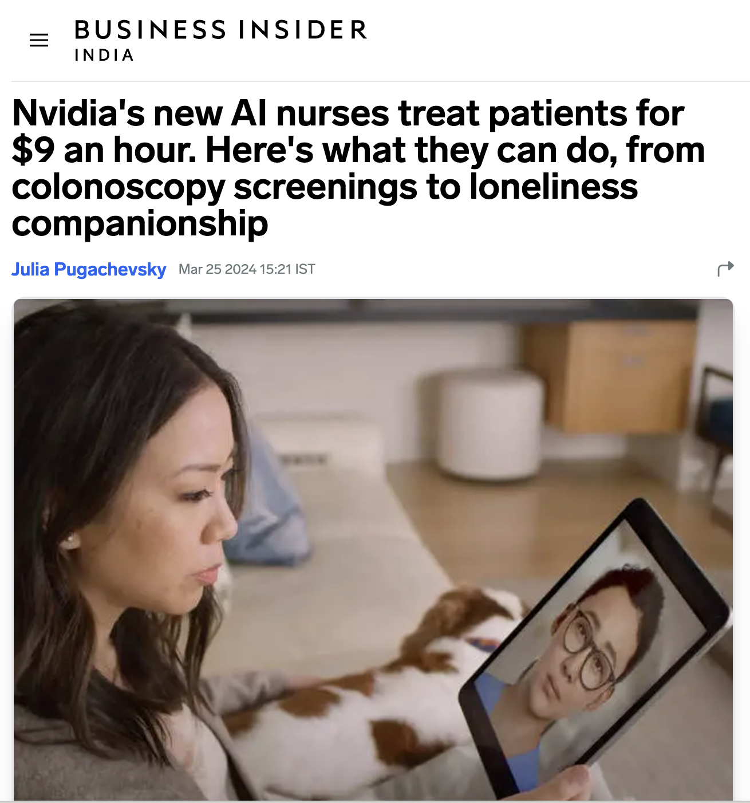
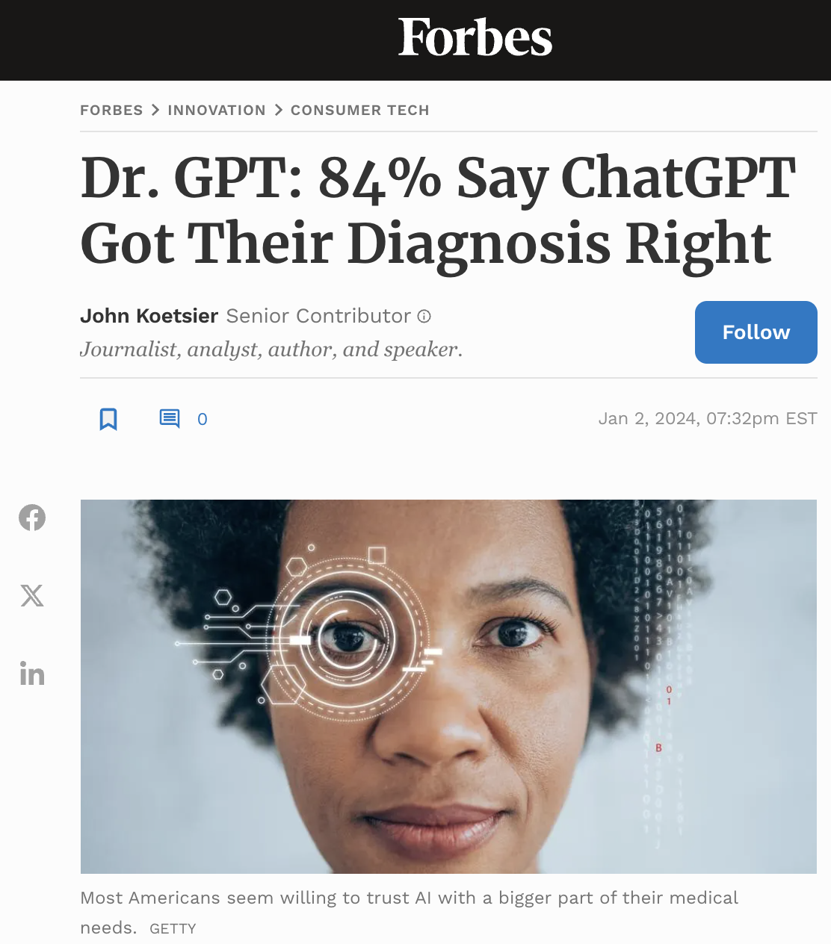
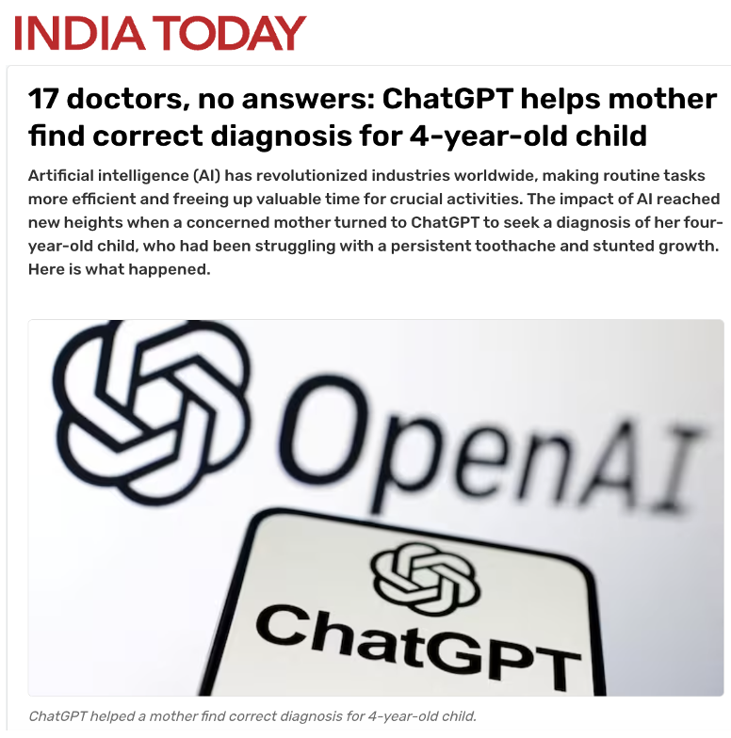
Rapid Developments in the Private Sector: Implications for Health Regulation

Slide 11
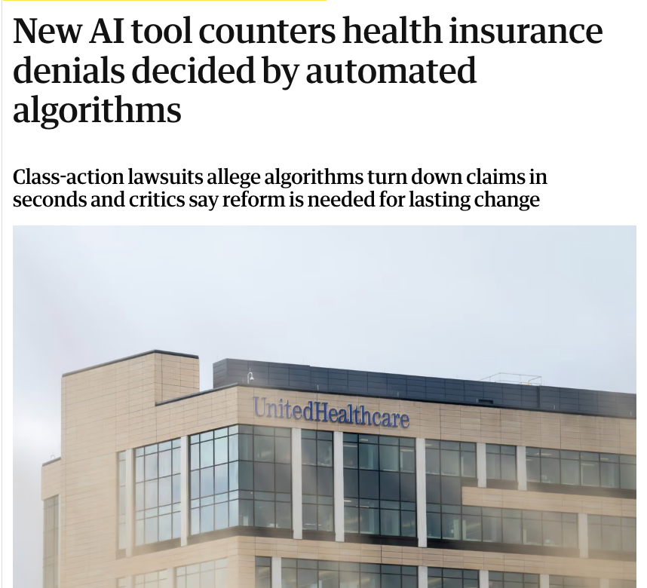
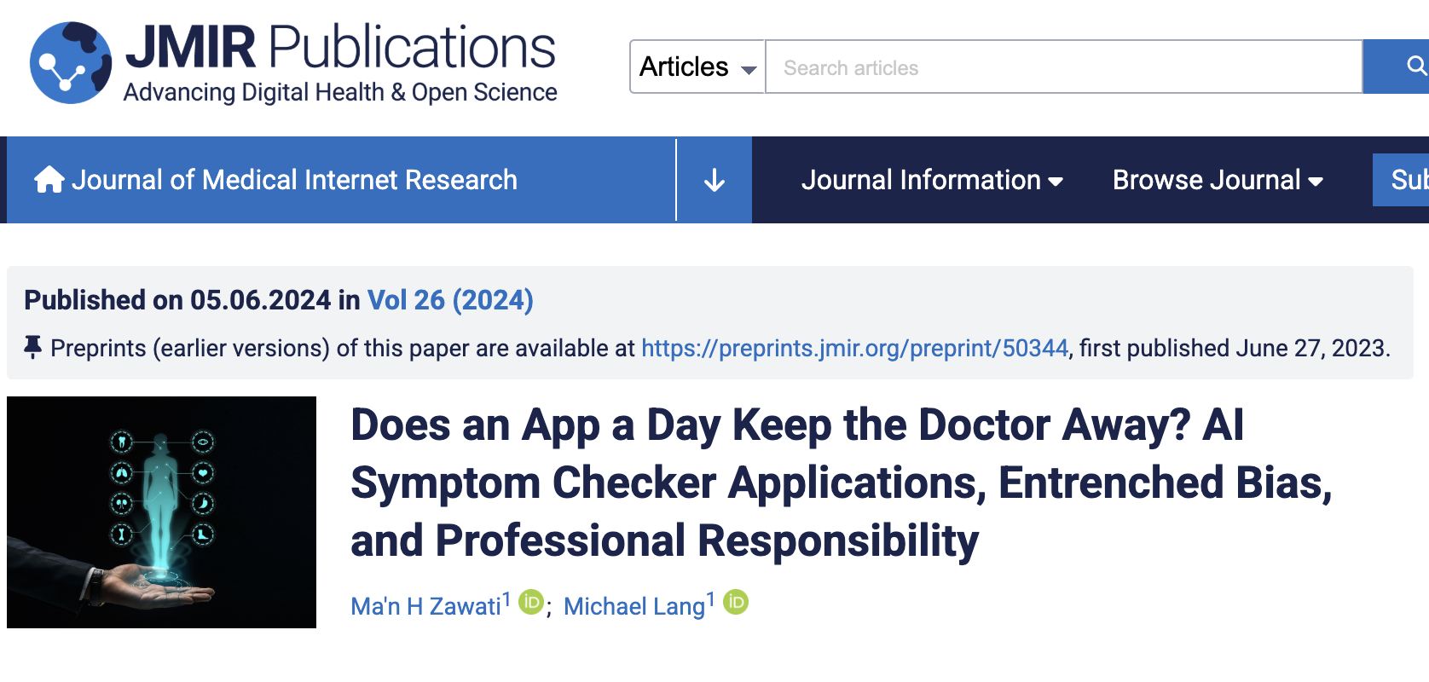

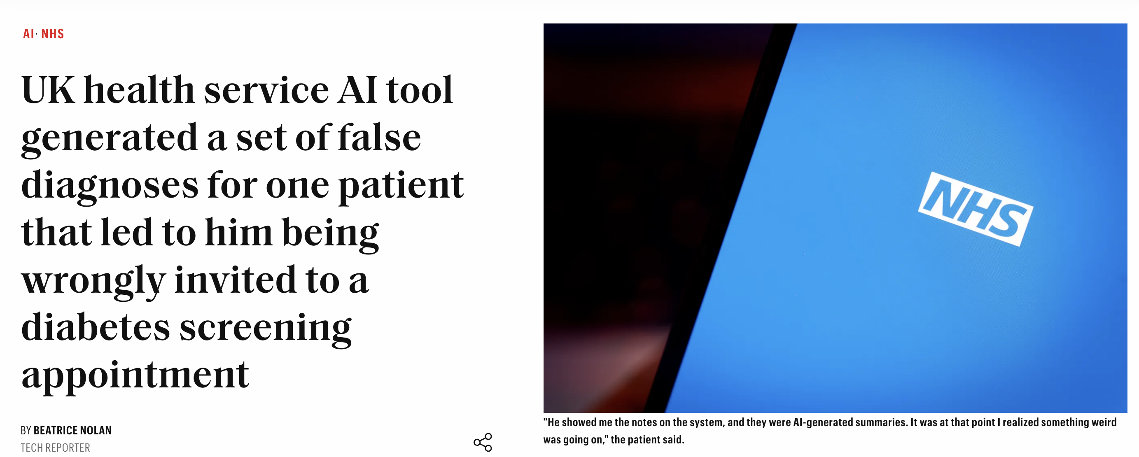
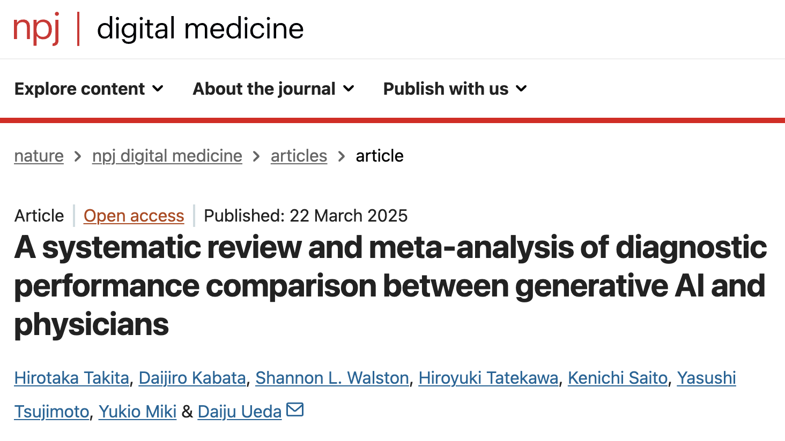
Real-World AI Missteps in Healthcare — Why Oversight Matters
In the U.S., major insurers face class-action lawsuits alleging their AI tools rapidly and wrongly denied lifesaving care—sometimes reviewing claims in seconds and overturning most denials on appeal.
Independent testing found Babylon’s AI symptom‐checker gave erroneous advice in roughly one out of three simulations. An NHS doctor who publicly raised safety concerns reported errors in ~33% of his tests.
The meta-analysis found that generative AI models had an overall accuracy of about 52%. While their performance was roughly similar to non-expert physicians, they were significantly less accurate than expert physicians (about 16% lower on average).

Slide 12
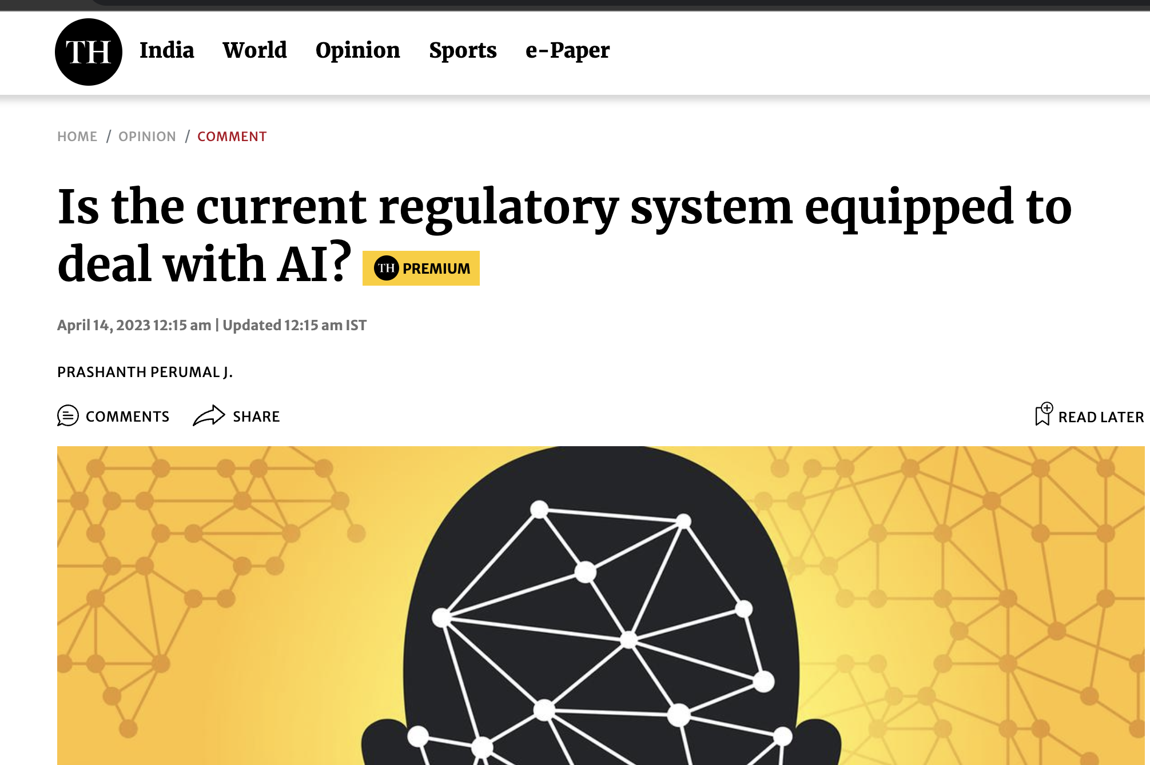

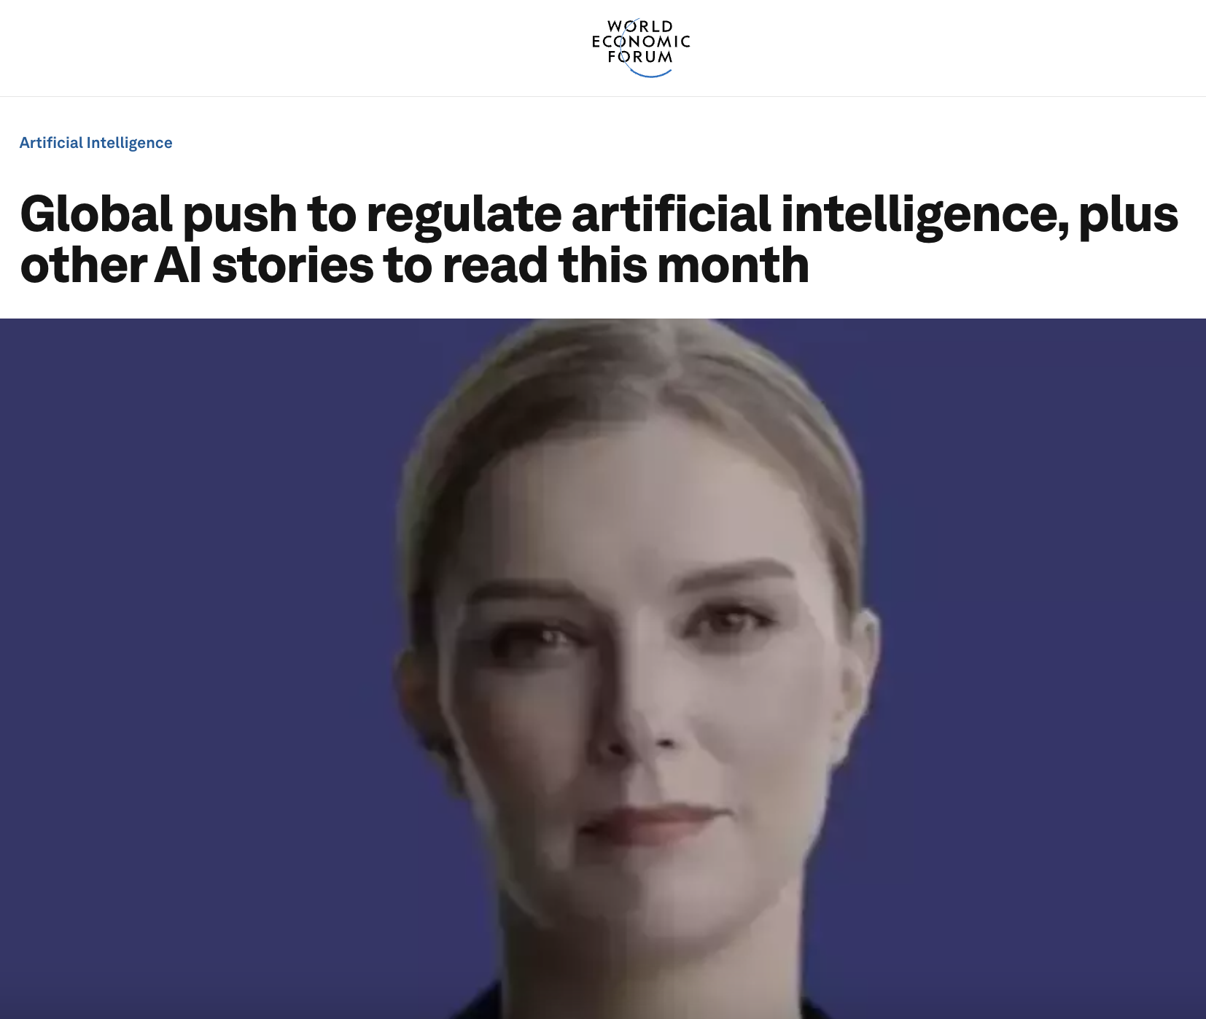
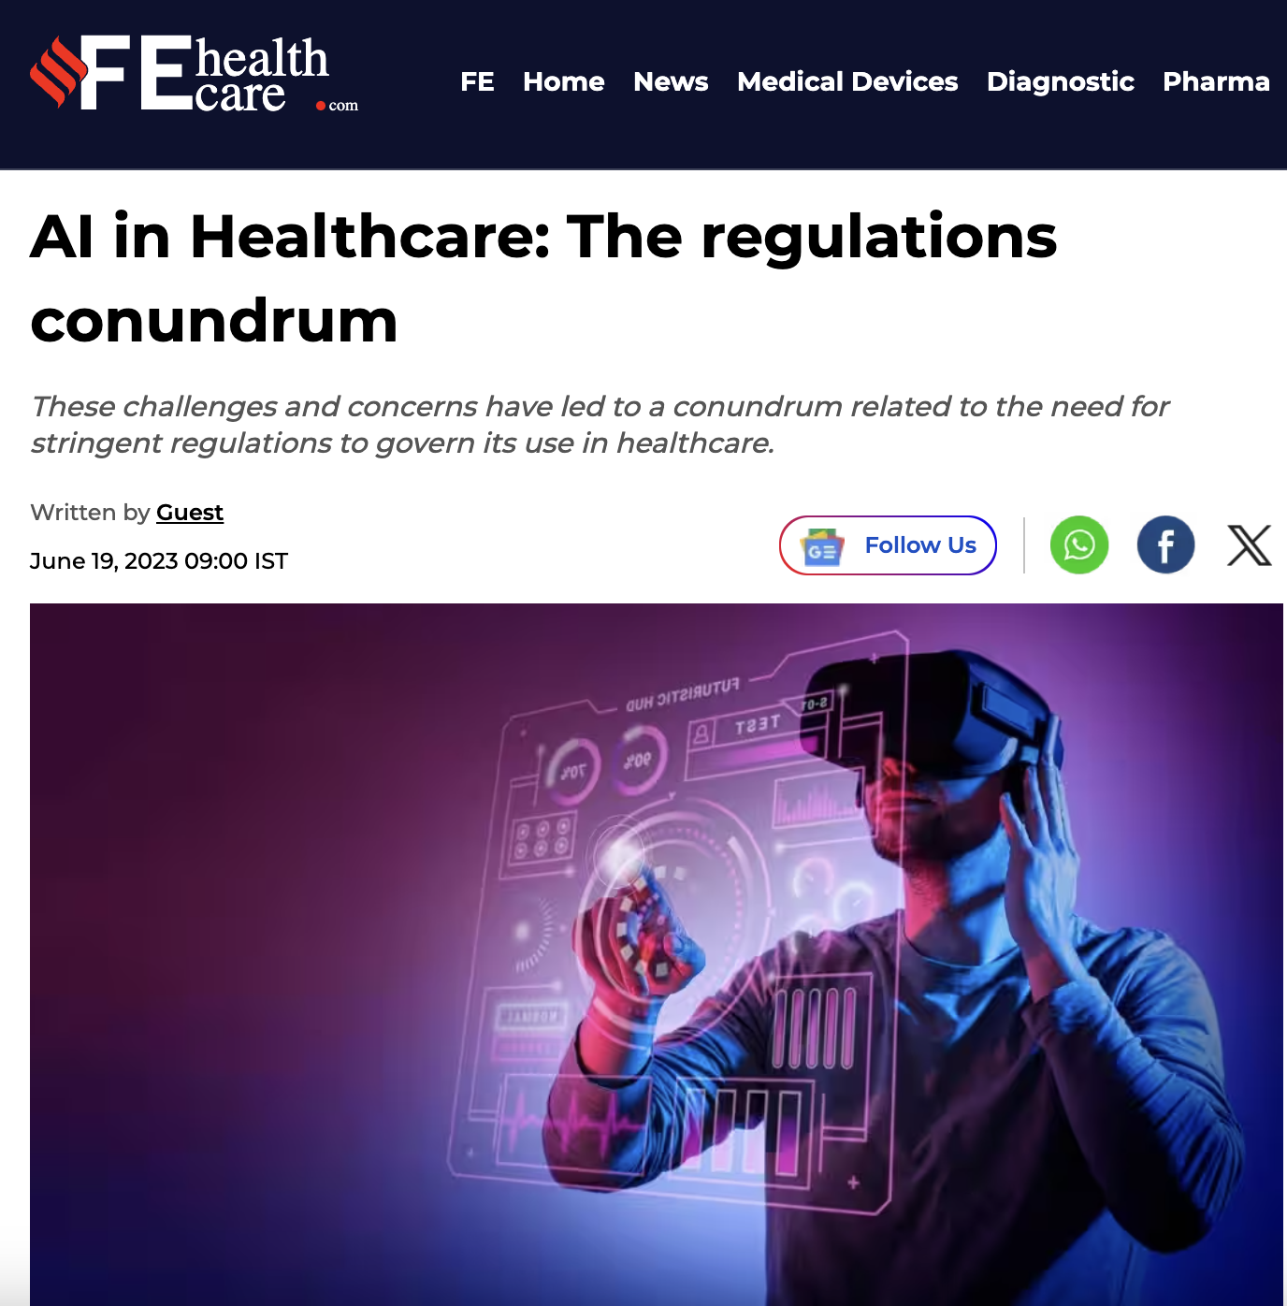
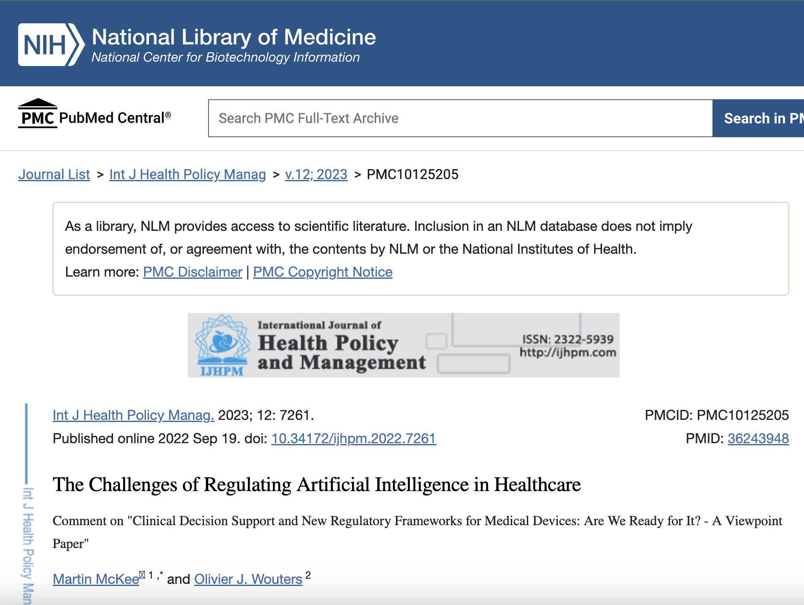
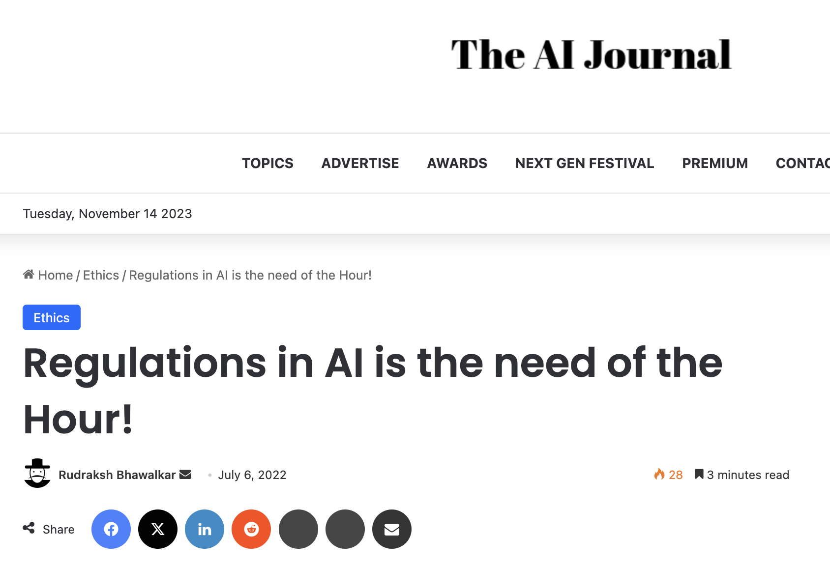
GOVERNANCE for Responsible AI IS
THE NEED OF THE HOUR!!

Slide 13
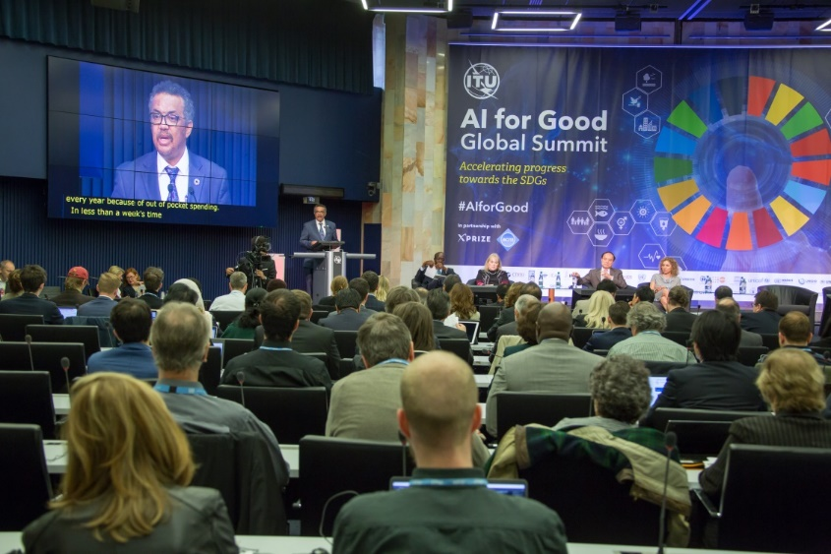


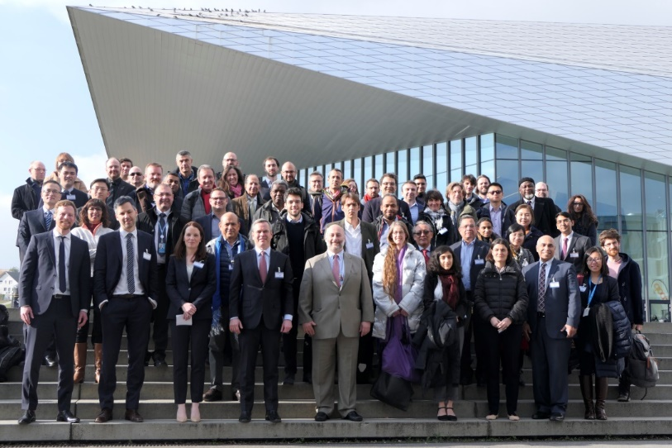
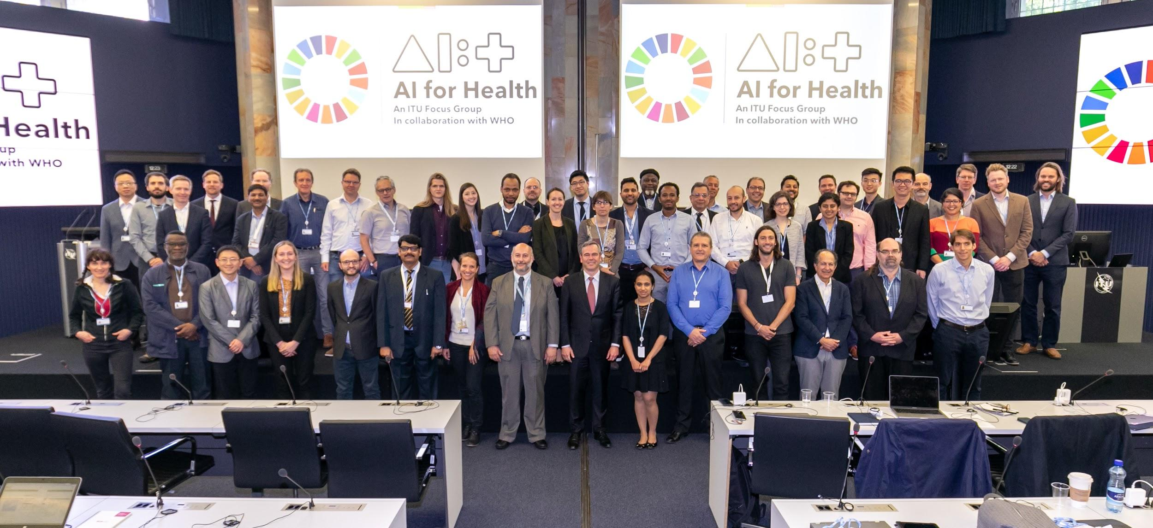
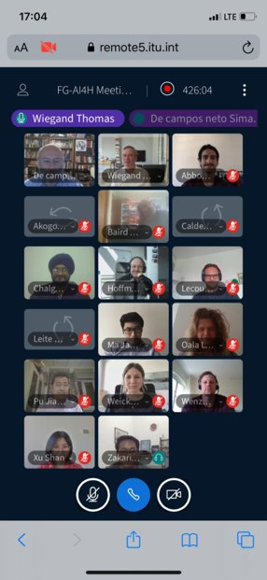

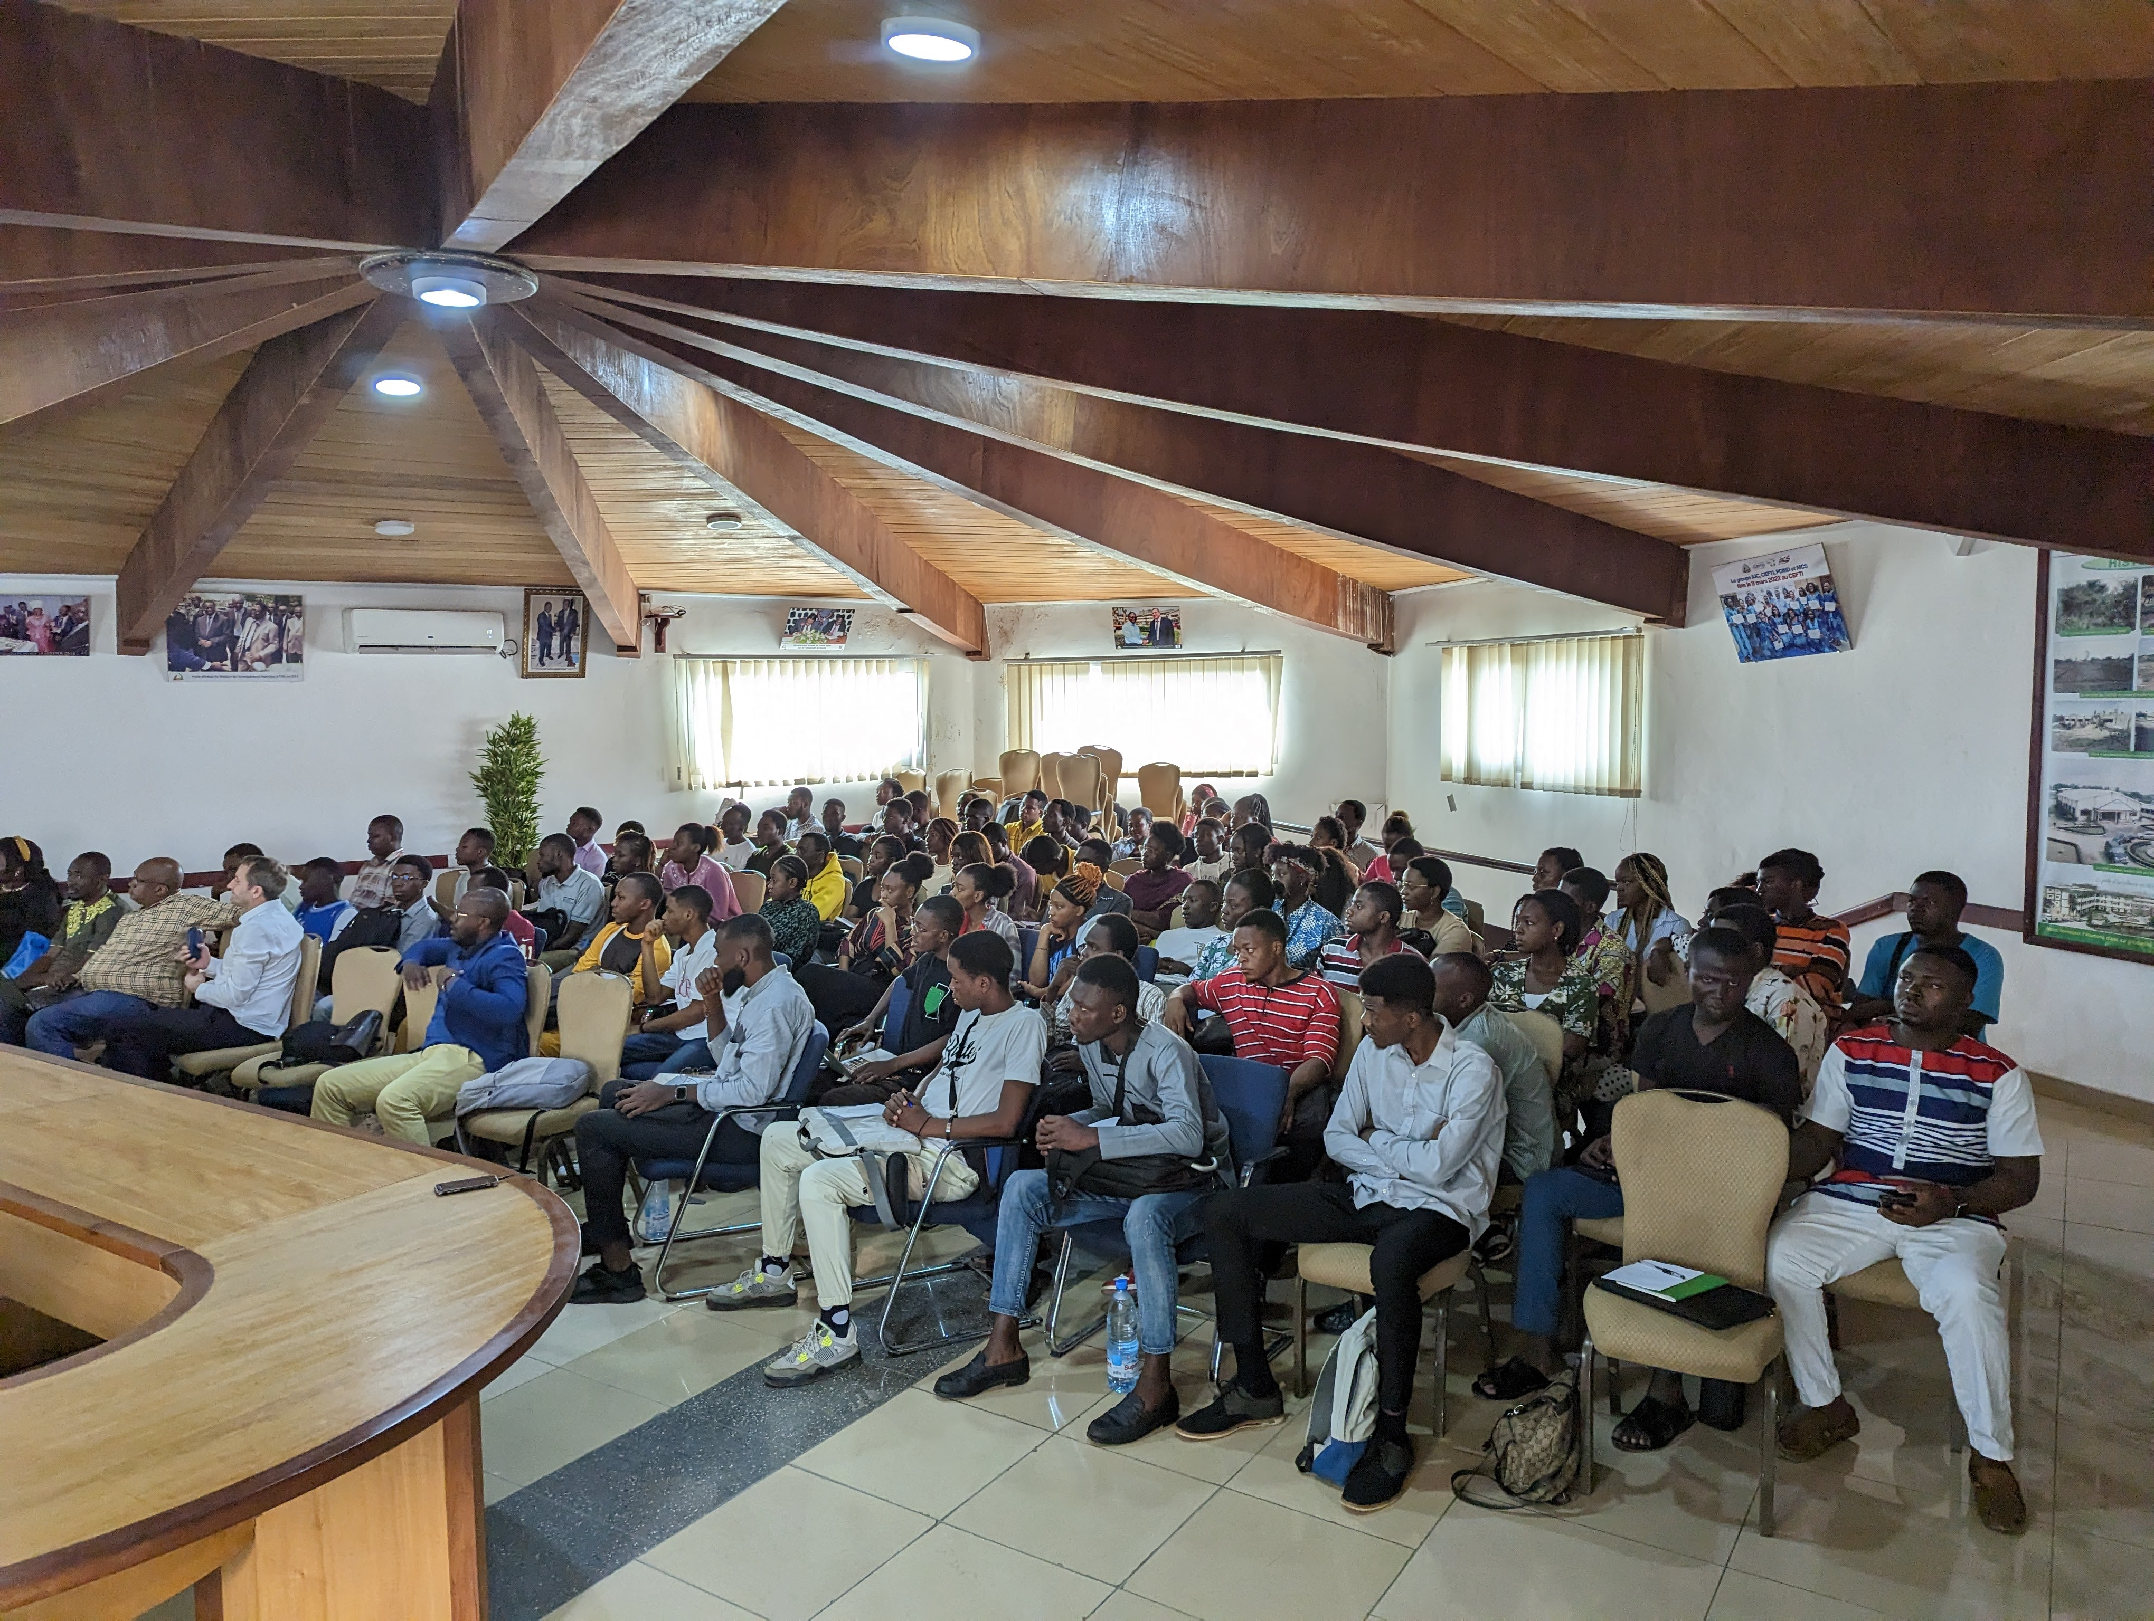
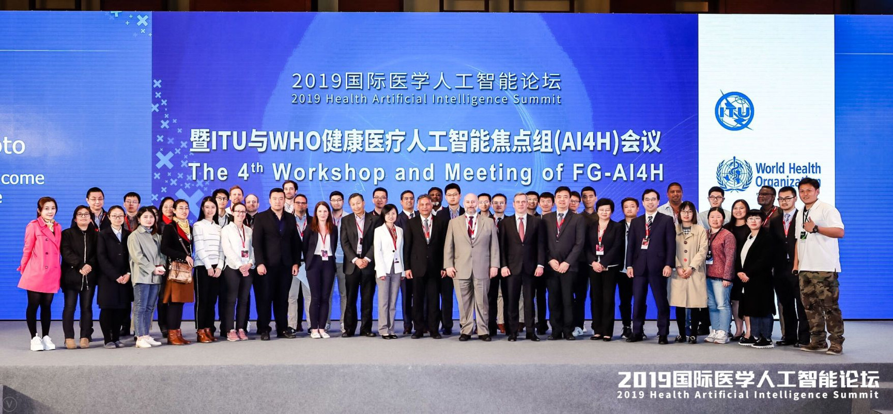

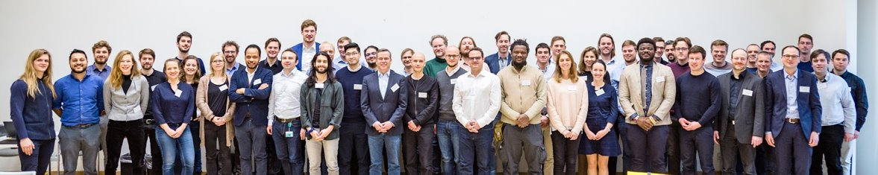


Journey to the GI-AI4H
A systematic approach for advancing the work of the FG-AI4H
11/2018
Columbia University
NYC
Source: ITU
5/2018
AI for Good
Geneva
4/2019
World Expo
Shanghai
9/2019
UCSAF
Zanzibar
1/2020
PAHO/WHO
Brasilia
5/2020
Online
1/2021
Online
9/2021
Online
05/2022
Berlin
12/2022
Douala
07/2023
Launch GI-AI4H
03/2025
NUS, Singapore
GI-AI4H
FG-AI4H
10/2018
WHO HQ
Geneva
1/2019
EPFL
Lausanne
5/2019
AI for Good
Geneva
11/2019
ICMR & NICF
New Delhi
9/2020
Online
5/2021
Online
2/2022
Online
9/2022
Helsinki
03/2023
Harvard/MIT
10/2023
KACST, Riyadh

Slide 14



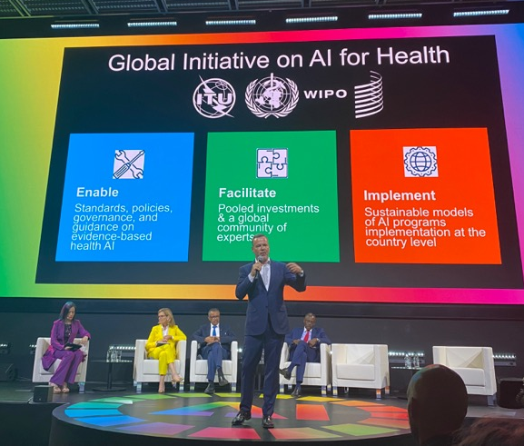
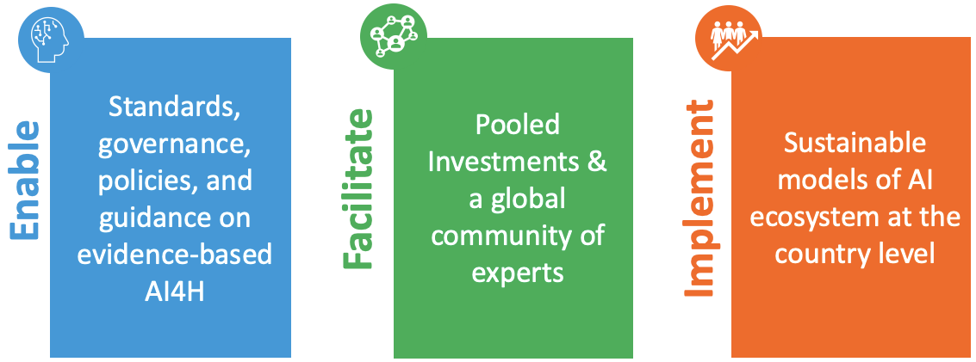
Global Initiative on AI for Health (GI-AI4H)
Launched on July 6, 2023!
Ribbon cutting of the Global initiative on AI for Health at AI for good summit on 6 July 2023​
(L-R: Ms. Doreen Bogdan-Martin (SG ITU), Dr. Tedros Adhanom Ghebreyesus (DG WHO), Mr. Edward Kwakwa (ADG WIPO)
Notes:
Shada to edit
•Inline with the text in the MoU (3 pillars definitions)

Slide 15

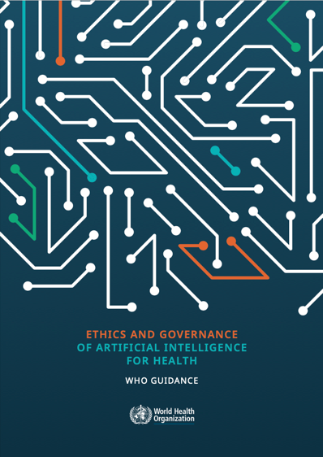
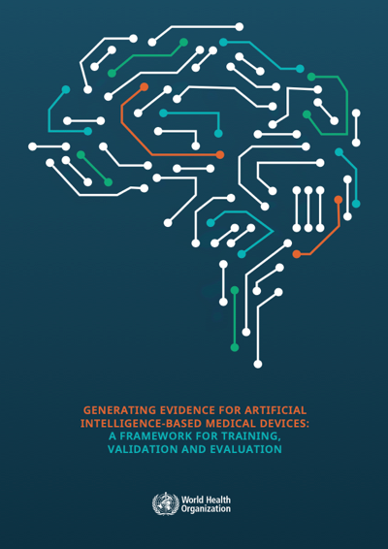
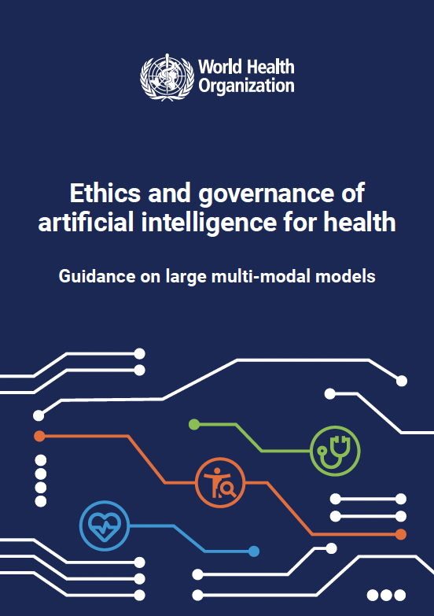
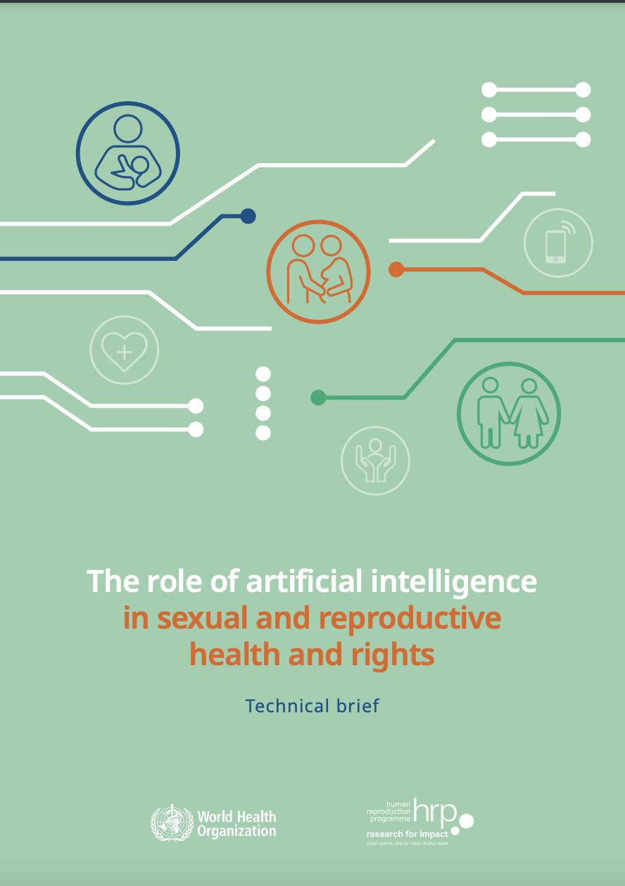
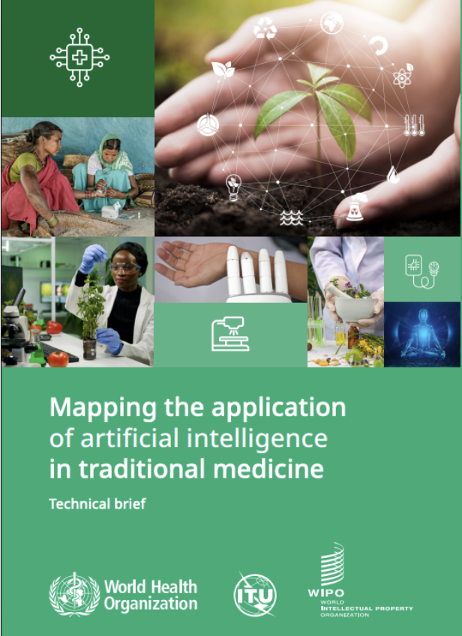



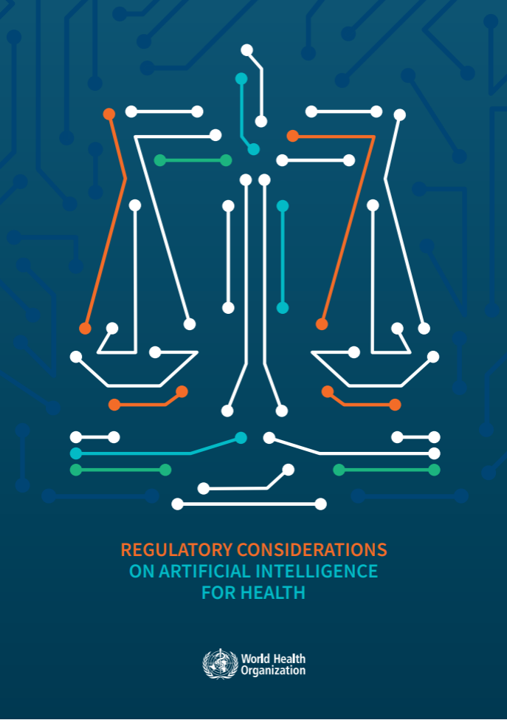

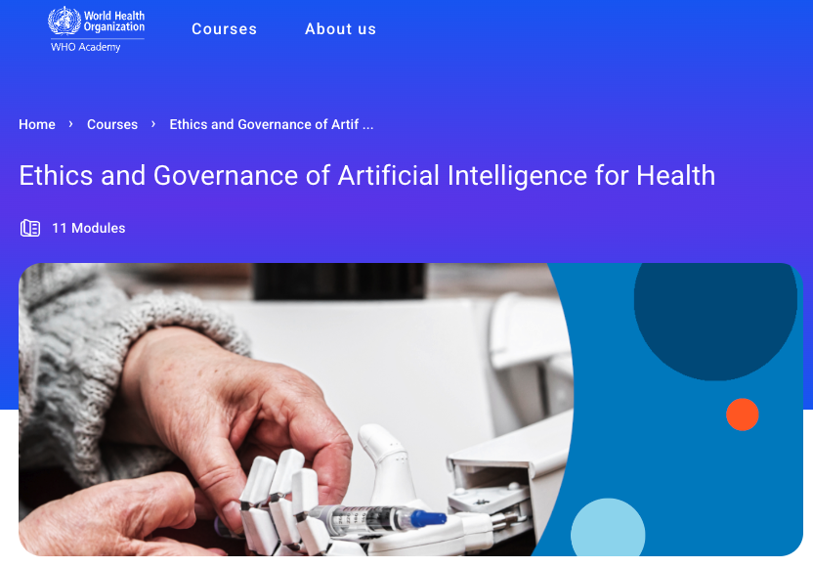
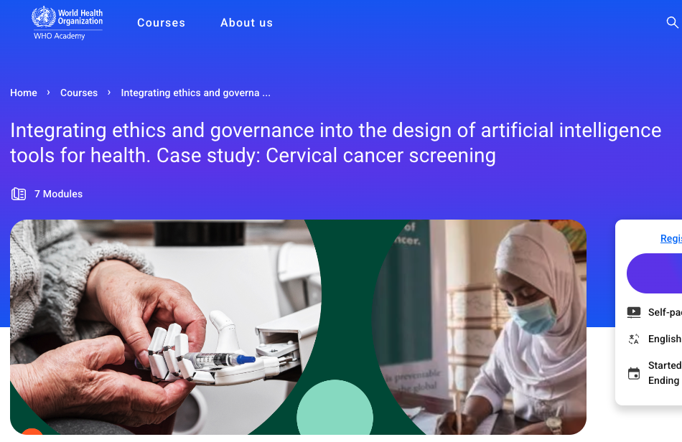


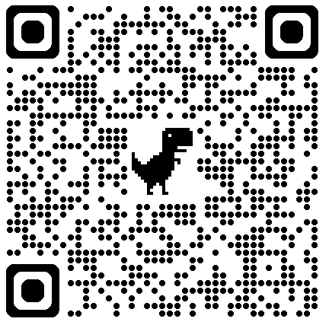
Enable policies, standards, guidance on AI for health
NEW
Guidance on Ethics and Governance of AI for Health
Generating Evidence for AI-based Medical Devices
Ethics and Governance of AI for Health: Large Multi-Modal Models
The role of AI in sexual and reproductive
health & rights
Mapping the application of AI in traditional and complimentary medicine
2021
2021
2021
2023
2024
2024
2024
2024
2025
WHO Online introductory course on Ethics and Governance of AI4H
Regulatory Considerations on AI for Health
Benefits and risks of using AI for pharmaceutical development & delivery
WHO Online course for AI Designers, Developers, and Data Scientists
Over 500,000 + Downloads

Slide 16
Enable policies, standards, guidance on AI for health
Relevant Guidance on AI for Health: Ethics, Governance, and Regulations
Ethics and Governance of Artificial Intelligence for Health
2021
Ethics and Governance of AI for Health: Large Multi-Modal Models
2024
Regulatory Considerations on
Artificial Intelligence for Health
2023
Notes:
Latest statistics to be filled in the notes
Regulatory Considerations: 30,000+
LMM Guidance: 51,000+

Slide 17
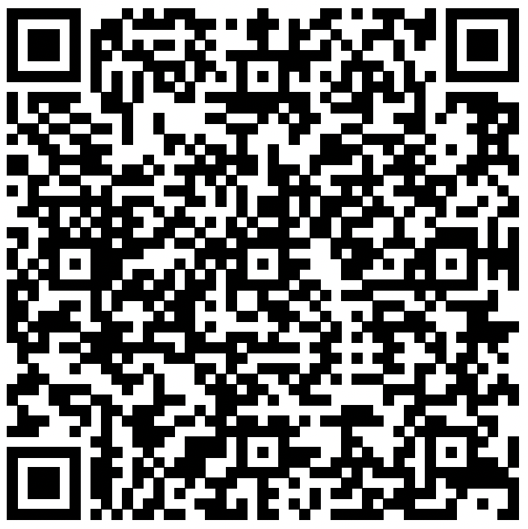



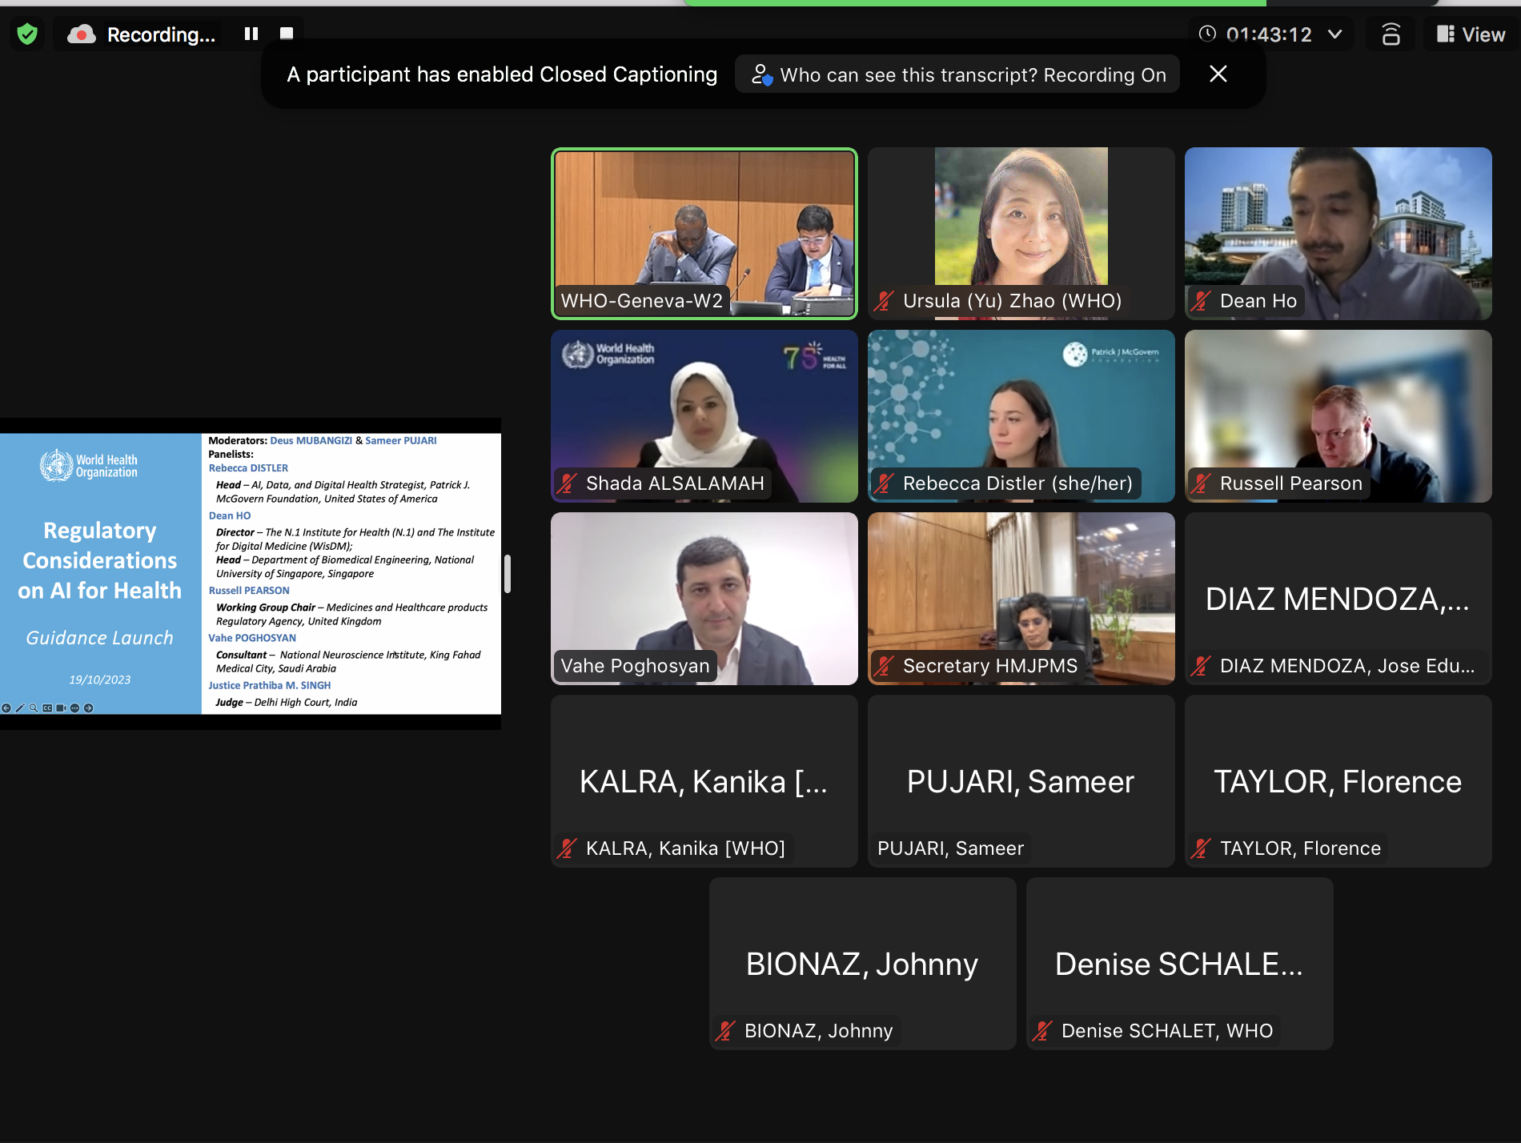


WHO Guidance on Regulatory Considerations on AI for Health
When?
What?
Who?
1
Comprehensive Scope
18 recommendations across 6 key topic areas
Credits: Yu luck
Credits: Studio 365
2
Researchers & Developers
Regulators & policy-makers
Launch date
19 October 2023
3
Dynamic & Adaptable
Credits: Larea
4
Patients
Global Alignment & Collaboration
Credits: Lars Meiertoberens
Manufacturers
5
50,000+ downloads
Credits: Eucalyp
Healthcare Workers
Notes:
Three key points highlighting how the guidance document adds value:
1. Holistic Regulatory Framework: The guidance document provides a comprehensive and holistic regulatory framework for the use of AI in healthcare. By addressing key areas such as documentation, risk management, validation, data quality, and privacy, it offers a thorough approach that ensures the safety, effectiveness, and ethical use of AI systems across the health sector.
2. Strategic Adaptability: The document recognizes the dynamic nature of AI technology and its rapid evolution. By offering a framework that is adaptable and open to future deliberations, it provides regulatory authorities, governments, and stakeholders with a strategic approach that can accommodate emerging technologies and changes in the healthcare landscape.
3. Global Alignment and Collaboration: The guidance document fosters global alignment by engaging stakeholders at various levels, including developers, manufacturers, regulators, users, and patients. This collaborative approach ensures a shared understanding of regulatory considerations, promoting consistency and facilitating international cooperation in the responsible adoption of AI in healthcare.
Trust Building: By addressing crucial aspects such as transparency, risk management, and collaboration among stakeholders, the document contributes to building trust in AI technologies. This is essential for the widespread acceptance and adoption of AI systems in healthcare, fostering confidence among users, healthcare professionals, and the public.
Equitable and Ethical Use: The guidance document emphasizes the importance of ensuring the equitable and ethical use of AI in healthcare. This includes considerations for avoiding biases, protecting privacy, and promoting inclusivity. These principles contribute to creating a framework that aligns with ethical standards and values in the delivery of healthcare services.
Support for Innovation: While providing a robust regulatory framework, the document also supports innovation in the AI for health ecosystem. By encouraging an environment that promotes investments, research, and development, it fosters the continued advancement of AI technologies for the benefit of global health outcomes.

Slide 18
Regulatory Considerations on Artificial Intelligence for Health
Documentation and Transparency
Risk Management and AI systems development lifecycle approaches
Analytical and clinical validation
18 Recommendations for Regulatory Considerations in
6 TOPIC AREAS
Data Quality
Engagement and Collaboration
Privacy and Data protection
Notes:
The publication emphasizes the importance of establishing AI systems' safety and effectiveness, rapidly making appropriate systems available to those who need them, and fostering dialogue among stakeholders, including developers, regulators, manufacturers, health workers, and patients.
WHO outlines six key considerations for the regulation of AI in healthcare:
1. Transparency and Documentation – Of the development and deployment process
WHO emphasizes the need for documentation and transparency to build trust in AI systems, as well as developers, manufacturers and end-users. It recommends that developers of AI technology document the entire product lifecycle, as well as tracking development processes. Effective documentation and transparency help guard against data biases and manipulation.
2. Risk Management – holistic approach, focusing on intended use, continuous learning, human interventions, training models and cybersecurity threats
The WHO also highlights that AI systems used in healthcare may fall into many categories, including AI systems used in medical devices. WHO recommends taking a holistic risk-based approach throughout the entire product lifecycle, including during pre- and post-market deployment. It recommends that developers, manufacturers and deployers of AI technology address issues relating to intended use, continuous learning, human interventions, training models and cybersecurity threats.
3. Intended Use and Analytical and Clinical Validation
WHO highlights the importance of clearly setting out an AI system’s intended use. Given that AI systems are dependent on the code, training data, setting and user interaction, it is important to describe the relevant use case in order for the system to perform safely and effectively.
Additionally, WHO recommends undertaking the appropriate validation of the AI system. It recommends that data are externally validated and that it is clear how those data are used. External validation ensures the quality and safety of input data used in models, minimizing risk to patients.
4. Data Quality
Data is the bedrock of AI systems and there are huge amounts of data in healthcare. However, the use of poor quality and biased data sets is of significant concern. WHO recommends the use of rigorous evaluation systems pre-release to ensure data quality. This should ensure systems do not amplify biases.
5. Privacy and Data Protection
WHO recommends that developers, deployers and manufacturers of AI technology understand the scope and requirements of relevant data protection and privacy laws. The EU General Data Protection Regulation (“GDPR”) and the U.S. Health Insurance Portability and Accountability Act (“HIPAA”) are of particular relevance.
6. Engagement and Collaboration
WHO recommends that developers, manufacturers, health-care practitioners, patients, policymakers, regulatory bodies and other stakeholders actively engage and collaborate with each other to improve the safety and quality of AI technologies. It notes that many regulatory bodies (including the UK Medicines and Healthcare products Regulatory Agency, the European Commission, the U.S. Food and Drug Administration and other international regulators) are already engaging and collaborating on AI. The WHO considers it fundamental to streamline the oversight process for AI regulation through such engagement and collaboration in order to accelerate practice-changing advances in AI.

Slide 19


















WHO’s Working Group on Regulatory Considerations for AI in Health
EXPERT MEMBERS
Justice Prathiba M. Singh
Judge, High Court of Delhi, India
Dr. Marco Marsella (Director – Digital, DG SANTE)
Prof. Dean Ho
Provost’s Chair Professor
Director, NUS, Singapore
Dr. Abdelrahman Al Mahmoud (UAE MoAI)
Paula E. Kohan
(Argentina)
Dr. Robert Ssekitoleko
(Makerere Uni, Uganda)
University in the Principality of
Liechtenstein (UFL), Triesen
Dr. Abdulmalik A.
(Saudi Arabia FDA)
Paul Byrne (Regulatory Operations & Support Services, Medical Council, Ireland)
Prof. Pei-Lee The (Monash University, Malaysia)
Dr. Paulyne Wairimu
(Deputy Director at Pharmacy and Poisons Board Kenya)
Prof. Sam Halabi
(Georgetown University,
USA)
Dr. Ricardo Baptista Leite
CEO of HealthAI
Dr. Nikhil Tandon
(AIIMS, India)
Dr. George Mensah
(Artica Institute for Regulatory Affairs, Ghana)
Dr. Eva Weicken (HHI Germany)
Prof. Phoebe Li
(Professor of Law & Tech, University of Sussex, UK)
Dr. Barry Solaiman
(HBKU, UAE)
Notes:
Add all experts

Slide 20




WHO’s Working Group on Regulatory Considerations for AI in Health
Journey from AIRIS 2024 AIRIS 2025
Regulatory Landscape on
AI in Health
Template Law
for
AI in Health
Training & Knowledge Tools on AI Regulation
Implementation Toolkit (step-by-step guidance)
Maps and analyzes existing and emerging global regulations on AI in healthcare to identify gaps, trends, and opportunities.
Provide a global blueprint to ensure the ethical, safe, and equitable use of AI technologies in healthcare, balancing innovation with robust regulation and patient rights.
Develops training modules and knowledge resources to strengthen regulatory capacity and build workforce expertise on AI in health.
Provides step-by-step guidance, practical tools, and real-world use cases to support countries in implementing AI regulatory frameworks.
Notes:
4 boxes instead from Shada’ slides

Slide 21
Enable policies, standards, guidance on AI for health
Relevant Guidance on AI for Health: Ethics, Governance, and Regulations
Ethics and Governance of Artificial Intelligence for Health
2021
Regulatory Considerations on
Artificial Intelligence for Health
2023
Ethics and Governance of AI for Health: Large Multi-Modal Models
2024
Notes:
Latest statistics to be filled in the notes
Regulatory Considerations: 30,000+
LMM Guidance: 51,000+

Slide 22
WHO’s Working Group on Ethics & Governance of AI in Health
FOUR WORKSTREAMS
Guidance on Research Ethics Oversight of AI in Health
Casebook on Ethics and Governance of AI in Health
Policy Brief
on AI-Powered Chatbots
Policy Brief on AI and Neurotechnology
Assessing the ethics of AI health chatbots,
focusing on misinformation, autonomy, and accountability.
Exploring ethical challenges of AI in neurotechnology, focusing on consent, privacy, and commercialization of brain data.
Supporting ethics committees and health authorities with tools to review AI health research while ensuring ethical rigor and participant protection.
Providing real-world insights through 15 global case studies on applying ethical principles across diverse health settings and AI use cases.
Notes:
4 boxes instead from Shada’ slides

Slide 23
WHO’s Working Group on Evaluations of AI in Health
THREE WORKSTREAMS
Clinical
Evaluation
Operational
Evaluation
Economic
Evaluation
To assess whether AI tools are clinically effective, safe, and improve patient outcomes across various health conditions and settings.
To determine how well AI technologies perform in real-world health system environments — including usability, workflow integration, reliability, and scalability.
To understand the cost-effectiveness, affordability, and value-for-money of AI solutions in health
Notes:
To support safe and effective use of AI in health, WHO has structured its evaluation efforts around three core workstreams: clinical, operational, and economic.
First, clinical evaluation helps us understand whether an AI tool is actually improving patient outcomes. We look at how accurate, safe, and effective the technology is when used in real-world clinical settings.
Second, operational evaluation focuses on how the AI tool fits into the day-to-day running of health systems. We examine how easy it is to use, how well it integrates into existing workflows, and whether it's scalable and reliable over time.
And third, economic evaluation looks at whether the AI solution is cost-effective. It helps decision-makers understand the value for money, affordability, and long-term sustainability of these technologies — especially in resource-constrained settings.
Together, these three workstreams give us a full picture of how AI performs — not just in theory, but in practice.

Slide 24


AI for Health Collaborating Centre Consortium (AI4H-CCC)
EURO​
Idiap Research Institute​
The École Polytechnique Fédérale de Lausanne (EPFL)​
University of Helsinki​
Development of normative products
Enable
Assist to develop benchmark and evaluation
Global
WPRO​
National University of Singapore (NUS)​
China National Health Development Research Center (CNHDRC)​
Global, regional and country specific events
Facilitate
Technical workshops
Design, develop and deliver learnings
PAHO​
University of Campinas
MIT Media Lab​
University of Michigan
O'Neill Institute for National and Global Health Laws​
Countries
EMRO​
King Abdulaziz City for Science and Technology
New York University Abu Dhabi​
AFRO​
Stellenbosch University​
Carnegie Mellon University Rwanda
Implement
Localization
SEARO​
Indian Institute of Technology
Mahidol University, Thailand ​
All India Institute of Medical Sciences (AIIMS)

Slide 25




































Collaborators
The Global Initiative has grown to 500+

Slide 26




AI is already playing a role in diagnosis and clinical care, drug development, disease surveillance, outbreak response, and health systems management …
The future of healthcare is digital, and we must do what we can to promote universal access to these innovations and prevent them from becoming another driver for inequity.
- Dr Tedros Adhanom Ghebreyesus, WHO Director-General
Learn more
Global Initiative on AI for Health
Email us ai@who.int

