Slide 1
Regulation and review points of AI-enable medical devices in Japan
Mitsuru Yuba, PhD
Reviewer, Office of Software as a Medical Device
Pharmaceuticals and Medical Devices Agency (PMDA), Japan

Slide 2
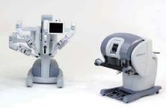
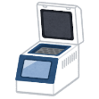
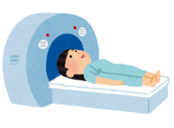
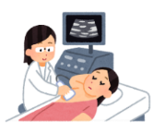
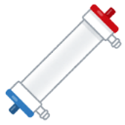
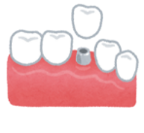
Medical Device Classification and Regulation
MDs are classified into 4 categories (Class I to IV) according to risk level
Pre-market regulatory process for MDs differs depending on the classification
Low
Risk
High
Classification
Classs I
Calss II
Class III
Class IV
Definition | Even if a malfunction occurs, the risk to the human body is considered to be extremely low. | Even if a malfunction occurs, the risk to the human body is considered to be relatively low. | Items that are considered to pose a relatively high risk to the human body in the event of a malfunction. | Items that are highly invasive to patients and may directly lead to life-threatening problems if a malfunction occurs.
Regulatory Classification | General Medical Devices | Controlled Medical Devices | Specially Controlled Medical Devices
Premarket | Notification | 3rd Party Certification Ministerial Approval (PMDA’s Review) | 大臣承認（PMDAで審査）
Postmarket | MHLW and PMDA
Software for medical use corresponded to Class I is exempt from PMD Act

Slide 3
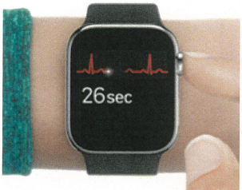
Overview of Approved/Certified SaMD
As of March 2025
Non MD
MD
Class II
Class III
Software for heath management
Software for education
Software for supporting hospital operation
Software corresponding to class I
For Home Use
Program for diagnostics assist for home use (9)
For Diagnosis and examination
Program for computer assisted Imaging diagnostics (382)
Program for computer assisted diagnostics other than imaging (108)
Program for gene mutation analysis (13)
For Treatment
Program for therapy planning support (68)
Program for surgery support (3)
Application for behavioral therapy (5)
Programmer for active implantable device (3)

Slide 4
Number of approved SaMD
As of March 2025
53
43
39
36
33
32
Number of approved SaMD each FY
Number of approved SaMD in total
19
19
13
9
2015
2016
2017
2018
2019
2020
2021
2022
2023
2024

Slide 5
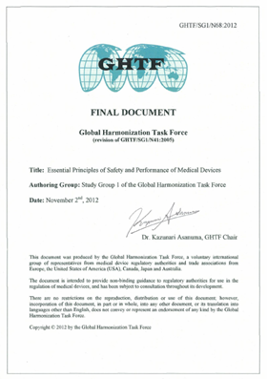
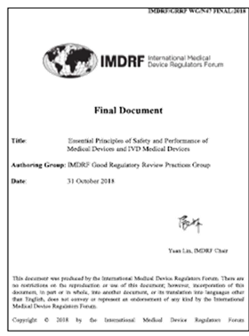
Review of Software Products
Essential principle
Concept of development
Intended use of SaMD
Non-clinical evaluation
Performance
Safety
Clinical evaluation
Clinical trials
Literature investigation

Slide 6
Review as Medical Device, Not just as Function
What is the medical utility of the product?
What RISKs are associated with the implementation of the product?
A function could be utilized in a various situation
→ Understanding of the function itself is not enough to determine the sufficiency of the evaluation.
It is important to understand
how the product can be implemented into the current medical practice as a medical device.
e.g.
Relationship to current practice
Combination with current practice
Substitute for current practice
Replace current practice
Add new scheme/mean
Contribution to patient outcome
Equivalent efficacy to current practice
Higher efficacy to current practice
Effect on patients not addressed by current practice
etc…
etc…

Slide 7
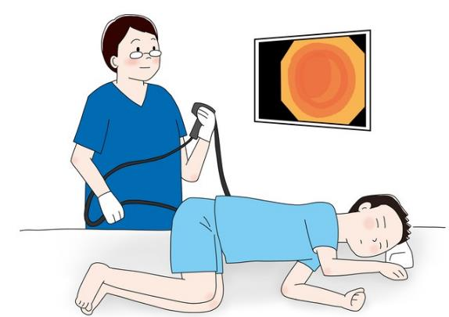
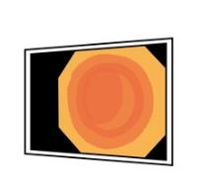
Do Software Products Have No Risk?
In general, software products do not cause direct invasiveness to patients.
Sub monitor（CAD）

Slide 8
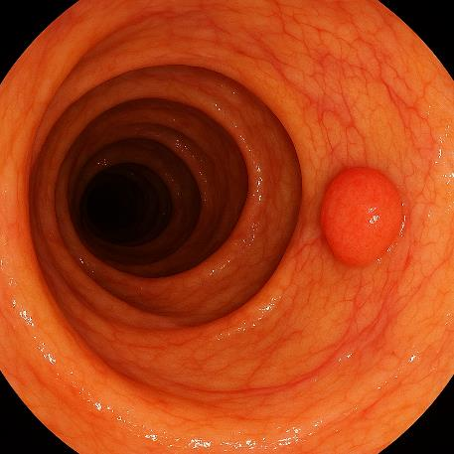
What’s the risk of Computer-aided detection on endoscope imaging
Endoscopic image is created by Generative AI

Slide 9
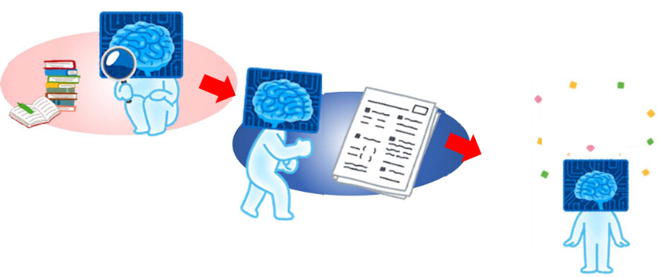
Discussion points of SaMD based on AI
Training data from hospital “A”
（2024）
Test data from hospital “A”
（2024）
Pass!
Training
Evaluation
Cheating is a crime.
Isn't the training data the same as the test data?

Slide 10
Discussion points of SaMD based on AI
Training data from hospital “A”
（2023）
Test data from hospital “A”
（2024）
Pass!
Training
Evaluation
“A” Hospital specialty product?
Can generalizability be accounted for by conducting the evaluation on data collected from the same population as the development data?

Slide 11
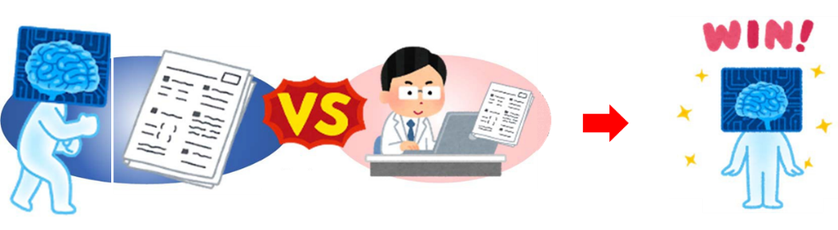
Discussion points of SaMD based on AI
5,000 images of test data
Isn't it an unfair test?
Let the AI function and compete in ways that physicians don't normally do.

Slide 12
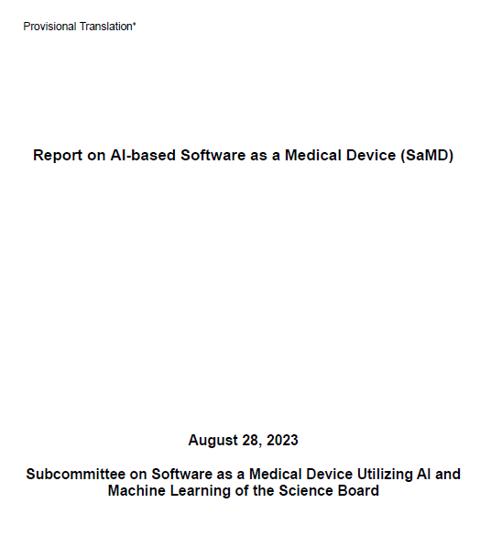
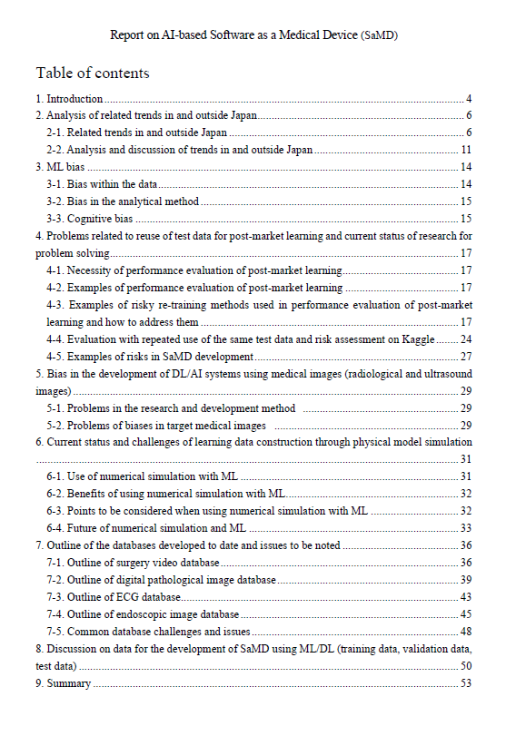
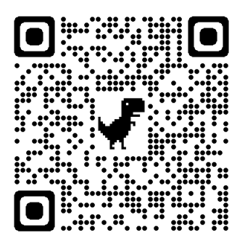
Points to Consider for review for AI-enable Medical Device

Slide 13

I am PiMTTO
Thank you for your attention!
yuba-mitsuru@pmda.go.jp

