Slide 1

Implications of the EU AI Act for Medical Devices
Rolf Oberlin Hansen
Danish Medicines Agency’s unit for Medical Devices
Senior Advisor
ROOH@DKMA.DK

Slide 2
The EU AI Act – Risk hierarchy
Bans certain applications
Classifies using sectoral risk classes
Primarily regulates high-risk
Unacceptable risk
High-risk
Limited risk
Minimal risk

Slide 3
The EU AI Act – Horizontal approach
Adds additional requirements for sectorial legislation
Allows for post-market learning
MDR & IVDR primarily regulates Medical devices
AI Act regulates the addition of AI
GDPR (General Data Protection Regulation) regulates the data
Certain use-cases to avoid bias allows for exceptional data treatment
Medical device
MDR
IVDR
AI Act
GDPR

Slide 4
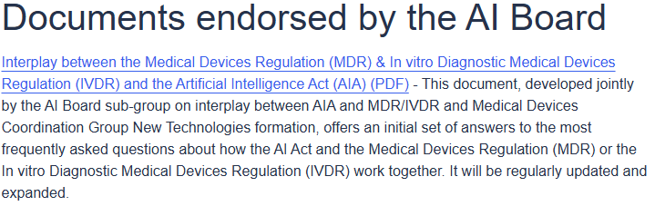
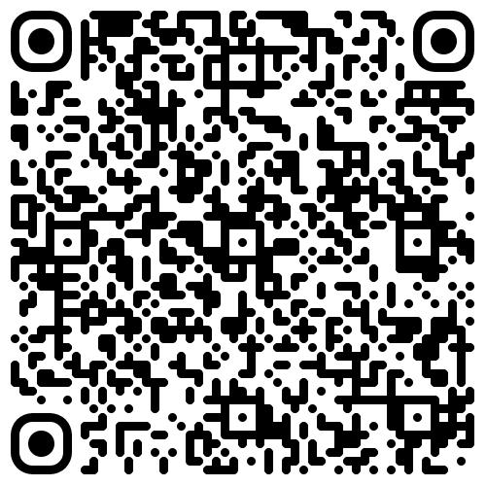
The EU AI Act – Horizontal approach
Medical device
DG CNCT
EDPB
DG Sante
AI Act
GDPR
MDR
IVDR
AIB 2025-1
MDCG 2025-6
Interplay between the Medical Devices Regulation (MDR)
& In vitro Diagnostic Medical Devices Regulation (IVDR)
and the Artificial Intelligence Act (AIA)

Slide 5
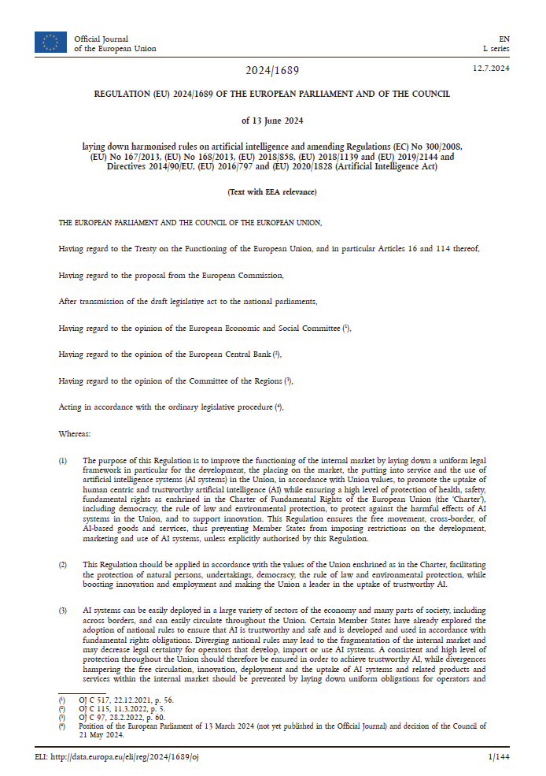
The EU AI Act – New requirements
Transparency obligations
Information on AI interaction
Description of data sets
Fundamental rights infringement
Post-market log generation for use and changes
Human oversight features

Slide 6
The EU AI Act – Role of deployer
New legal actor in the value chain
Specifically targets hospitals
Necessitated by post-market learning
Responsibility of the organisation
Monitoring of performance
Reportability of incidents
Manufacturer
Distributor
Medical device
Deployer
User

Slide 7

The EU AI Act – Designation and personel
Baseline enforcement strictness
EU level
National level
Central designation
Pooling of expertise
Delays in reporting timelines
Sectoral designation
Existing pathways for vigilance
New expertise for ”the infringement of obligations under Union law intended to protect fundamental rights”

Slide 8
The EU AI Act – Implementation timeline
2. August 2025
- Designation of competent authorities
- Governance: AI Board, AI Office, Scientific panel, Pool of experts
2. August 2026
High-Risk AI
(Annex III), limited risk (In-house)
2. February 2025
Banned AI practices
2. August 2027
High-risk AI
(Annex I)
WE ARE HERE

Slide 9
Thank you kindly for your attention
Rolf Oberlin Hansen
Danish Medicines Agency’s unit for Medical Devices
Senior Advisor
ROOH@DKMA.DK

