Slide 1


WHO Working Group on Regulatory Approaches to AI and Health – The Training Workstream and Conceptual Approaches to the Regulatory Interface
Prof. Sam Halabi, JD, MPhil
11 September 2025

Slide 2

Mission of the WH-RC
To facilitate the safe and appropriate use of AI technologies for the development of AI systems in health care, the WHO and the International Telecommunication Union (ITU) have established a Focus Group on AI for Health (FG-AI4H).
To support its work, FG-AI4H has created several working groups, including a Working Group on Regulatory Considerations (WG-RC) on AI for Health. The WG-RC consists of members representing multiple stakeholders – including regulatory authorities, policy-makers, academia and industry – who have explored regulatory and health technology assessment concepts and emerging “good practices” for the development and use of AI in health care and therapeutic development. The work of the WG-RC represents a multidisciplinary, international effort to increase dialogue and examine key considerations on the use of AI in health care.

Slide 3

Four WG-RC Workstreams
Landscape
WS
Ricardo Baptista-Leite
Paula Eugenia Kohan
Template Law WS
Prathiba Singh
Marco Marsella
Training
WS
Abdualmalik Bin Khulayf
Sam Halabi
Implementation
Toolkit WS
Dean Ho
Abdelrahman AlMahmoud

Slide 4


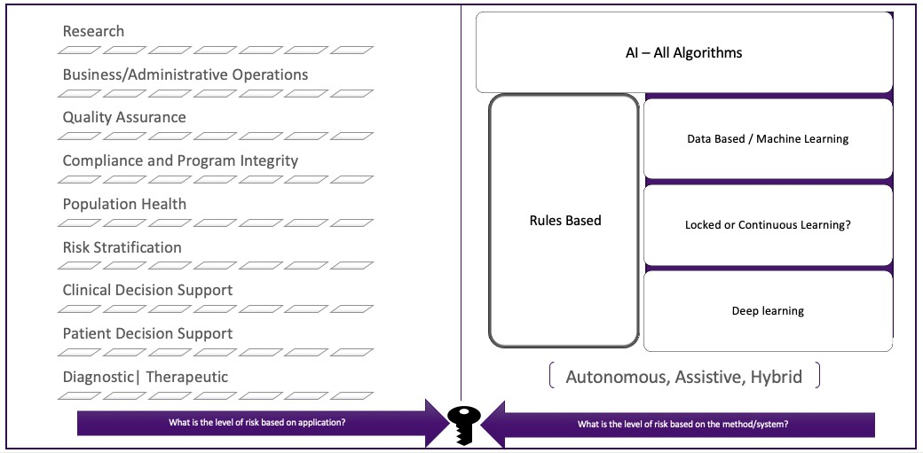
There is not a single health care AI system, application, or method, but many. Systems may use one or more methods and likely have different risk profiles and benefits with corresponding roles for regulators:

Slide 5

Phase 1
Mapped resources and gap analysis
As part of Phase 1, the WS3 team conducted a review and mapping of available WHO guidance documents related to artificial intelligence in health. The objective was to identify areas that lack corresponding training programs and to determine the key focus areas for WS3 development.

Slide 6
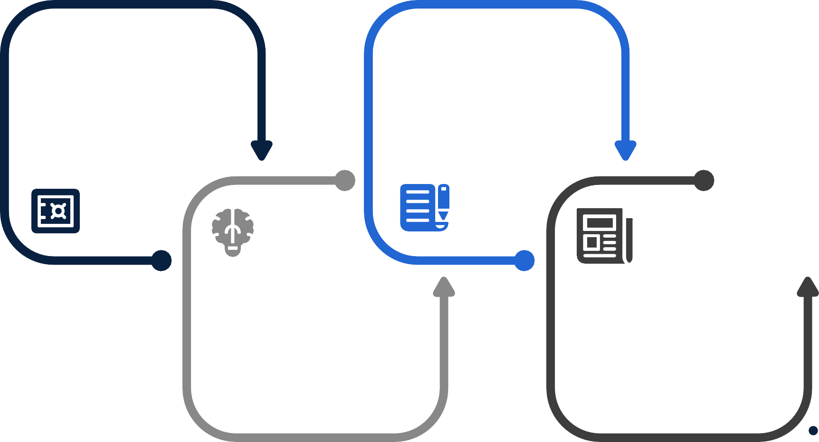
Existing Training Programs Available on WHO Academy Platform
Ethics and Governance of Artificial Intelligence for Health
Introduction to Epidemic Intelligence from Open Sources
Integrating Ethics and Governance into the Design of Artificial Intelligence
Use of Epidemic Intelligence Systems with Particular Focus

Slide 7



Identified Gaps and Focus Areas for Training Modules
Application Specific Generating Evidence for Artificial Intelligence-Based Medical Devices
Conceptual
Assessing Risks and Benefits in Novel AI Applications
Policy
Artificial Intelligence and Achievement of Universal Health Coverage

Slide 8
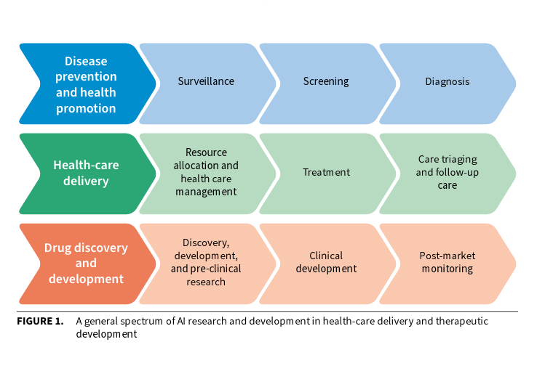
Regulatory Domains: AI in Healthcare

Slide 9
Revisiting the Core Functions of Regulation
Command-and-control rules impose specific requirements on regulated firms. For instance, a developer of an AI diagnostic application that relies on a large number of images may be required to ensure that images training the model are sufficiently uniform.
Performance-based standards tell firms what they must accomplish but leave them to decide how best to do so. Such a standard, for example, might require that firms remain below a specific error rate, and leave the specifics of doing so to them.
Finally, incentive-based systems force firms to internalize the total costs of their activities, leaving firms to decide what, if anything, to do about those costs.

Slide 10
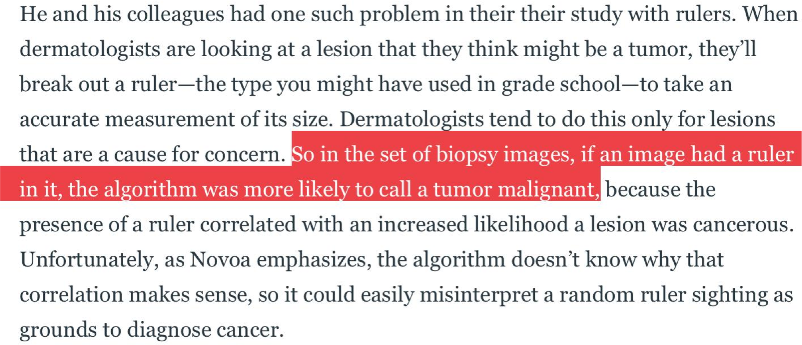
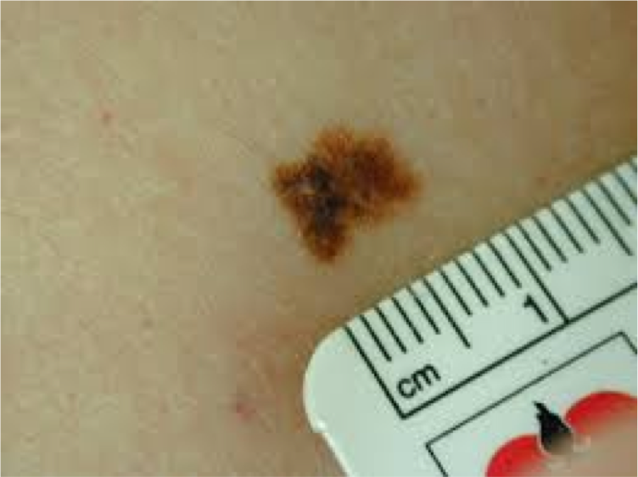
Command and Control Approaches

Slide 11
Revisiting the Core Functions of Regulation
Command-and-control rules impose specific requirements on regulated firms. For instance, a developer of an AI diagnostic application that relies on a large number of images may be required to ensure that images training the model are sufficiently uniform.
Performance-based standards tell firms what they must accomplish but leave them to decide how best to do so. Such a standard, for example, might require that firms remain below a specific error rate, and leave the specifics of doing so to them.
Finally, incentive-based systems force firms to internalize the total costs of their activities, leaving firms to decide what, if anything, to do about those costs.

Slide 12
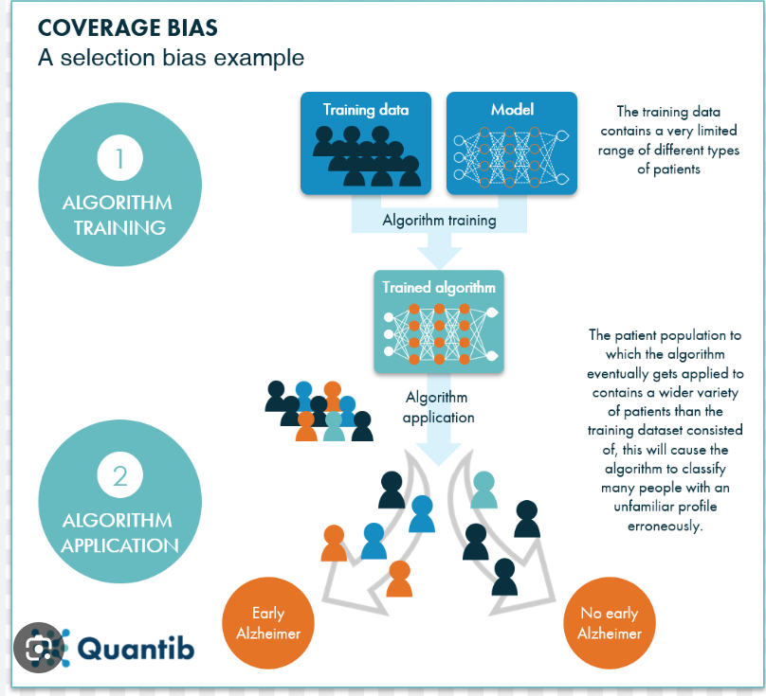

Slide 13
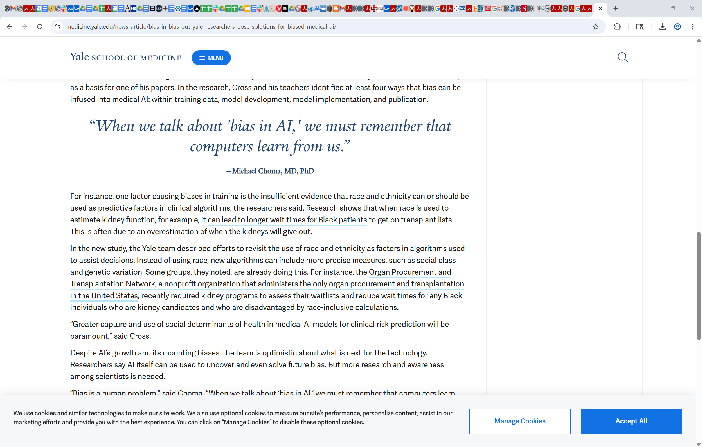

Slide 14
Revisiting the Core Functions of Regulation
”Regulatory policy can be arrayed on a continuum from self –regulation (regulation in the interest of the regulated) to aggressive regulation (regulation of one individual in the interests of another).”
Theodoulou & Cahn, Public Policy, 1995
.

Slide 15
Place Legal Liabilities on the Party Best Positioned to Control Adverse Effects of AI
Incentive-based regulation (IBR) uses rewards and penalties to encourage desired behaviors from individuals or organizations. Instead of directly dictating actions, it provides financial or other incentives to achieve specific goals, allowing for more flexibility in how those goals are met.
AI developers
Hospitals
Physicians
If these parties must pay for the adverse outcomes they cause or contribute to causing, then those parties will internalize the costs of bias, error, and product hazards. Moreover, processes to establish the right set of liability rules will encourage more transparency from those developing and using AI applications for gain.

